Slide 1
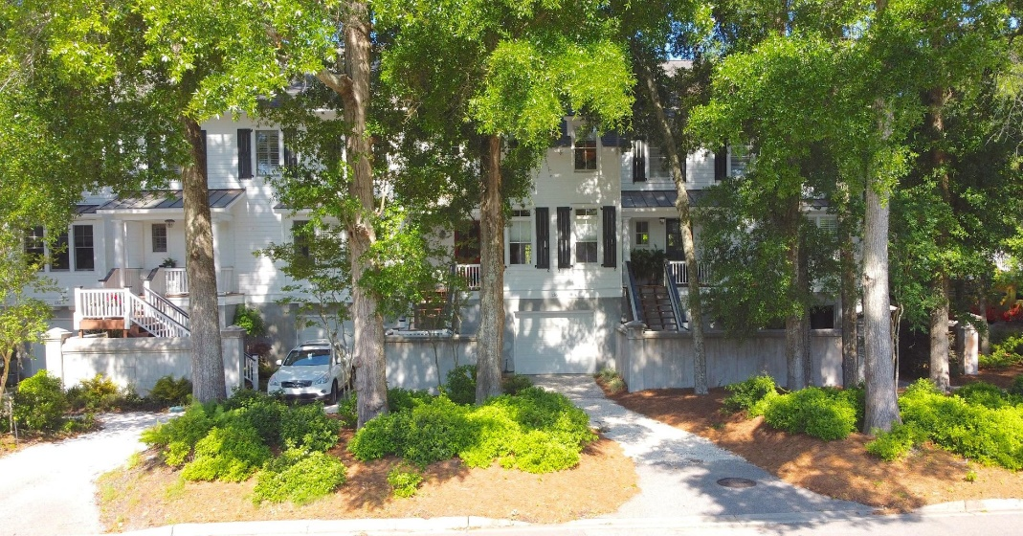

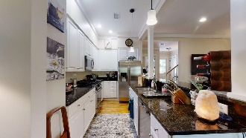
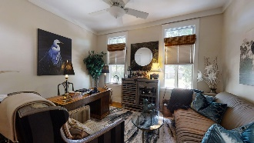


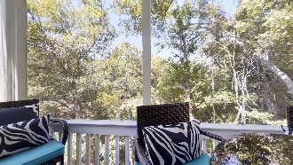
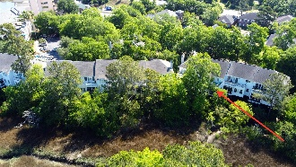
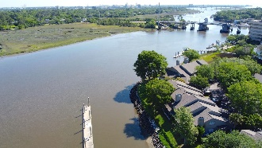
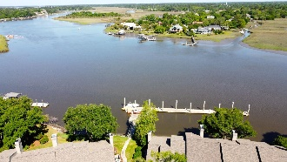


136 Wappoo Creek Drive Wappoo Landing Charleston, SC 29412 MLS# 21012423 $649,900
Lovely home overlooking the marsh of Wappoo Creek. Just minutes to downtown Charleston, shopping & dining, conveniently located n James Island. A community dock and pier head on the Wappoo cut / Intercoastal waterway is just a minutes from the unit, A great spot for entertaining. relaxing and fishing. This home has an open floor plan with high ceilings and oversized windows and doors on the maim living level. Hardwood floors, granite countertops with eat-in breakfast area and stainless steel appliances. Home office/study or could be third bedroom on the first floor. Also has a cozy screened-in porch overlooking the marsh & tidal creek, The master suite has walk-in closet, double vanity, garden tub & walking-in shower. Also has a sun deck with the marsh view. Guest room with it's own bath.
Take a Virtual Tour: https://my.matterport.com/show/?m=mRxY9hmiBLP
Just Listed To $425,000
Minutes to Downtown Charleston
Cathy Rosenblum
843-817-7869
crosenblum@comcast.net

