Slide 1
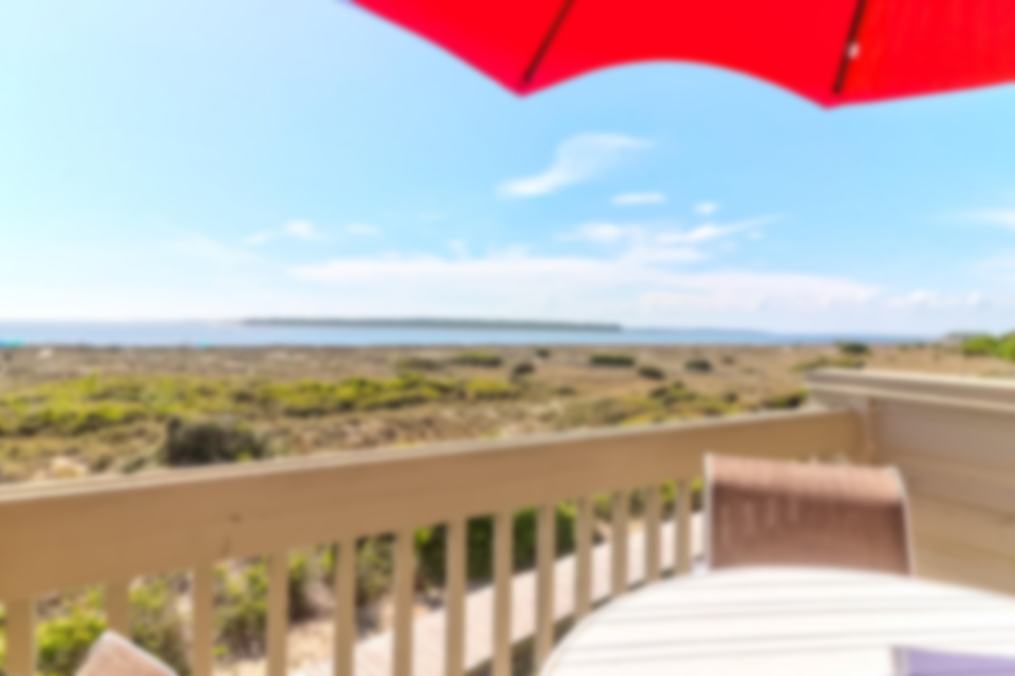

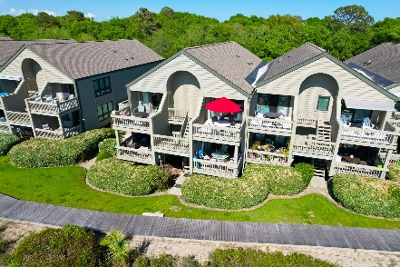
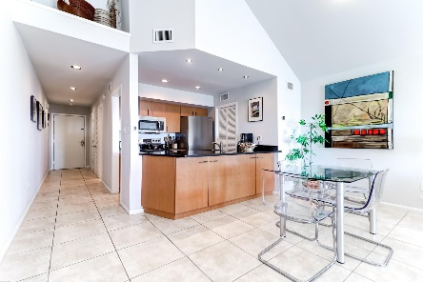
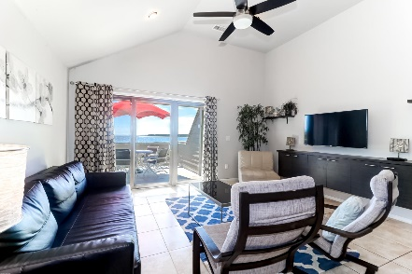
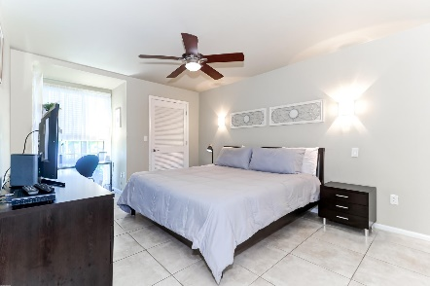
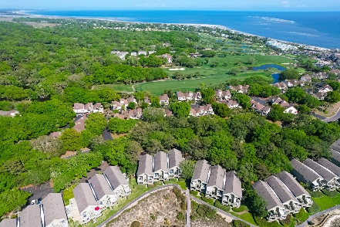
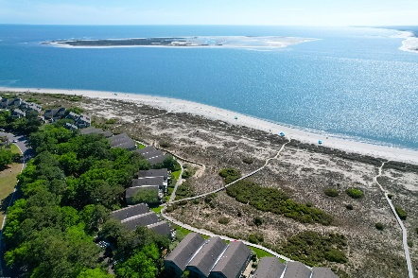


1370 Pelican Watch Villas Seabrook Island, SC 29455 | MLS# 23007752 | $750,000
Stunning Ocean Views
in Seabrook
Sip your morning coffee in the company of soaring pelicans from your private top floor balcony enjoying endless water views or go for a walk on the pristine beach just steps away. To dream of owning this one bedroom, two bath, oceanfront condominium with unforgettable sunsets views of the Atlantic Ocean and Edisto River is just the beginning.
Seabrook Island is a gated oceanfront community dedicated to providing its residents with a lifestyle like no other--two championship golf courses, a tournament-grade tennis facility, an equestrian center, and top flight dining opportunities along with miles of pristine beaches to enjoy. And this is just the short list! Come take a peek--you won't be disappointed! Club membership is required. Please see agent notes and documents for more details.
Fantastic Rental Property
Ann Cortes Office - (843) 886-8110
Mobile - (843) 324-6808
ann.cortes@carolinaone.com
Carolina One Real Estate | 1503 Palm Blvd | Isle of Palms, SC 29451-2280

