Slide 1

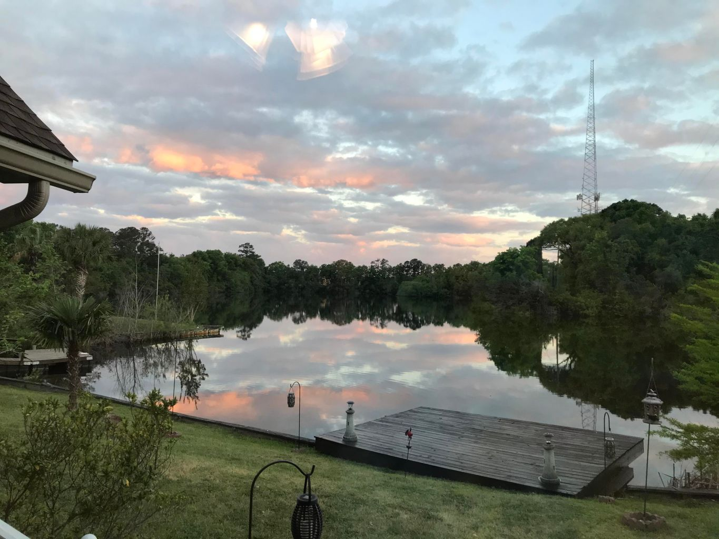
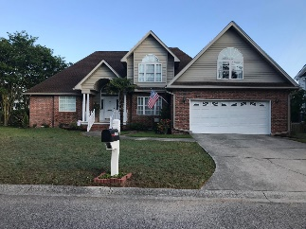
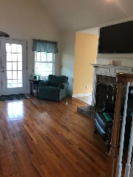
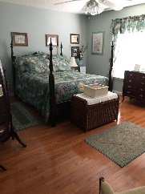
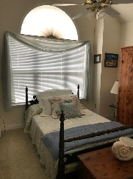
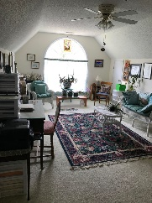
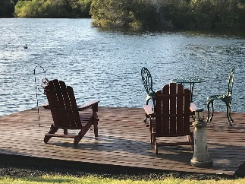

Jane Locke, Realtor
M (843) 819-3508
lockejaneb@aol.com
www.century21properties.com
Major Price Update in Laurel Lakes…
Waterfront Living At Its Best
1373 Woodlock Road | Mt Pleasant, SC 29464 | MLS# 21011330 | $895,000
DRAFT
Waterfront living on a fresh water twelve acre lake in the middle of Mt. Pleasant. Convenient to I-526, 10 minutes to beach, 15 to Charleston, shopping center near. Freshly remodeled kitchen, master bedroom, guest bath, and half bath. New front porch, new water heater, new stove, new microwave. Crawl space is encapsulated. New paint on all exterior trim. Launch your canoe, kayak, or paddleboard from your dock. Great fishing, also. Enjoy a nice beverage on the dock watching the sunset., or sit around the fire pit. Home has the best sunsets in Mt. Pleasant. Quiet neighborhood. Live like you are on vacation every day. This is the home for you to enjoy life to its fullest. Lots of storage. Oversized 2 car garage. Unfinished attic area could be converted to 2 bedrooms and bath.
Century 21 Properties Plus | 1090 Park West Blvd, Suite 3 | Mount Pleasant, SC 29466

