Slide 1
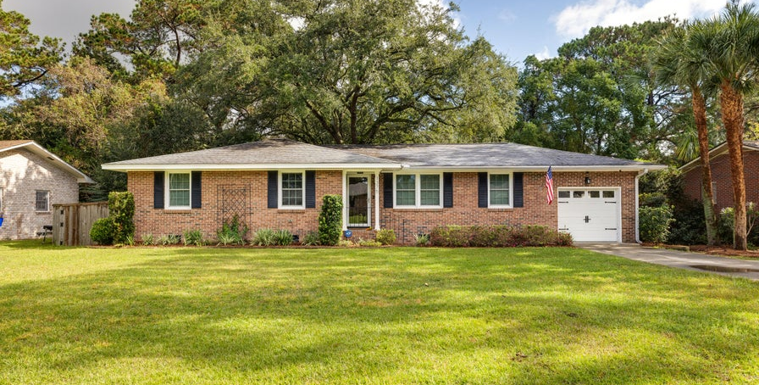
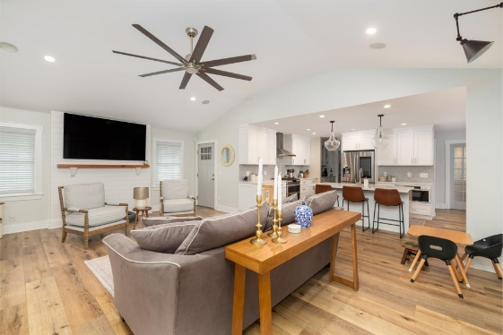
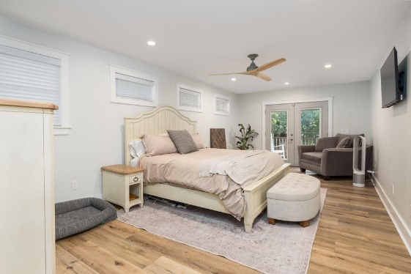
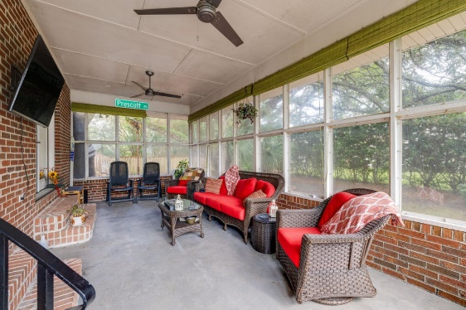

Beautifully Renovated Contemporary Ranch | $789,000
1375 Nye Street
Lenevar | Charleston, SC 29407 | MLS# 24028673
Welcome to 1375 Nye Street, a beautifully renovated contemporary ranch in Charleston's peaceful Lenevar neighborhood, where spacious lots and no HOA provide a rare sense of privacy and freedom. This brick home has been thoughtfully & meticulously upgraded. Inside, the vaulted ceilings and open floor plan create an airy, inviting atmosphere, accentuated by custom built-in cabinets in the living room and a cozy gas fireplace in the dining area. The gourmet kitchen is a cook's dream, featuring a gas range with a stylish hood and a sizable butler's pantry offering plenty of storage. The primary suite is a sanctuary with views of the expansive backyard, French doors leading to a private deck, dual extended vanities, a large steam shower, and an extended walk-in closet.
An additional set of French doors opens into the office, ideal for those who need a quiet workspace at home. A spacious sunroom brings the outdoors in, offering relaxing views of the lush backyard. Step outside to your very own retreat, complete with a deck, patio, firepit area, and a charming 144 sq ft guest cottage, all shaded by majestic oak trees. Additional highlights include new electrical and plumbing, a tankless water heater, and a fully encapsulated crawlspace with a dehumidifier. Located just 10 minutes from Downtown Charleston and 20 minutes from Folly Beach, this home combines a convenient location with timeless charm. Schedule your showing today!
Kelly Snyder
843-457-5951
kelly.snyder@agentownedrealty.com
Greg Gelber
843-494-2354
greg.gelber@agentownedrealty.com
AgentOwned Charleston Group | 902 Savannah Hwy | Charleston, SC 29407-7802

