Slide 1
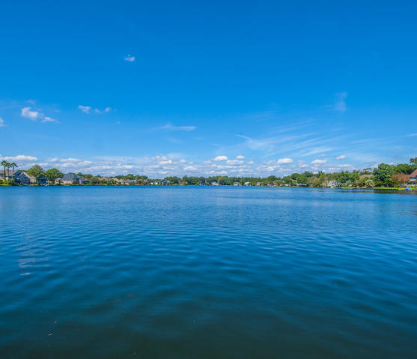
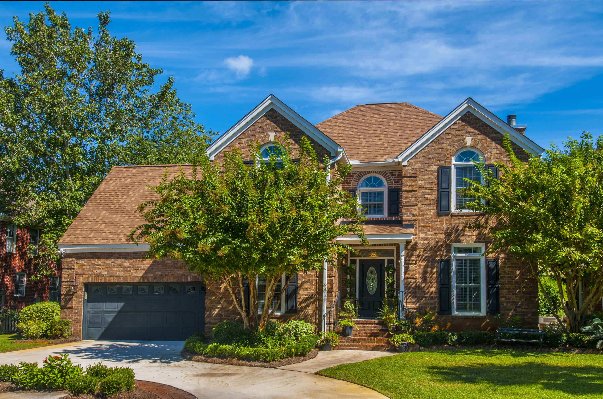
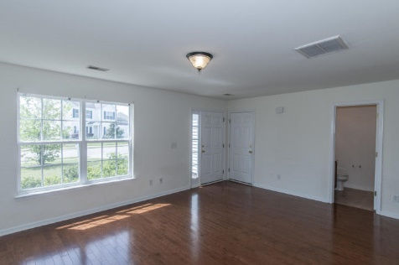
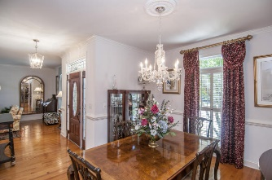
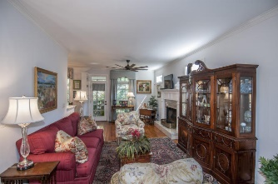
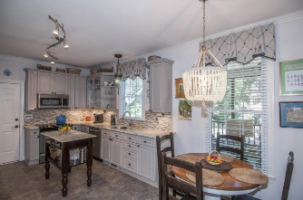
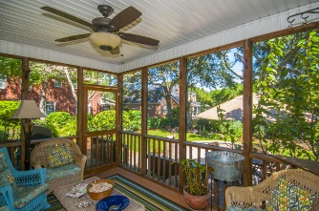
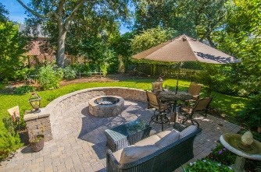
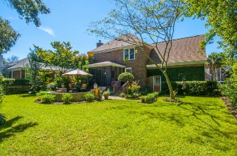


1379 Southlake Drive
Lakeshore ~ Mt Pleasant
Totally renovated brick home in the heart of Mount Pleasant
You’ll be welcomed with custom copper lighting and beautiful hardwood floors. The gourmet chef’s kitchen features granite counter tops with backsplash, stainless appliances including a new gas cook top and double oven, center island, huge pantry plus a Legrand under cabinet system with speakers, docking station and LED under cabinet lights. The kitchen opens to an elegant family room with fireplace and a custom granite mantle and hearth. Enjoy relaxing after a long day on the screened in porch or entertain special friends on the outdoor oasis with a custom patio with benches and fire pit while enjoying a professionally landscaped private yard. The large master bedroom with sitting room is fit for a queen and the totally remodeled master bath has a huge tile shower, dual granite vanity and a large walk-in closet with custom built-ins. There are two additional bedrooms plus a huge media room that could serve as a 4th bedroom. New HVAC units Watch the sunset on the community dock or enjoy canoeing around the lake. Located close to the beaches, downtown Charleston, dining, shopping and so much more. This is a must see.
Asking $529,000
MLS# 16012994
2,400 SqFt
4 Bed/2½ Baths
Great Location...
Expect to be impressed
Don Dawson
843-514-0452
ddawson@carolinaone.com
Carolina One Real Estate • 2713 Highway 17 North • Mount Pleasant, SC 29466
www.TeamDawsonSC.com

