Slide 1
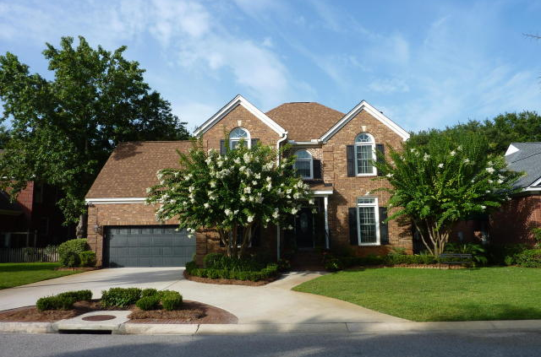
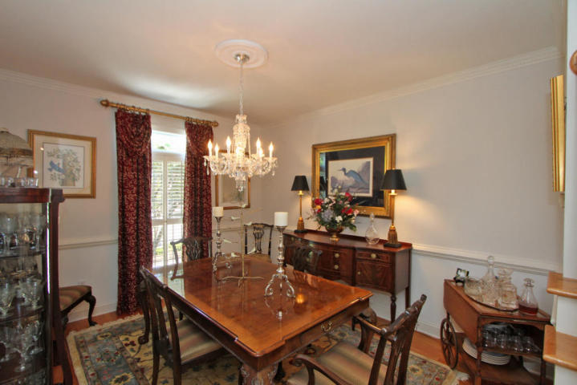

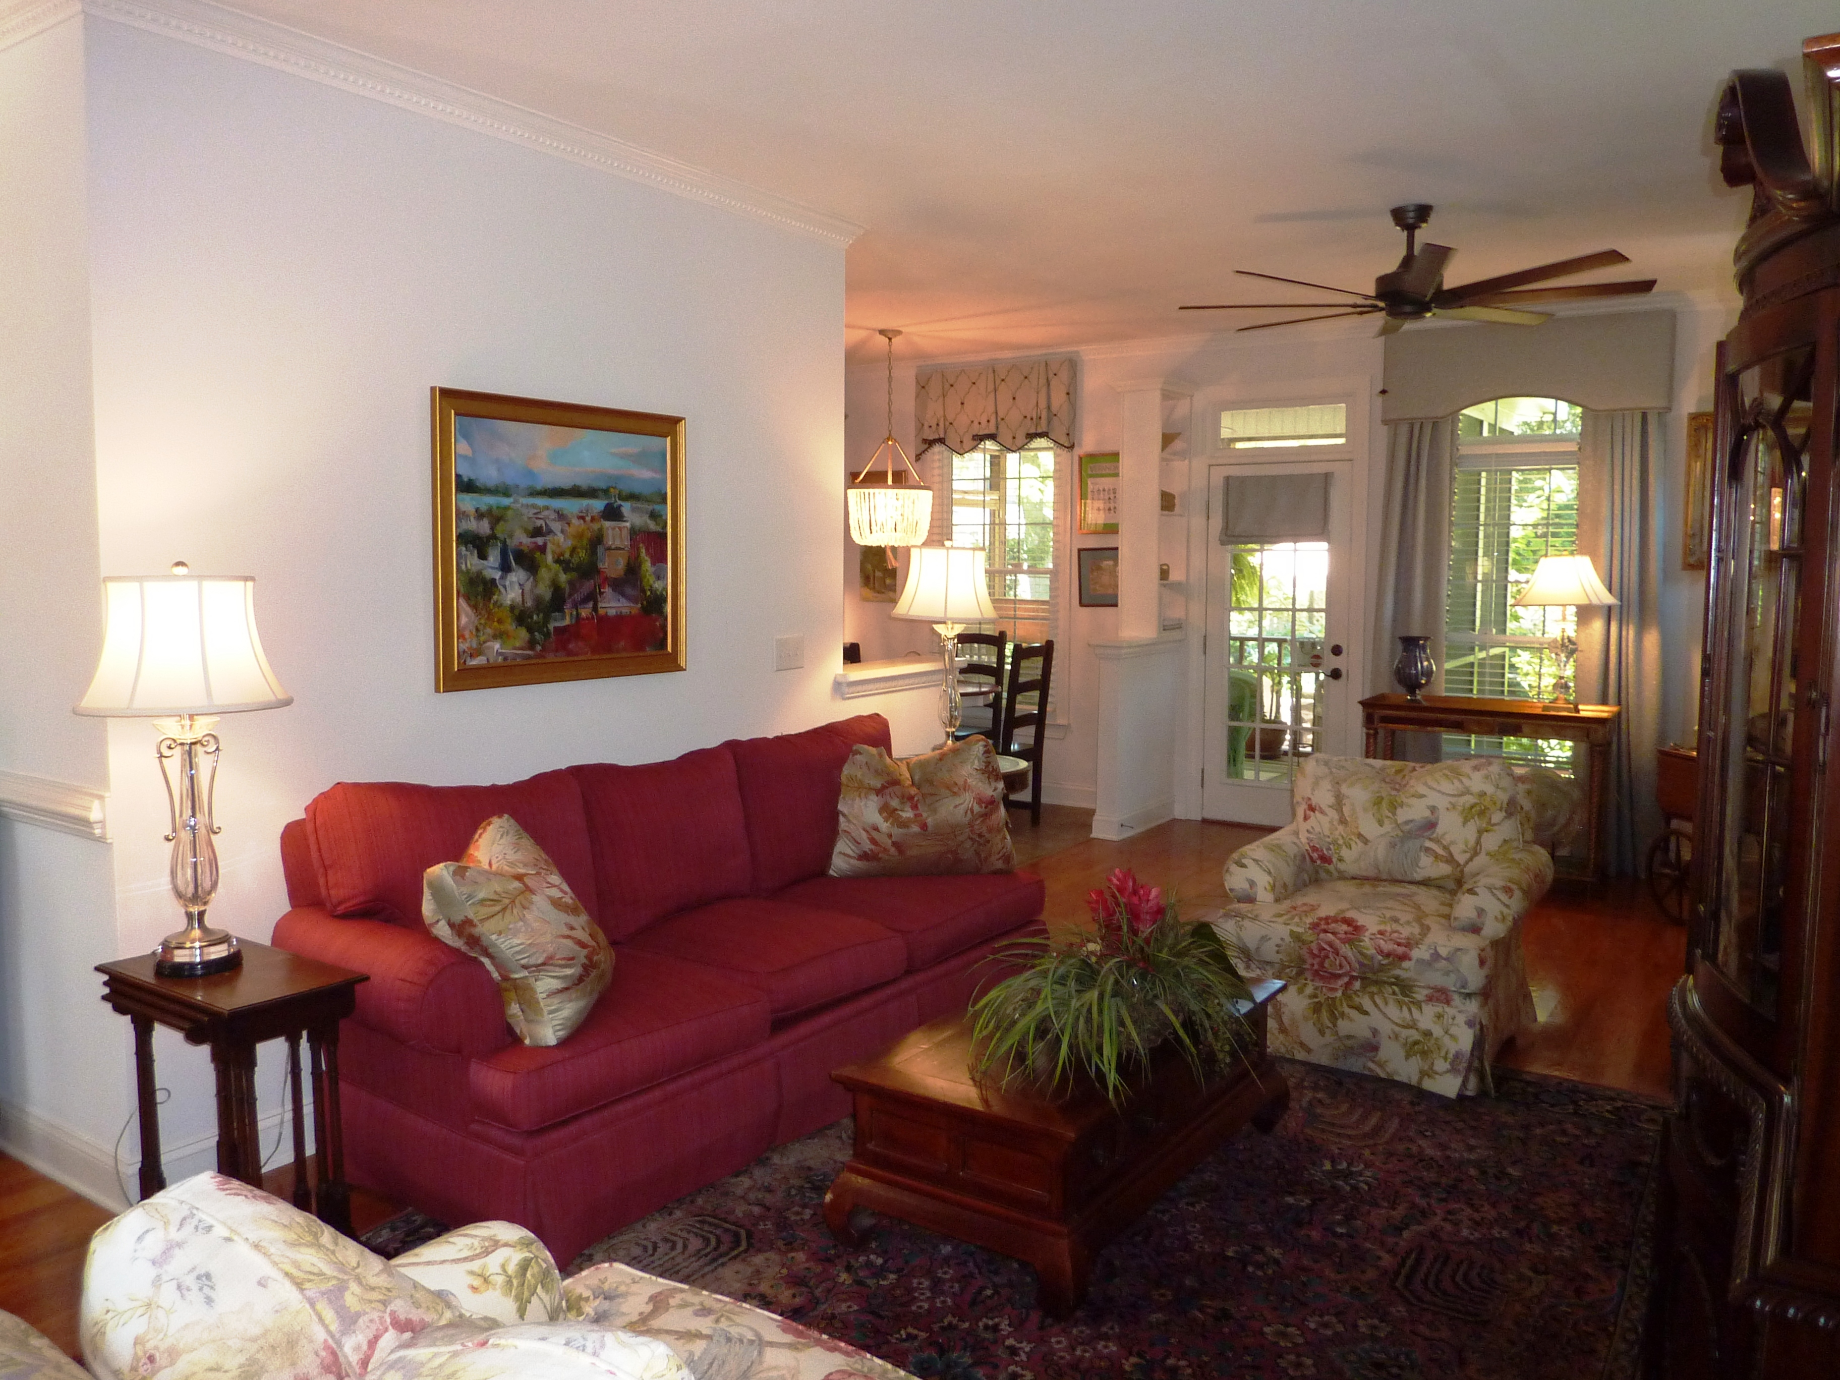
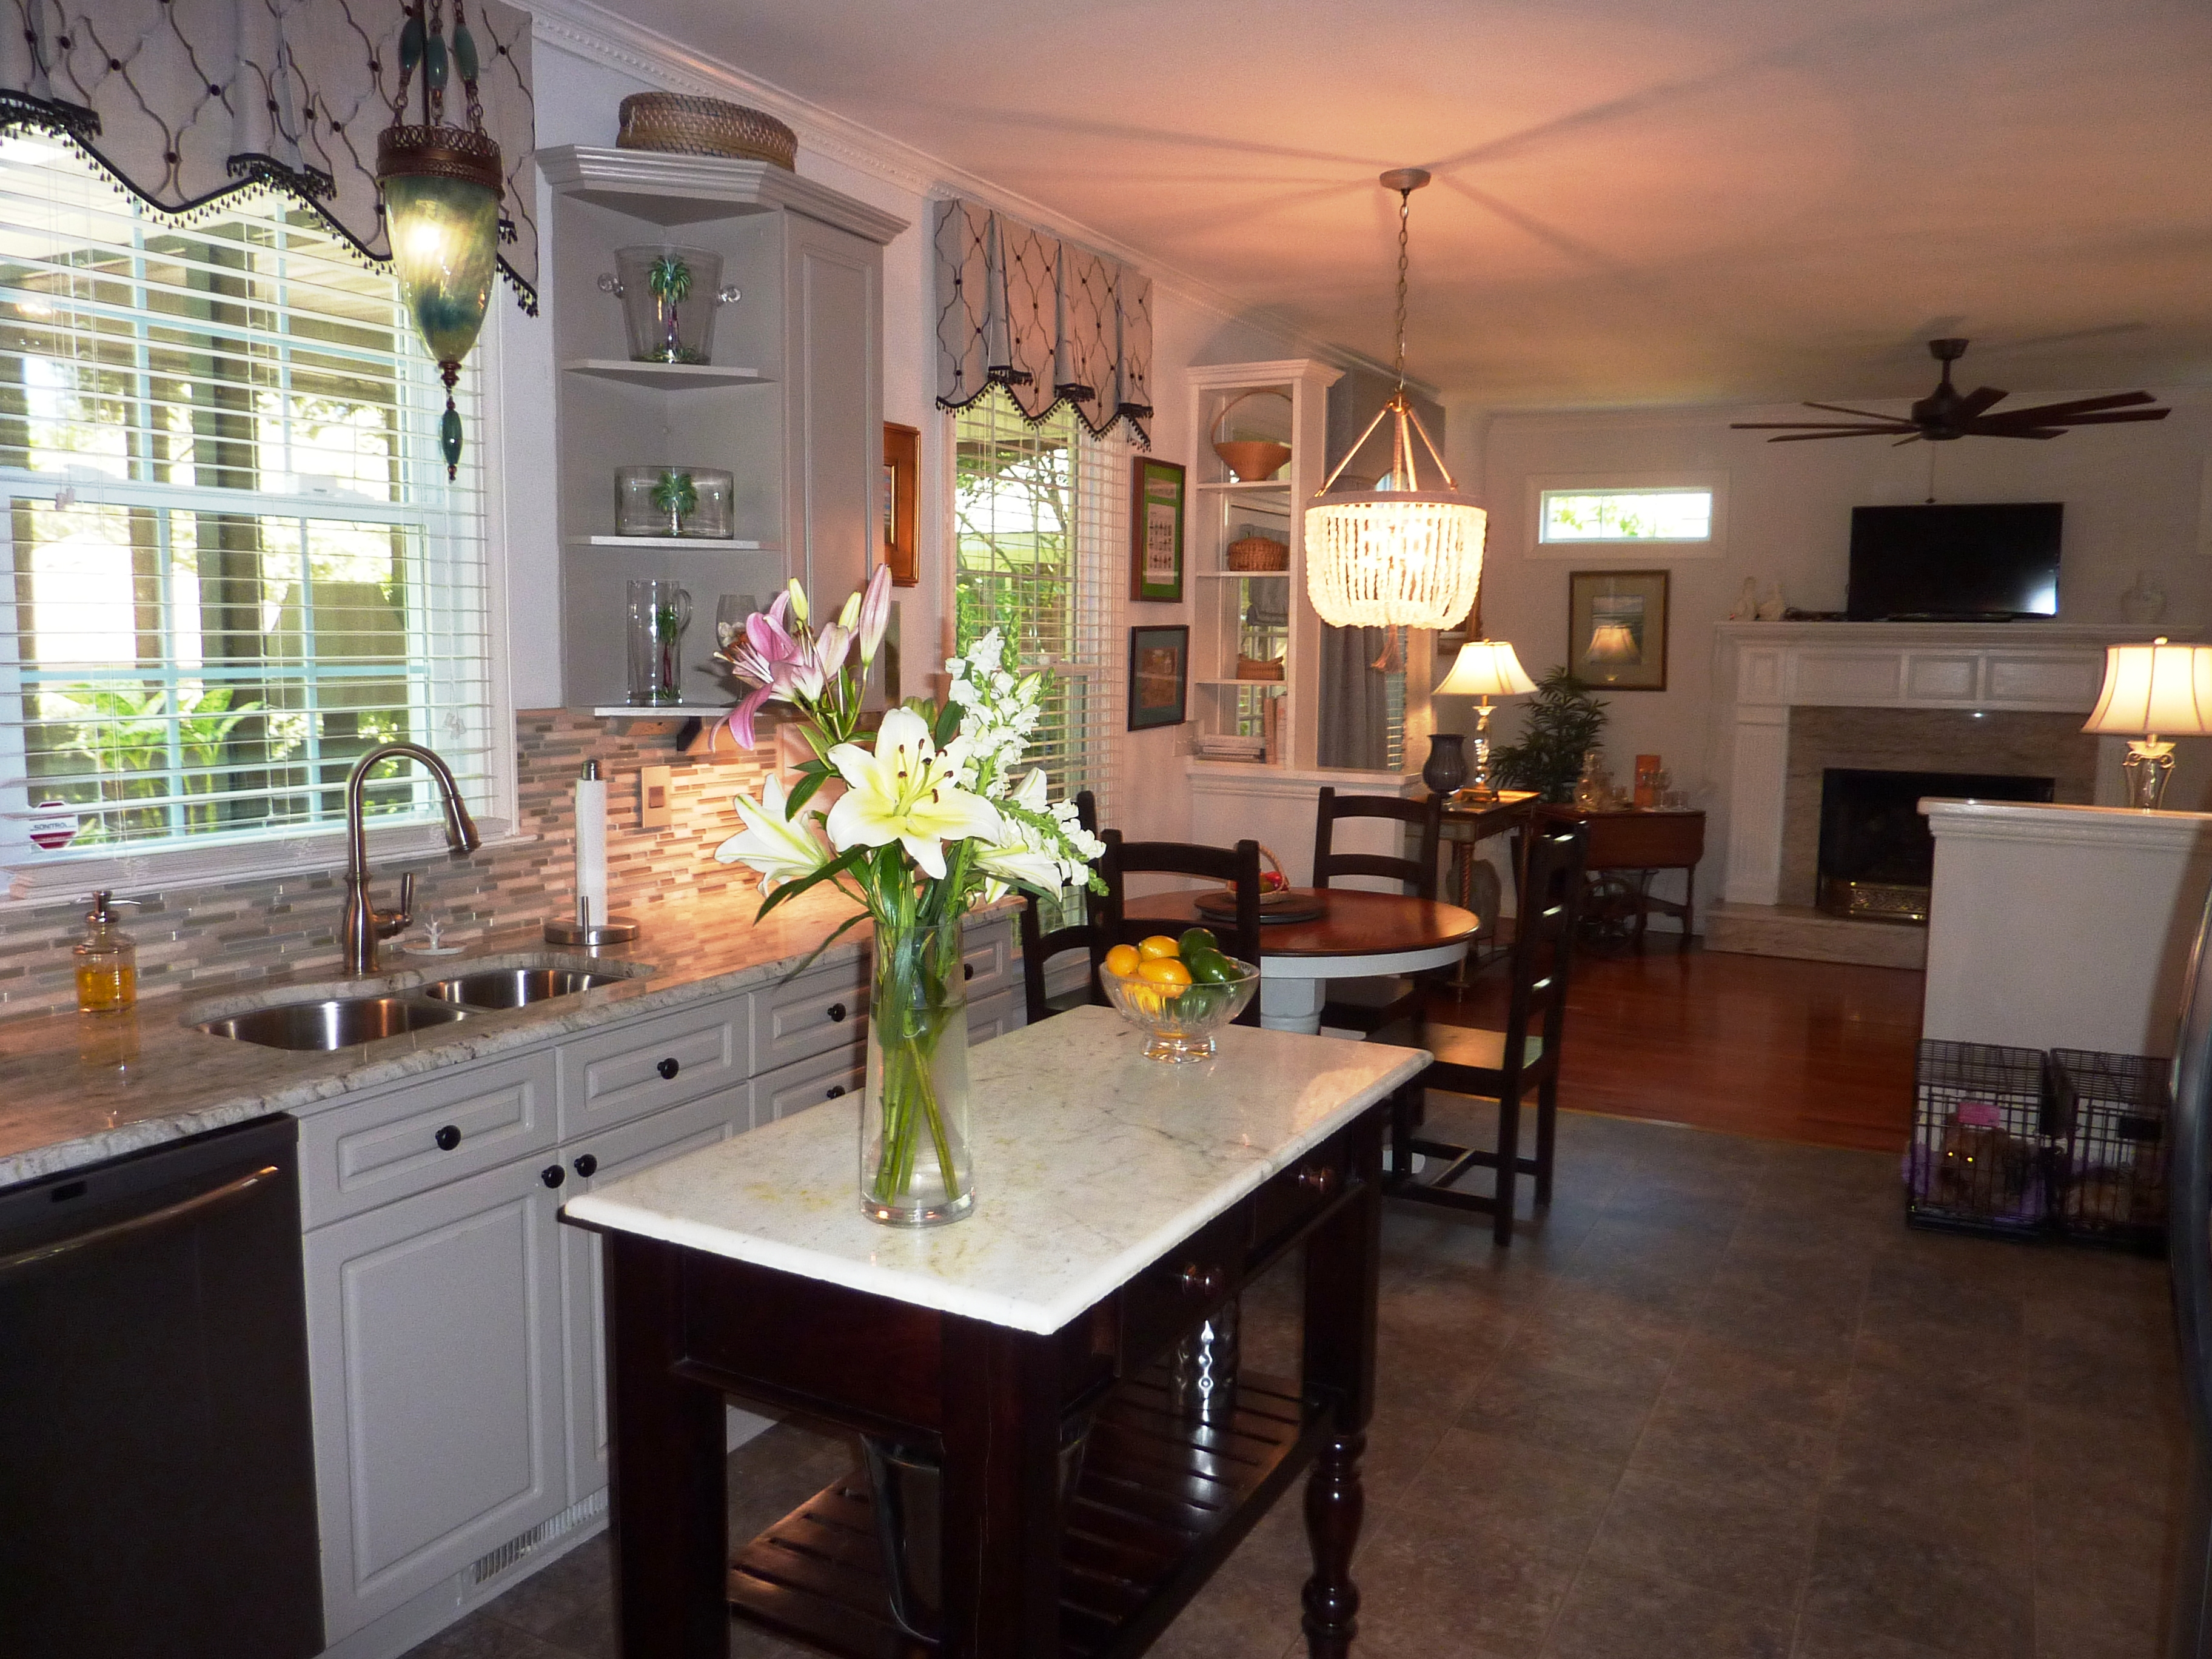
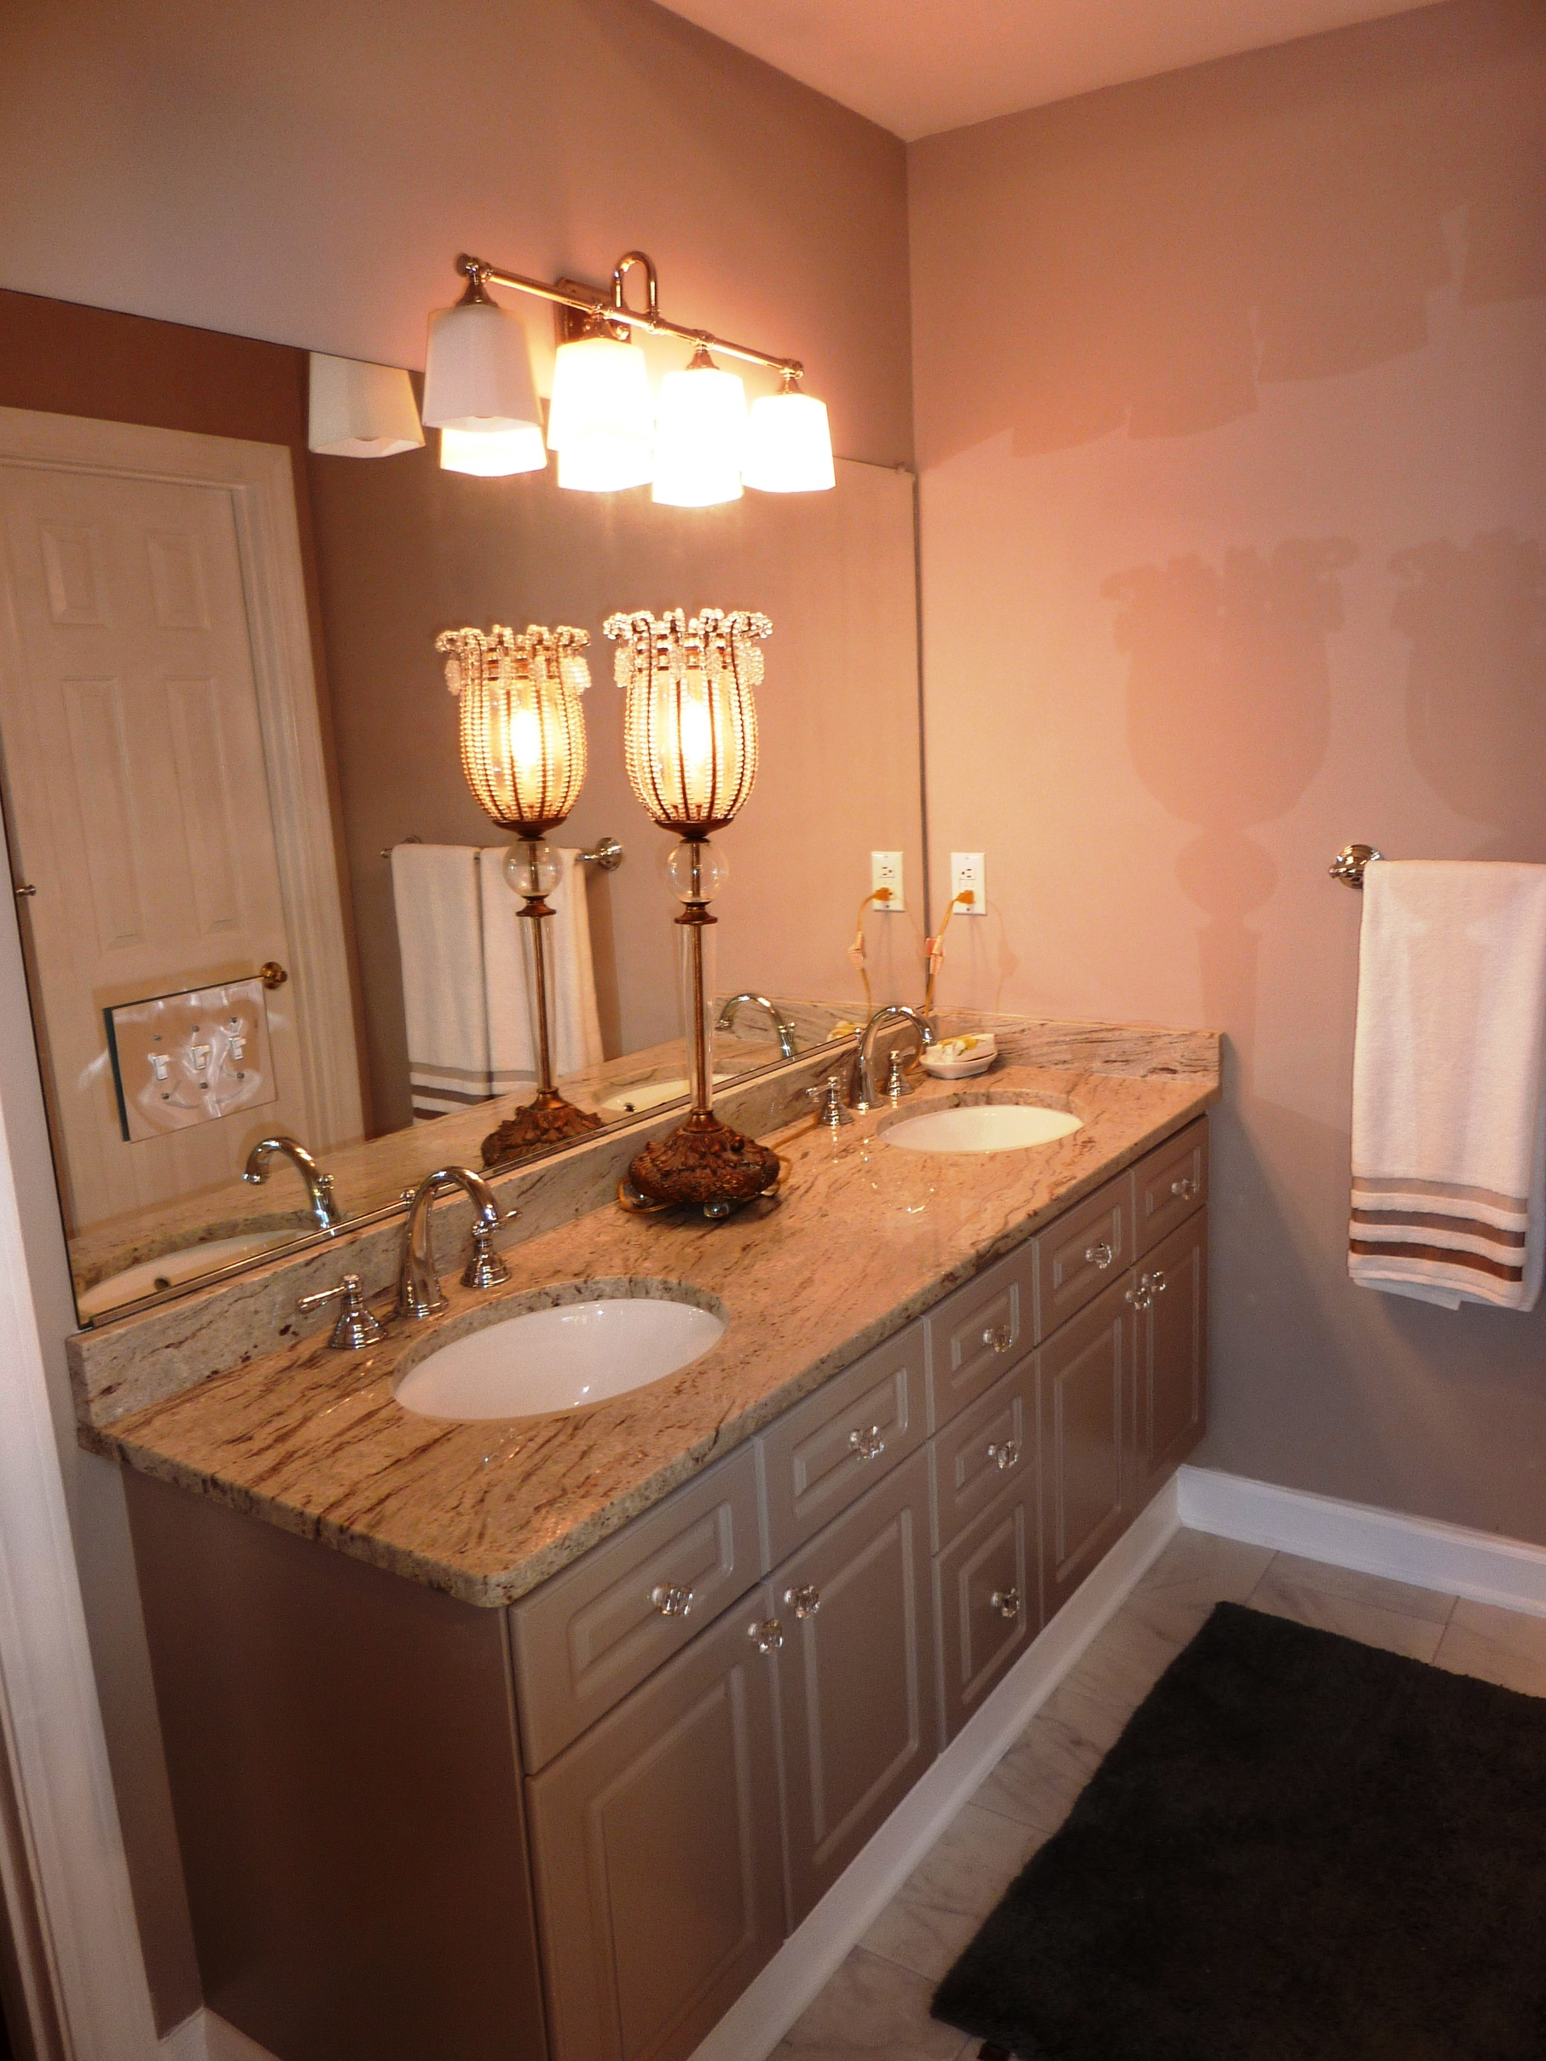
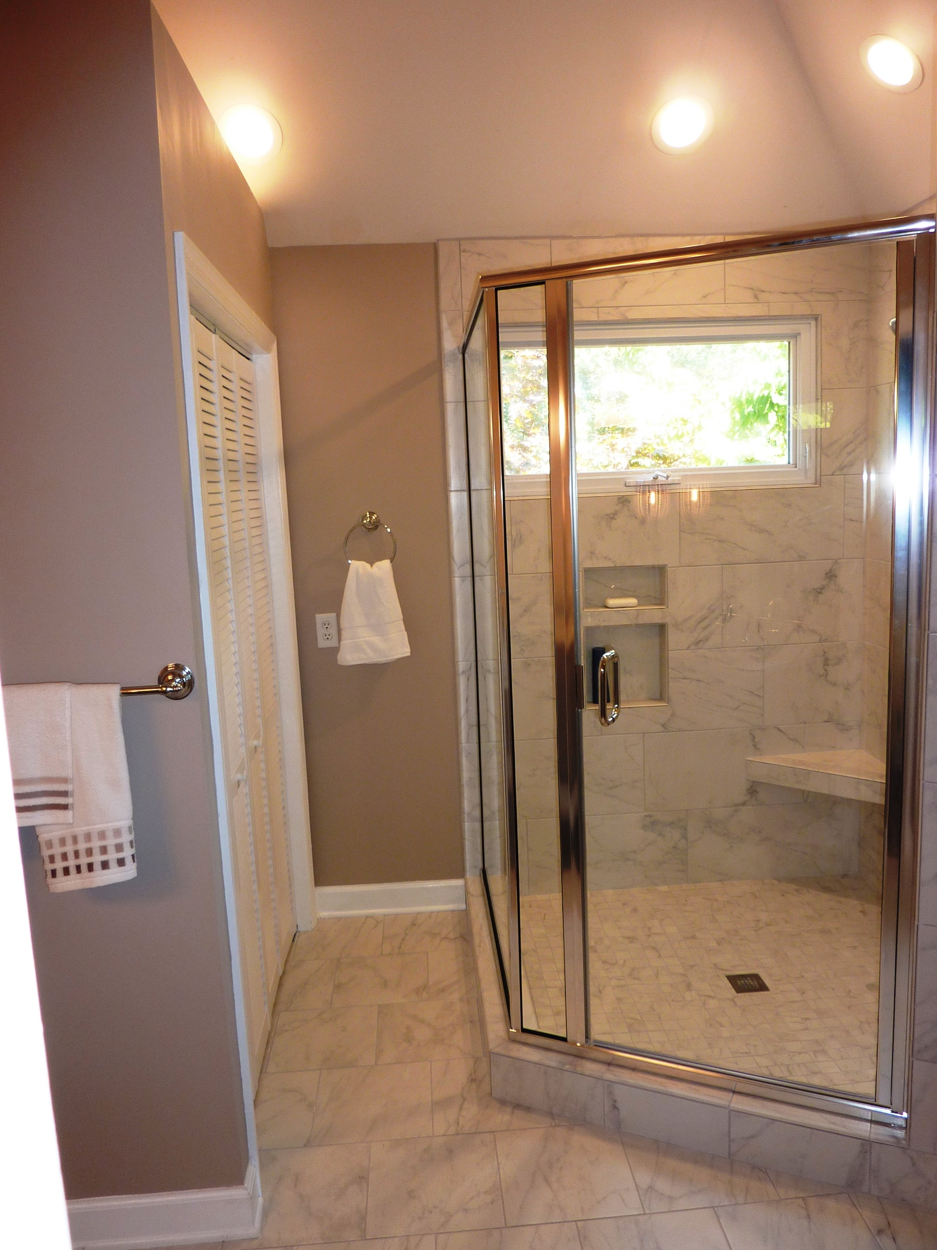


Renovations Complete!
New Master Bathroom and New Roof!
1379 Southlake Drive
Lakeshore | Mount Pleasant | MLS# 15011391 | $519,000
Renovations and landscaping are complete on this brick home in the heart of Mount Pleasant. The kitchen has granite with a tile backsplash and a Legrand under cabinet system with speakers, docking station and LED under cabinet lights. Stainless appliances, an island and a huge pantry complete the kitchen. The kitchen is open to the living room with a fireplace with an elegant custom mantle with granite surround and hearth and new gas logs. The master bedroom has a sitting area, while the master bath renovation includes a huge tile shower, a new linen closet and the double sink vanity features granite and crystal knobs. The walk-in closet has been fitted with a new closet system. Lakeshore has 81 brick homes. Minutes to I-526, 5 min to Isle of Palms, 15 min to Historic Charleston. The other two bedrooms share a hall bath with a granite countertop. The FROG is huge and is currently used as a media room and office, although it can be a 4th bedroom, as it has a closet. Enjoy the fabulous outdoor living space with a screened porch and patio with a built-in fire pit. The patio has columns with custom copper lanterns and there is a brick wall bench built around the fire pit. The landscaping has been redone in the front and back and has and is illuminated by LED landscape lighting.
Jean Rozint
Cell: 843-224-1951
jeanrozint@kw.com
www.charlestonmove.com
Keller Williams Realty
496 Bramson Court, Suite 200
Mount Pleasant, SC 29464

