Slide 1



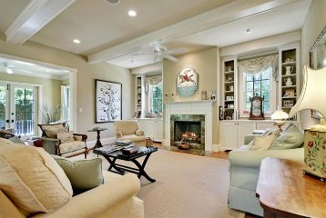
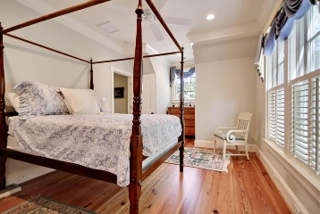
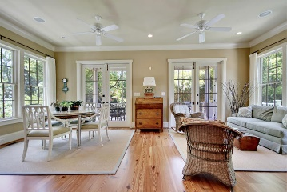

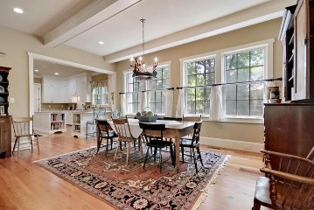
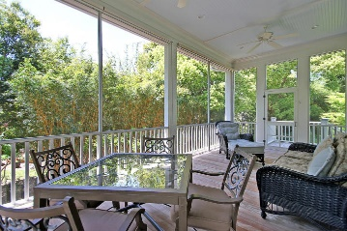
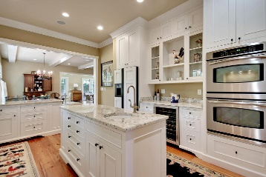
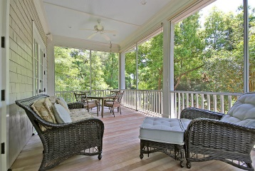
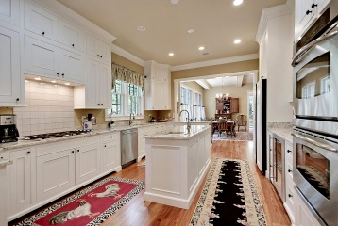
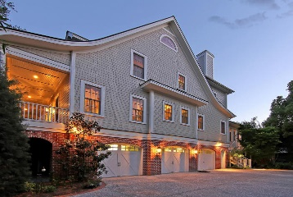

Island Living…Just Got Better!
Price Reduced!
137 Island Drive
Edgewater Park ~ Charleston ~ MLS# 16011202 ~ $1,099,000
Island Living in Charleston's Edgewater neighborhood, complete with neighborhood boat-ramp to the Stono River. Cape Cod Luxury home, built to perfection with Brick lined tabby driveway, lush landscaping, brick archways, metal roof, and full front porch. Step inside to find beautiful heart-pine floors, high ceilings with crown molding & a wonderful open floor plan filled with natural light. From the gourmet kitchen flowing into the great room & overflowing to the sun room, this floor plan easily lends itself to entertaining & comfortable everyday living. The extension of the living space onto the screened-in porch allows for further enjoyment on the main level. The elevator makes for easy travel between the 1st & 3rd levels. This home is one of the most well-built luxury homes in Charleston.
Additional features include:
Russell Rosen Engineered Home
Harper James Finucan custom builder
Anderson impact windows
Metal roof
Heart pine floors from Virginia
Halfround gutters
Ranni hot water heater
Custom cabinets in kitchen and all bathrooms
Ipe steps and porches
Screened porch shades
Security system
Hydrolic elevator
Foam insulation in attic
Heat and AC in the attic
2 heat pumps
3 car garage and ample storage
Built-in closet shelving
Gas hook-ups for grill in garage
Fans in all rooms
Fresh outdoor paint
Irrigation system
All interior doors are solid
10' inch crown molding in all rooms
Lighted outside steps
Boat ramp for residents of Edgewater Park
Exterior impact doors
Central vacuum
Sound system
The kitchen features granite counters, SS appliances, a wine refrigerator, double wall oven, gas range, tile backsplash and breakfast bar
Living room has a wood burning fireplace with built-ins on either side
The great room has a beautiful beamed ceiling
Master bedroom has pocket doors leading to a sitting room with big picture windows
Master bath has two walk-in closets, a dual vanity and huge walk-in shower with bench
The walk-up 4th floor is a floored, unfinished attic perfect for storage
The three car garage also has massive storage spaces and a half bath
Book your showing today!
Matt O’Neill matt@mattoneillteam.com 843-532-4220

