Slide 1
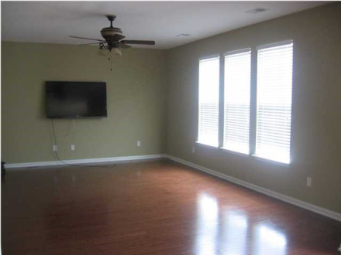
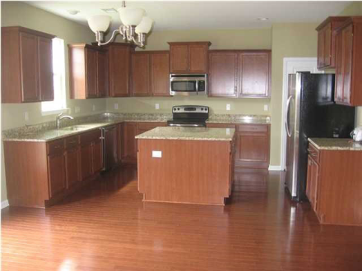
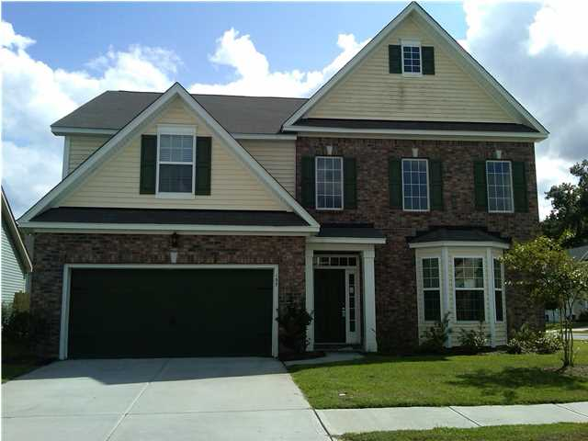
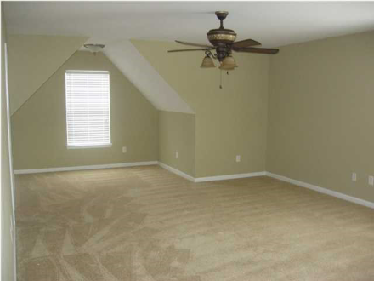
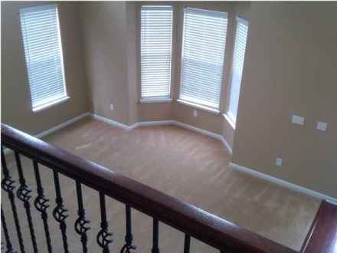
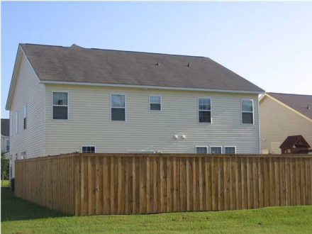


Approved Short Sale in Reminisce
137 Roadster Row
Summerville, SC
ML# 1219971 $254,500
3,285 Sq Ft ~ 4 Bedrooms ~ 2½ Baths
Prepared to be wowed when you walk through the door and notice the dramatic two story foyer and living room. There is a formal dining room along with an eat-in-kitchen off the large kitchen featuring an island, granite countertops, stainless steel appliances and upgraded knobs on the cabinets. From the kitchen you can see the large family room. There is a half bath downstairs along with a room that can be used as a study or a guest room. The first floor has beautiful hardwood floors throughout aside from the living room and extra room. The hardwood was extended up the stairs which features exquisite iron detailing. Upstairs contains the spacious master suite with his and her closets and master bathroom, along with three guest bedrooms. Two of the bedrooms share a Jack and Jill bathroom. The home is a on a nice corner lot with a newly fenced backyard. Come take a look at your new home today!
Ray & Sherry Walsh
Ray Cell: 843-830-1440
Sherry Cell: 843-697-2843
Office: 843-875-4676
Fax: 866-830-4848
walshr@sc.rr.com
HORNE REALTY, LLC
107 S. Main Street
Summerville,SC 29483

