Slide 1
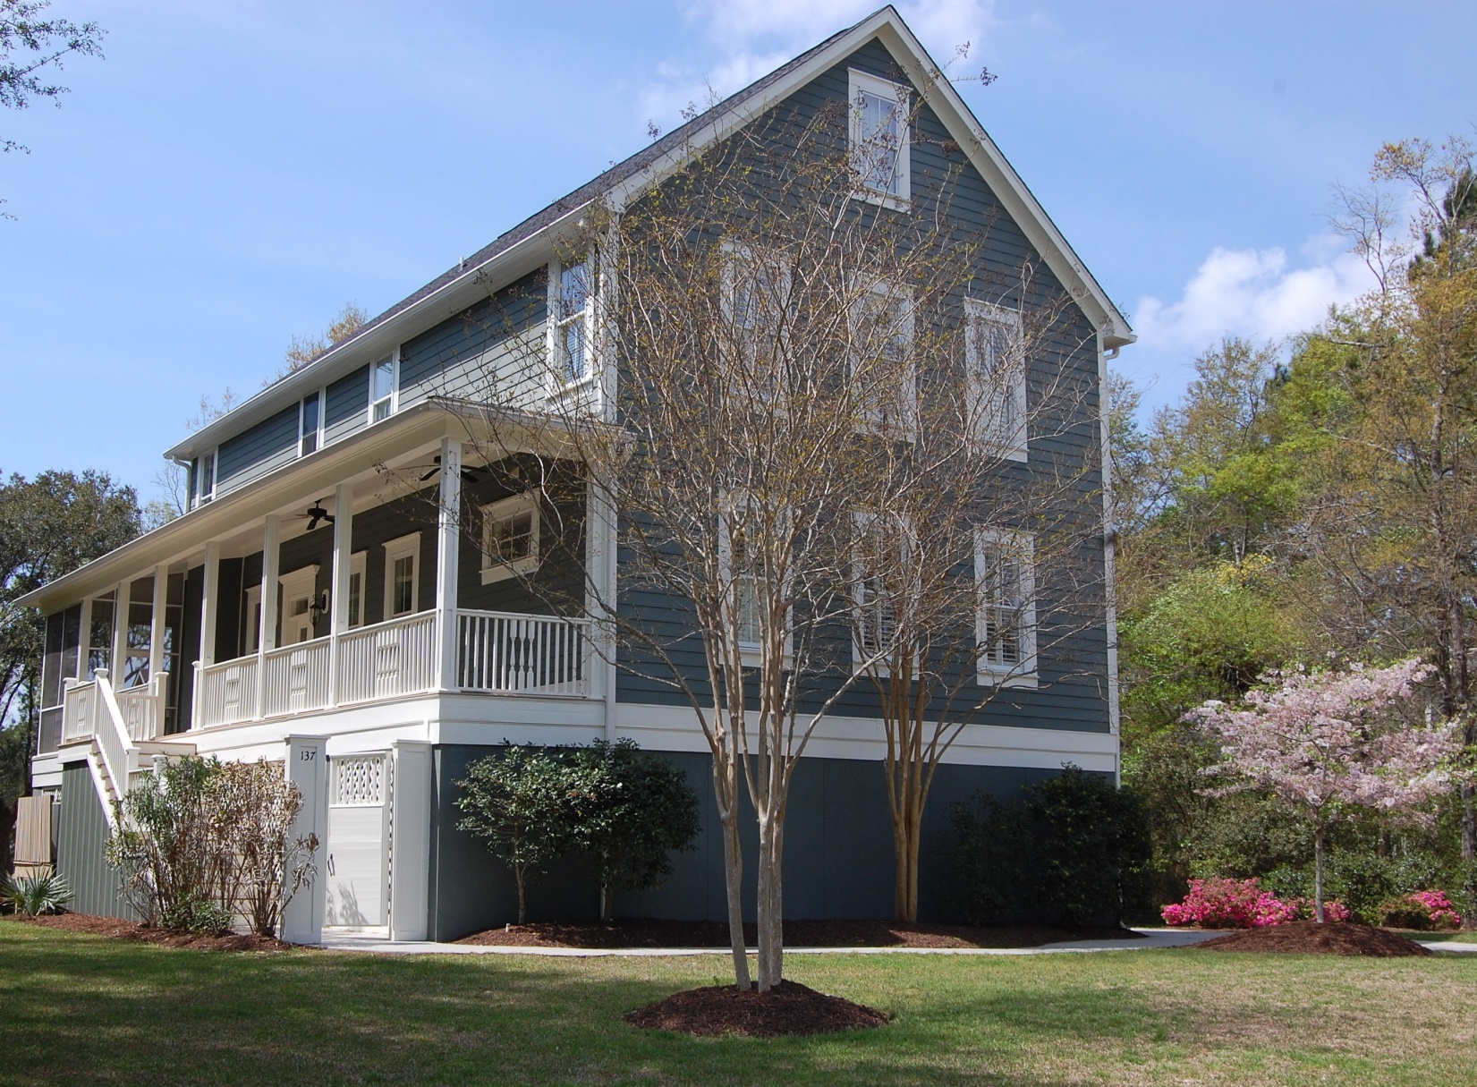
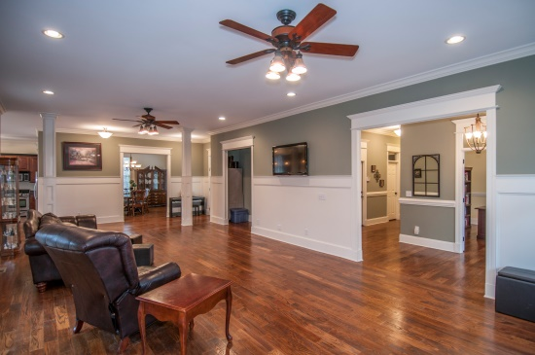
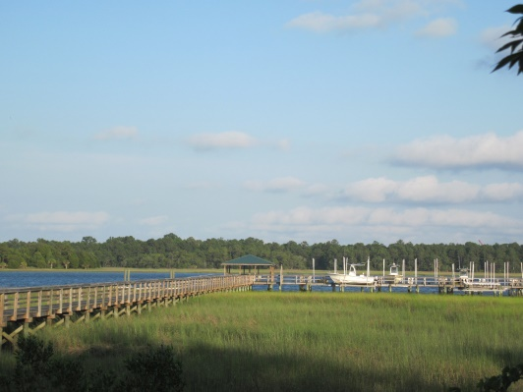
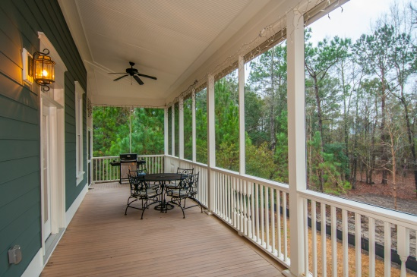


“Gated Neighborhood, Community Deep Water Dock…”
137 Wando Reach Rd
Charleston, SC 29492
$2000 Realtor ®
incentive with BIC approval
Reduced to an
amazingly low
$600K!!
Special Wando River location,
just around the corner, idyllic setting…
Wando Pointe – exclusive neighborhood with very bright future
Large very livable floor plan – 4800SF
4 full bedrooms each with its own full bath
Community Deep Water Wando,Dock
Only 41 lots in entire one-street community
Two new schools being built nearby = values game-changer
STEVE ROWE
,Realtor®
Retired Military. Active Agent.
(843) 303-7438
srowe@carolinaone.com
www.SteveRoweHomes.com

