Slide 1
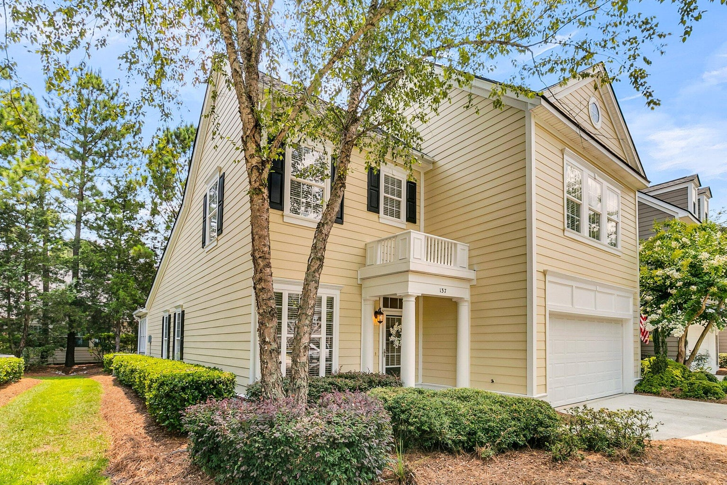
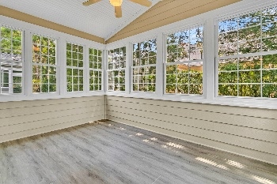
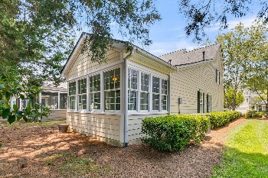
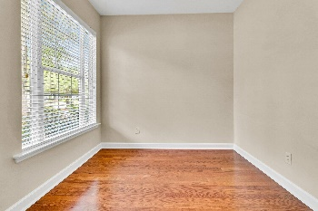
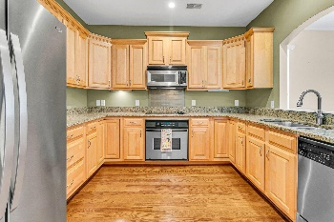
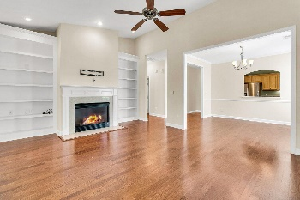
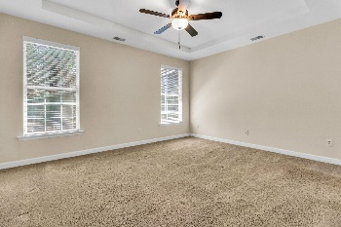
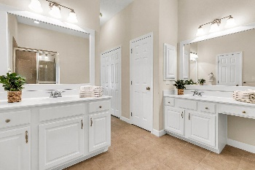
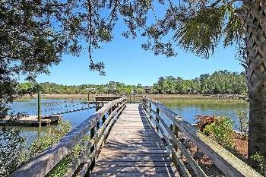

137 Fresh Meadow Lane
Dunes West · Mount Pleasant, SC 29466 · MLS# 24016633 · $625,000
Stunning Dunes West Townhouse
Welcome to 137 Fresh Meadow Lane, a charming end-unit townhouse in the desirable Dunes West neighborhood. This meticulously maintained home offers: a well-appointed kitchen w/ modern appliances, ample storage, and granite countertops. The spacious open floor plan, flooded with natural light, features 3 bedrooms and a rare 3.5 bathroom floor plan with a fabulous 4 season sunroom. The Inviting living room with a fireplace, is perfect for relaxation and entertaining. The primary suite is serene with a walk-in closet and luxurious bathroom. The optional Dunes West Club offers swimming, tennis, a zero-entry pool, and an exercise area. An optional Golf Membership is also available. Don't miss out on this opportunity to own a home in one of Mount Pleasant's most sought-after gated neighborhood.
Schedule your showing today!
Stan Huff
843-670-2835
stan.huff@agentowned.com
Jill Marcacci
843-297-5590
jill@agentowned.com
www.agentownedrealty.com
AgentOwned Realty Co. Preferred Group, Inc. | 824 Johnnie Dodds Blvd | Mt Pleasant, SC 29464

