Slide 1
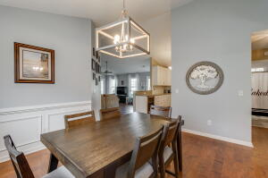
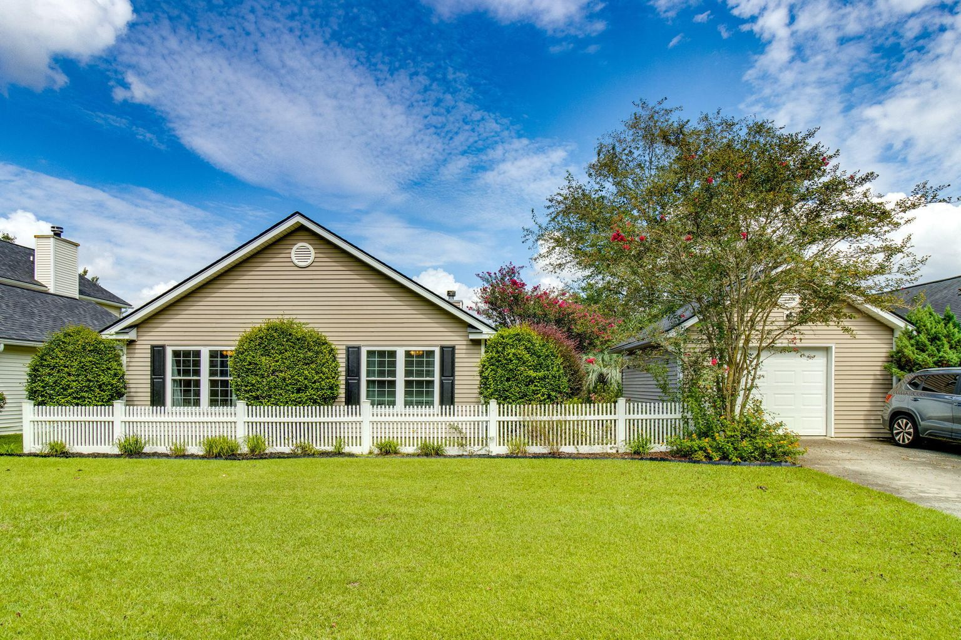
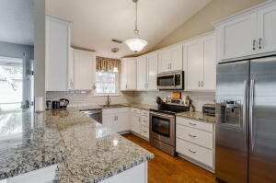
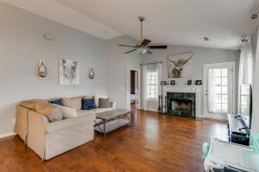
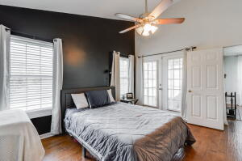
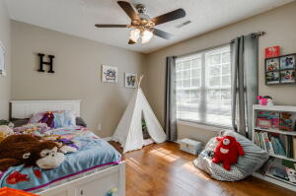
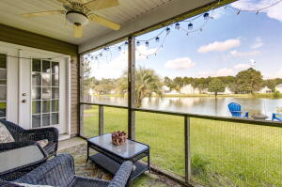
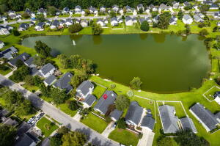


137 Jupiter Lane
Sunburst Lakes | Summerville, SC 29483 | MLS# 22023166 | $339,900
New Listing
Your search ends here! This one-story beauty with wide water views is situated on a neighborhood 5 acre pond close to schools, shopping, downtown Summerville and Charleston. Step inside to an open concept living space with high ceilings and a split bedroom floor plan. Newer wood floors, kitchen updated 2020 with granite countertops, white wood cabinets, SS appliances and wine cooler. Enjoy family and holiday meals in the huge dining room. Owner's Suite is a serene retreat offering a large and open space with pond views. French doors lead from the bedroom to the screen porch. Relax in the garden tub and soak your worries away. Dual vanities, separate shower and linen closet complete the space. 2 nice sized bedrooms, renovated full bathroom and laundry room are off of the dining area. Step outside to a beautiful yard with mature landscaping and awesome water views. Community pool and playground. Highly rated DD2 schools plus everything you need is close by.
Take a virtual tour: https://my.matterport.com/show/?m=D3p2vCgbRqJ
Beth Mandell
M 803-463-7734 | O 843-871-2121
bmandell@century21properties.com
www.bestcarolinahomedeals.com
Century 21 Properties Plus of Summerville | 118 W Richardson Ave | Summerville, SC 29483

