Slide 1
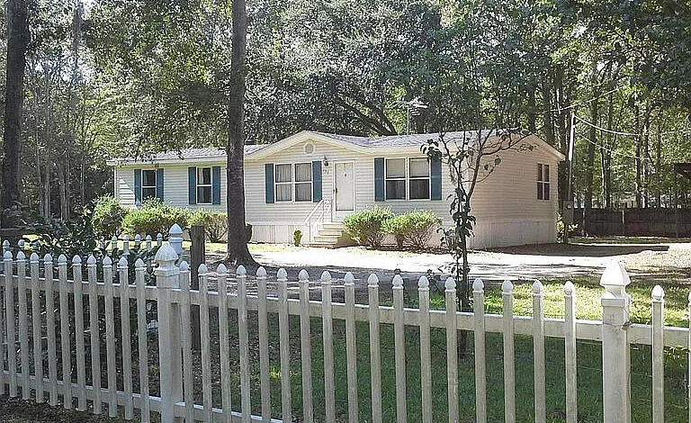
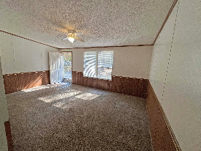
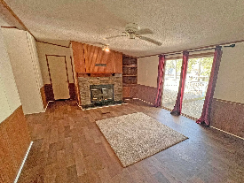
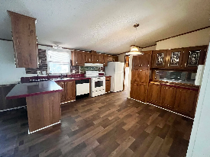
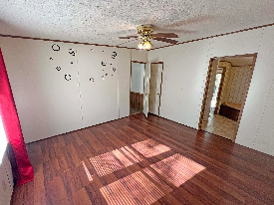
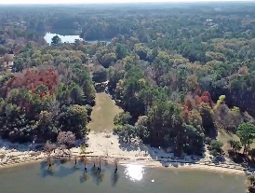
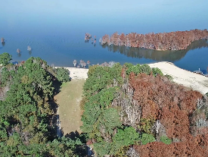


Easy to Show
CHARLESTON SINGLE STYLE HOME
4 BEDS/2.5 BATHS/LOFT
MASTER BEDROOM DOWN
YARD W/PRIVACY FENCE
HARDIPLANK SIDING
HOME ONLY 2 YEARS OLD
QUARTZ COUNTERTOPS
STAINLESS APPLIANCES
REFRIGERATOR INCLUDED
COVERED PORCH
PERFECT JOHNS ISLAND LOCATION
1 MILE FROM SEVERAL RESTAURANTS/SHOPS
BLINDS AND WASHER/DRYER INCLUDED
LESS THAN 10 MILES TO DOWNTOWN CHARLESTON
12 MILES TO KIAWAH OR FOLLY BEACH
137 Knott Dr
Eutawville, SC 29048 | MLS# 25030597 | $179,000
THREE BEDROOM AND TWO BATH HOME LOCATED CLOSE TO PUBLIC BOAT LANDING AS WELL AS FENCED COMMUNITY RECREATIONAL AREA WITH PRIVATE BEACH, PICNIC TABLES AND BONFIRE (WITH LOW ANNUAL FEE). SOME RENOVATIONS HAVE BEEN DONE TO INCLUDE MASTER BATHROOM TO REPLACE THE FLOOR AND VANITY. SECOND BATHROOM FLOOR HAS BEEN REPLACED AS WELL AS LIVING ROOM FLOOR HAS BEEN REPLACED AND VINYL FLOORING INSTALLED. THIS HOME HAS A HALF - ACRE YARD AND DOUBLE CARPORT.
Carla Davis
843-437-4873
gaweber@tds.net
Adler Realty
518 Parrot Point Dr
Charleston, SC 29412
www.adlerrealtychs.com

