Slide 1
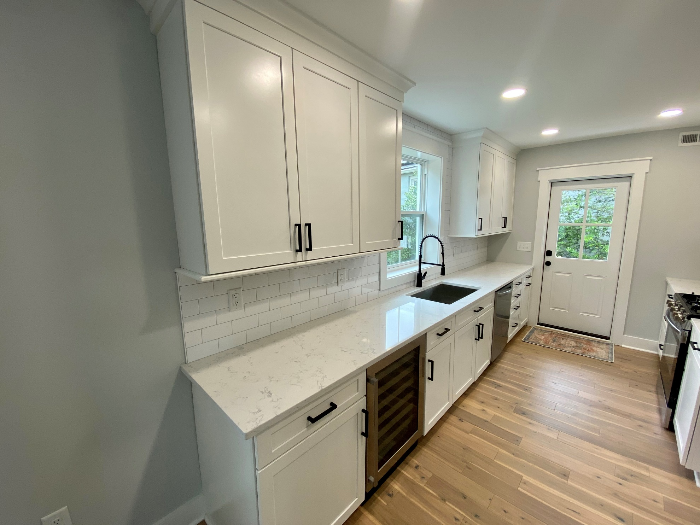
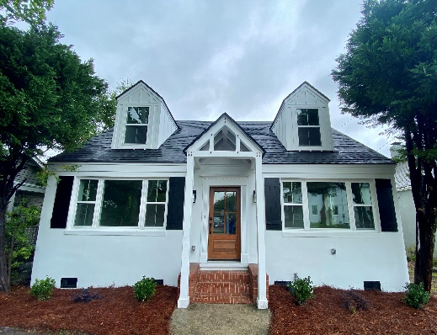
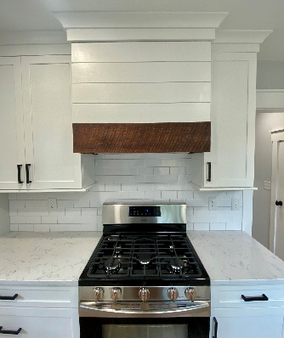
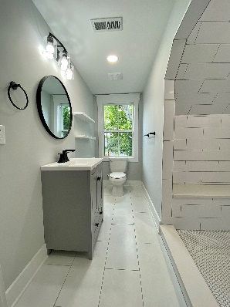
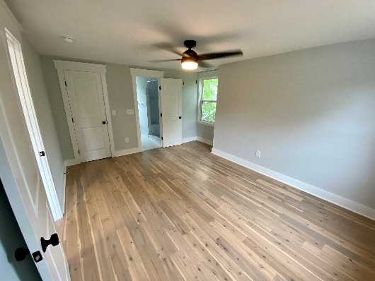
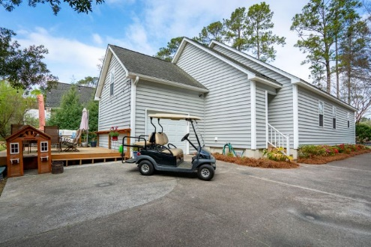


Downtown Complete Renovation
Immaculate and well cared for home in the heart of Summerville. Open floor plan downstairs, oversized master suite with his and hers closets and en suite bathroom, with new granite recently installed. Two additional bedrooms with a bathroom right off main living area. Good sized FROG and a nice deck off the back of the house. Stainless steel appliances in the open kitchen with a bar top for easy living and plenty of cabinet space. The best part is your proximity to Historic downtown Summerville. It is an easy golf cart ride to all the shops, dining, and attractions this area has to offer. This is a very well cared for home and it shows.
137 Simons St
Wagener Terrace
Charleston, SC 29403
Going Live Thursday Afternoon/Friday Morning!
Studs in renovation, no expense spared. Big yard, off street parking, 1543 SF home in a fantastic neighborhood on a great street. Twin master suites upstairs and a third bed and bath downstairs. Everything in house is new and beautiful, including all plumbing, electrical, Hvac and duct work.
Justin Natale
843-437-9739 | jnatale1982@gmail.com
www.theblvdcompany.com
The Boulevard Company, LLC | 806 Johnnie Dodds Blvd Ste 100 | Mt Pleasant, SC 29464

