Slide 1
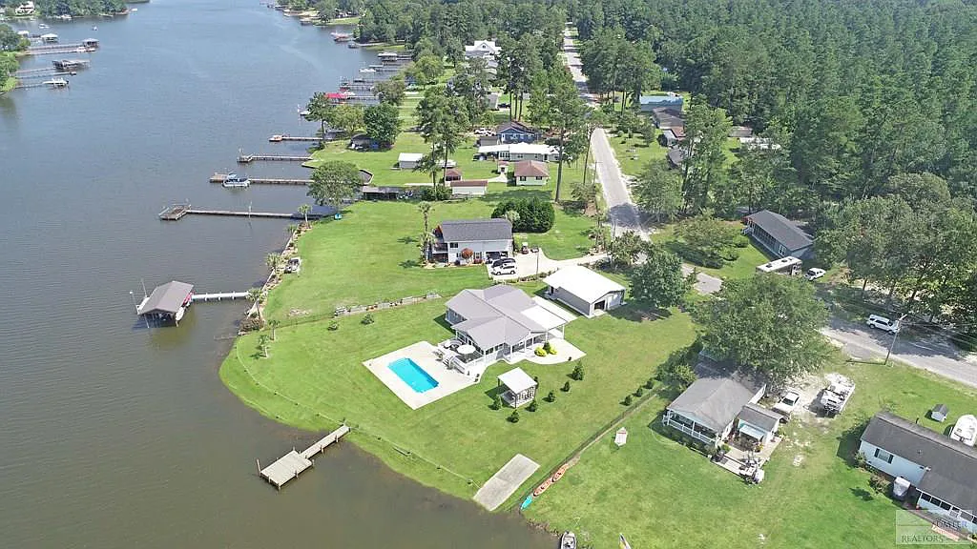
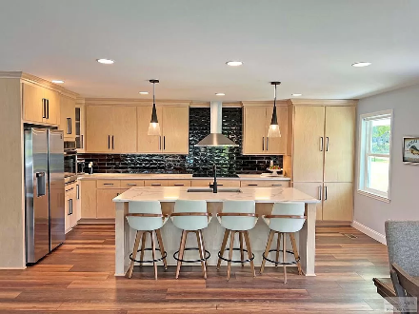
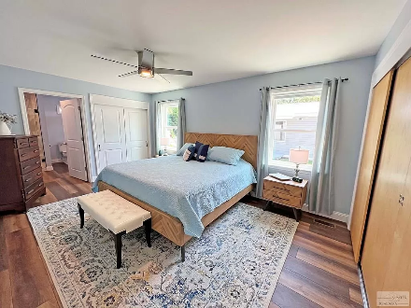
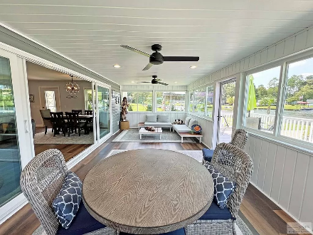
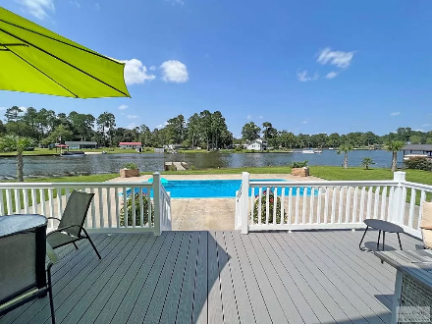

Move In Ready
With Boat Ramp
1383 Hobbs Dr
Summerton, SC 29148 ~ MLS# 157745 ~ $830,000
This Waterfront on Lake Marion is your own oasis away from the urban stress. Whether you enjoy sitting on the newly built dock, the pool side or the sun deck you will find your peace here. The inground pool sits overlooking the lake. Cooking your favorite meal or watching the newest show on tv you will be able to see the lake through the oversized glass doors/windows. The home was remodeled in 2022 with all new flooring, kitchen, baths, living spaces and roof. The floor plan was opened up to maximize the view. Features like a new septic/drain field, in line water heater and HVAC were added also. Not to mention the garage to house the lake toys and fully fenced in yard & boat ramp. This is truly the MOVE IN READY home for you, Just bring the suitcase and the boat. City water.
Lake Homes Realty, LLC
Elloree, SC 29047
www.SCLakeLife.com
Kristie Anderson
(803) 387-9459
kristie@sclakelife.com

