Slide 1
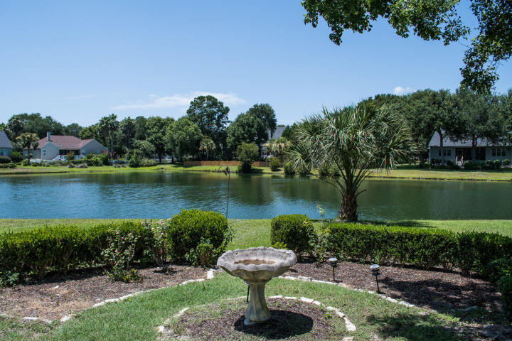
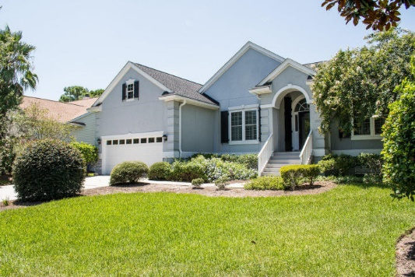
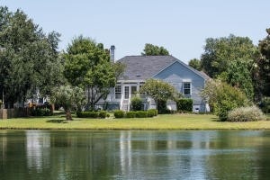
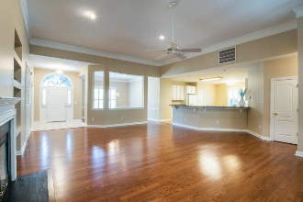
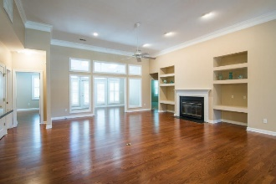
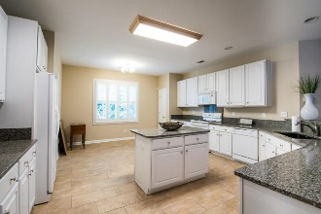
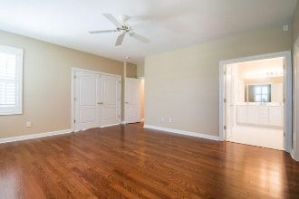
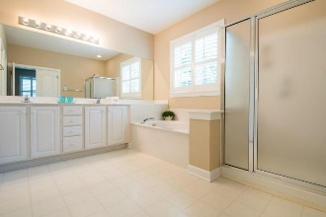


1384 Southern Magnolia Lane Seaside Farms | Mount Pleasant | MLS# 16020448 | $599,000
Fabulous Home On Water
In Seaside Farms!
Fabulous home located on the water in highly desired Seaside Farms. Short walk to the neighborhood pool and playground. Spacious open floor plan with lots of natural light. 12ft ceilings in main living area. Huge eat-in kitchen with bar and island. Sunroom for your morning coffee:) Separate Dining. Office/Study. New roof, new wood flooring, entire interior freshly painted including walls, trim and ceilings. FP in great room. 2-car garage. Extra built in storage platform above garage.
Barbara Walker
REALTOR
Office - (843) 886-8110
Mobile - (843) 906-5404
bwalker@carolinaone.com
www.barbarawalkerrealtor.com
Carolina One Real Estate
1503 Palm Blvd
Isle of Palms, SC 29451-2280

