Slide 1

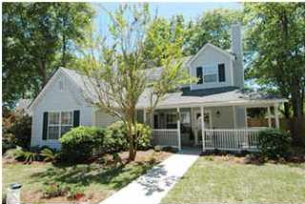
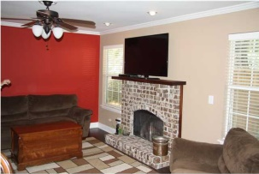
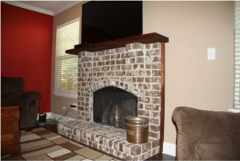
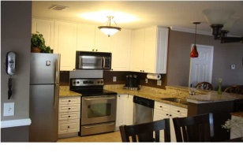
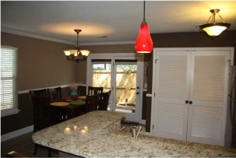
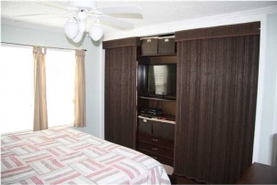
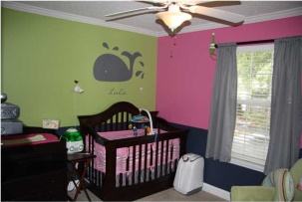
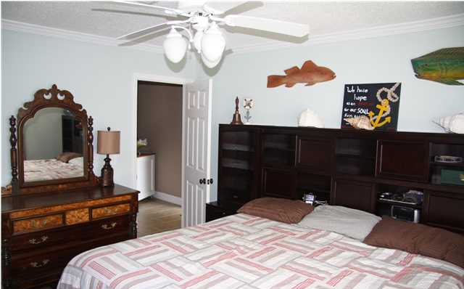
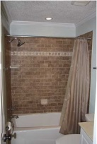
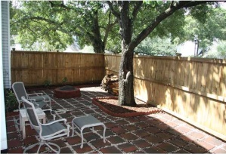
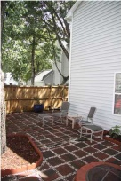
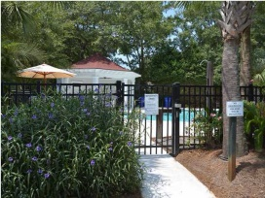
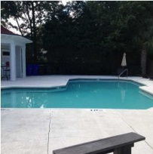
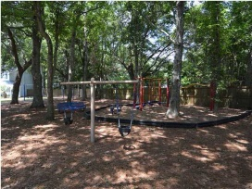
$500 Agent Bonus with ratified contract by 10/01/14
CHARLESTON'S PREMIERE BOUTIQUE REAL ESTATE FIRM
1387-A Cassidy St
Remington Forest
Mount Pleasant
Listing Price: $279,500
MLS# 1424165
3 Bedroom / 2 Bath
1,314 Square Feet
Carpets and tiles have recently been professionally cleaned and home is in pristine condition!
Location, location, location! This property is conveniently located only 4 minute's away from Sullivan's Island beaches and 1-526 and directly across the street from great dining and shopping. Also conveniently located to Coleman Boulevard and 15 minutes to downtown Charleston. This unit has been meticulously cared for by their owners. Recent upgrades include Master Bedroom customized built in closet and entertainment center to maximize the usage of space in the Master Suite. The owners have also recently upgraded the fireplace to a gorgeous brick fireplace hearth and solid wood mantel. The private fenced in backyard/patio is great for outdoor entertaining. This home has custom paint throughout. The Master suite is located on the first level/ground floor. The kitchen is fully equipped with granite countertops and stainless steel appliances. Exterior features gorgeous landscaping and paving and sidewalks. Inside you will find tiled entry and kitchen/dining areas with crown molding, ceiling fans in every room, tiled bathrooms, wood burning brick fireplace wood blinds in windows and more. Remington Forest has a neighborhood pool, playground/dog park, and dog stations throughout. Basic cable and pest control is included in the HOA dues. This is a property that you will not want to miss!
Mandy Harrison
mandy@corealtysc.com
843-323-1521
www.corealtysc.com

