Slide 1
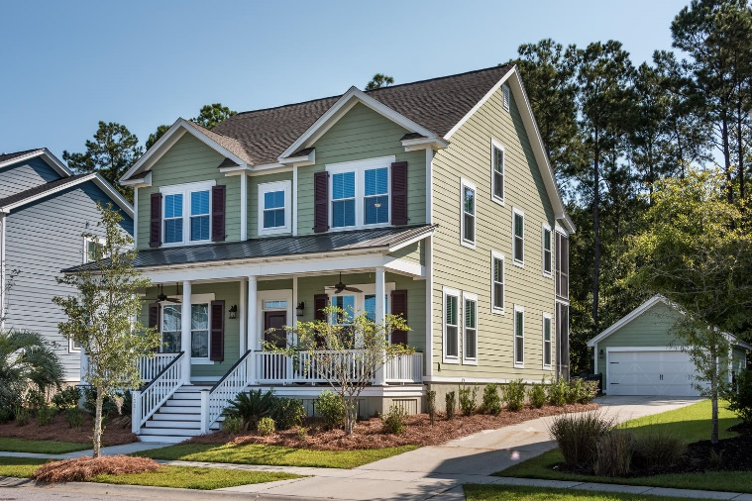
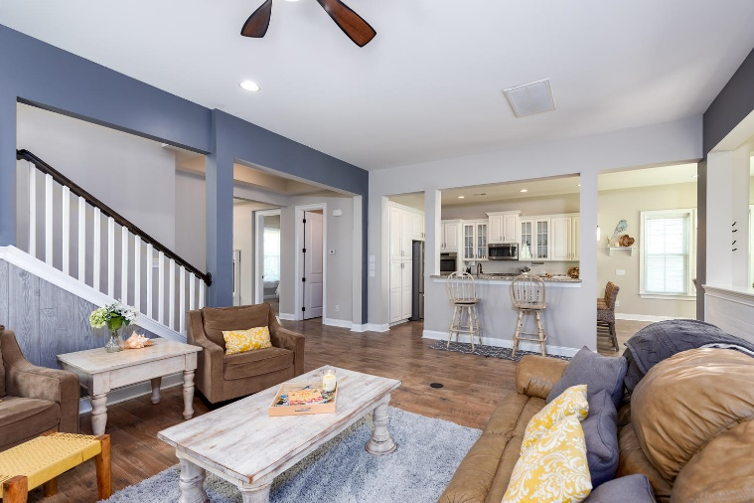
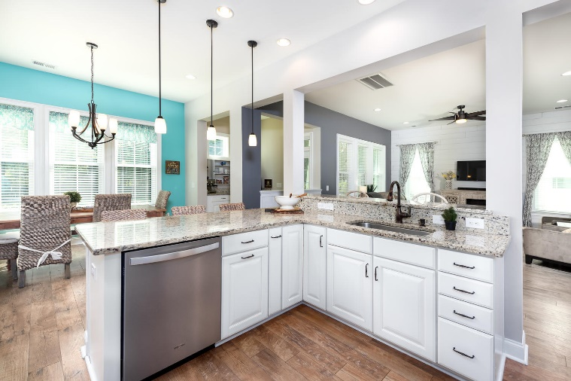
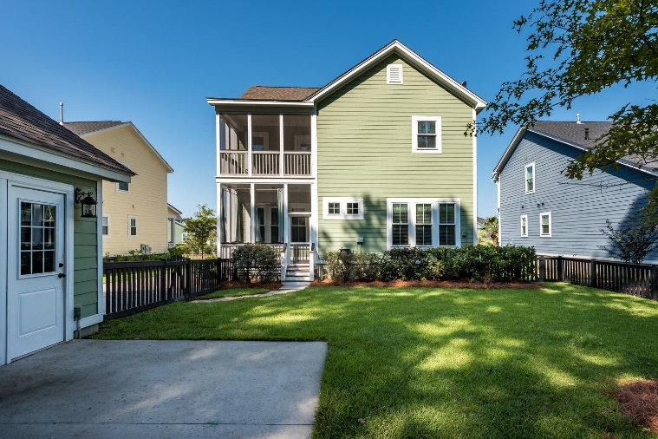


Open House Friday November 16th ~ 12-3 Serving Fresh Lemonade and Cookies Bring the children to play in the spacious backyard
1387 Crane Creek Dr
Carolina Park ~ Mount Pleasant
MLS# 18026594 ~ $565,000
Come Feel the Luxury of Spacious Family Living with 3,365 square feet of "spread out" room!!
Better than new, move right in! Fabulous, true 5-bedroom home perfectly located within an easy stroll to the new Charles Pinckney Elementary School and neighborhood amenities.
Premium fenced-in wooded lot. Many upgrades make this home very desirable. Open floor plan downstairs includes dining area, family room, guest bedroom, full bath and office.
Second floor has master with walk-in closet, two bedrooms, a loft and two bathrooms. Third floor bedroom could also be media room.
Relax in private on the rear screened-in porches overlooking the woods.
Detached, 2-car garage and long driveway allow for abundant parking.
Sarah Graham
(843) 693-0620 | sarahrgraham@kw.com
www.sarahrgrahamcharlestonhomes.com
Keller Williams Realty Charleston | 496 Bramson Ct Ste 200 | Mt. Pleasant, SC 29464

