Slide 1
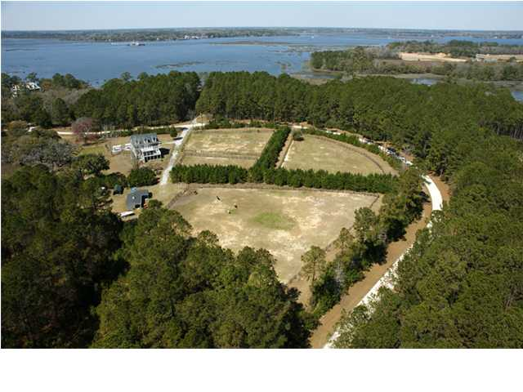
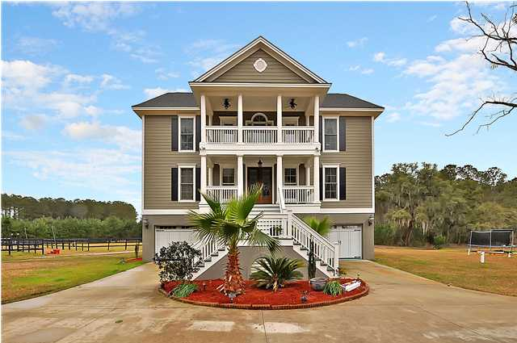
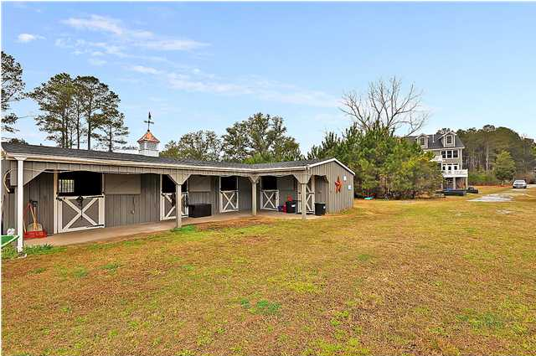
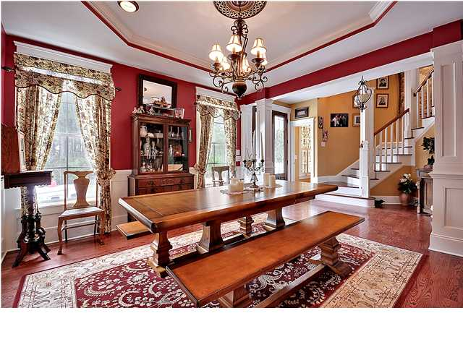
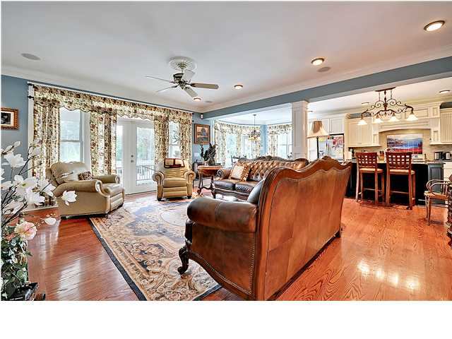
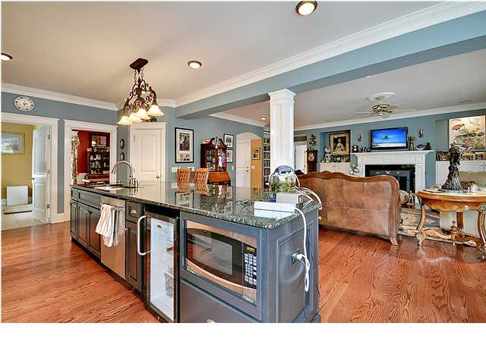
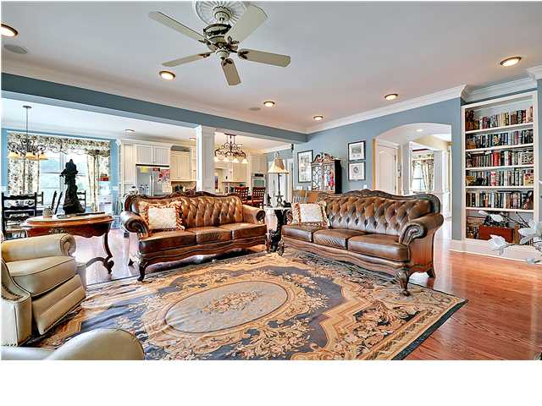
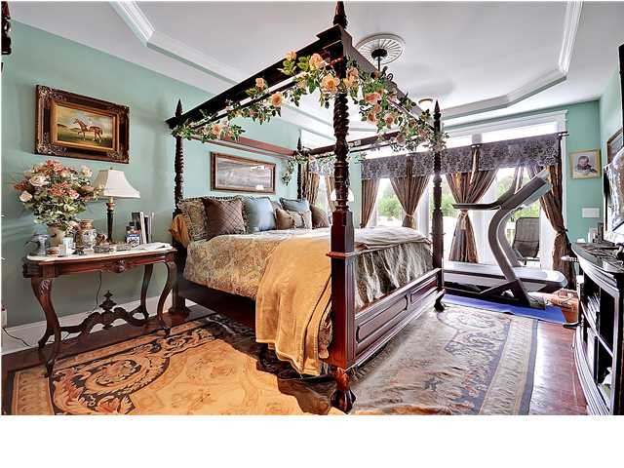
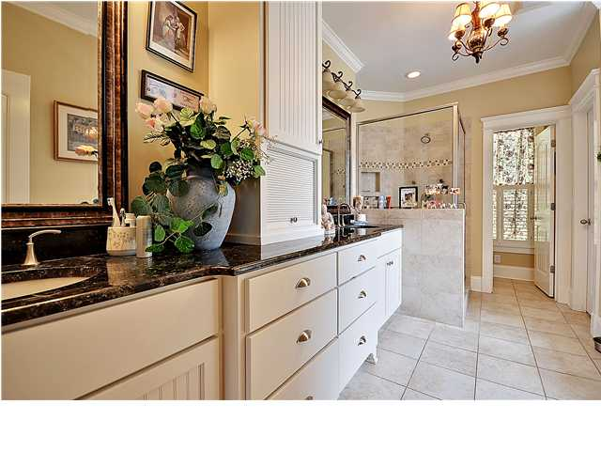
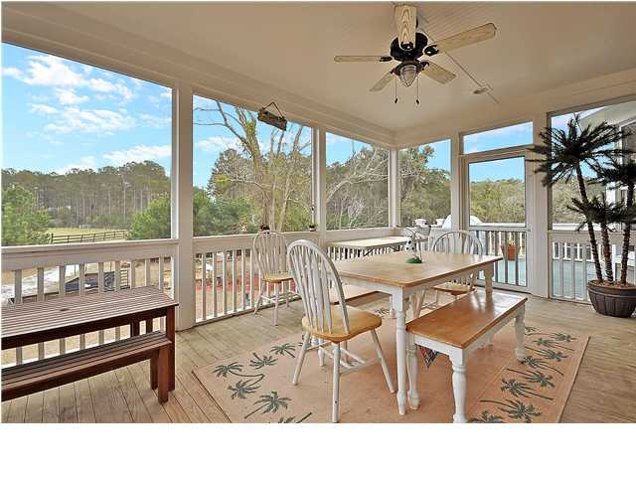
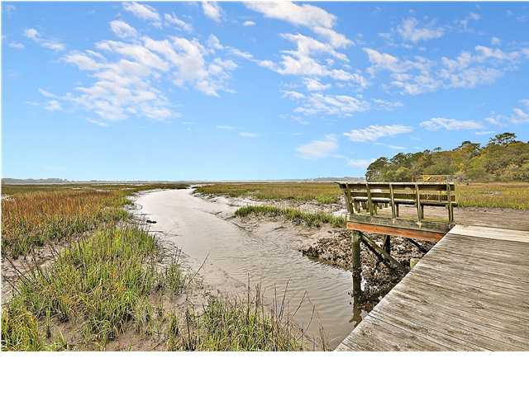

Price Reduced!
Lowcountry Horse Farm
1389 Polly Point Rd ~ Wadmalaw Island ~ MLS# 1306814 ~ $899,000
HORSE FARM IN CHARLESTON with spectacular 2009-BUILT MANSION!!! Welcome to Polly Point, a stunning gated community situated on a tidal marsh in beautiful Wadmalaw Island. This community is quiet, peaceful, horse-friendly, comes equipped with horse trails, and has a shared dock and floater for crabbing, fishing, or quick access to Wadmalaw Sound. You’ll be at peace in this secluded location while knowing you are only 25 minutes from downtown Charleston and 20 minutes from the beautiful beaches of Seabrook and Kiawha. Imagine sitting on your porch looking out over your beautiful land, tall trees and 100 year old oaks circling your property, gazing down at the horses in your very own back yard. The horses you own or board will be living the dream life with nearly four acres of fenced-in pastures equipped with direct water access, a lighted riding arena, and a roomy four-stall Amish barn with a tact room, matted stalls, and individual cross ties. The elevated home has two garages that can hold up to four cars. Once you step inside the first level of this magnificent home, you’ll find stunning hardwood floors throughout, a lovely formal dining room with wainscoting, a large and very well equipped kitchen, a comfortable and bright great room with a fireplace and attached screened-in porch, and the first level master bedroom. The kitchen comes complete with granite counters, stainless steel appliances, custom cabinets, a gas GE Monogram stove, and a triple sink. The roomy first floor master suite opens to an outdoor porch with great views, his and her walk-in closets, and a master bath with granite counters, a large tiled shower, and a jetted garden tub to relax after a day of horseback riding. Ascend to the second floor where you’ll find a large media room or office space and four spacious bedrooms with 2 full bathrooms. On the third floor you will find a huge bonus room that takes up the entire third floor. Use your imagination for this tremendous space…your options are unlimited! This home boasts recessed lighting and amazing light fixtures, an elevator shaft, crown molding, ceiling fans, spacious closets, surround sound on each floor, and a great water filtration system. If you have a passion for horses, a love of nature, a desire to be slightly off the beaten path, yet accustom to modern amenities and close to all Charleston has to offer, you need look no further. Welcome home to Polly Point!
Call or email for details: (843) 654-7777 or Matt@MattOneillTeam.com

