Slide 1
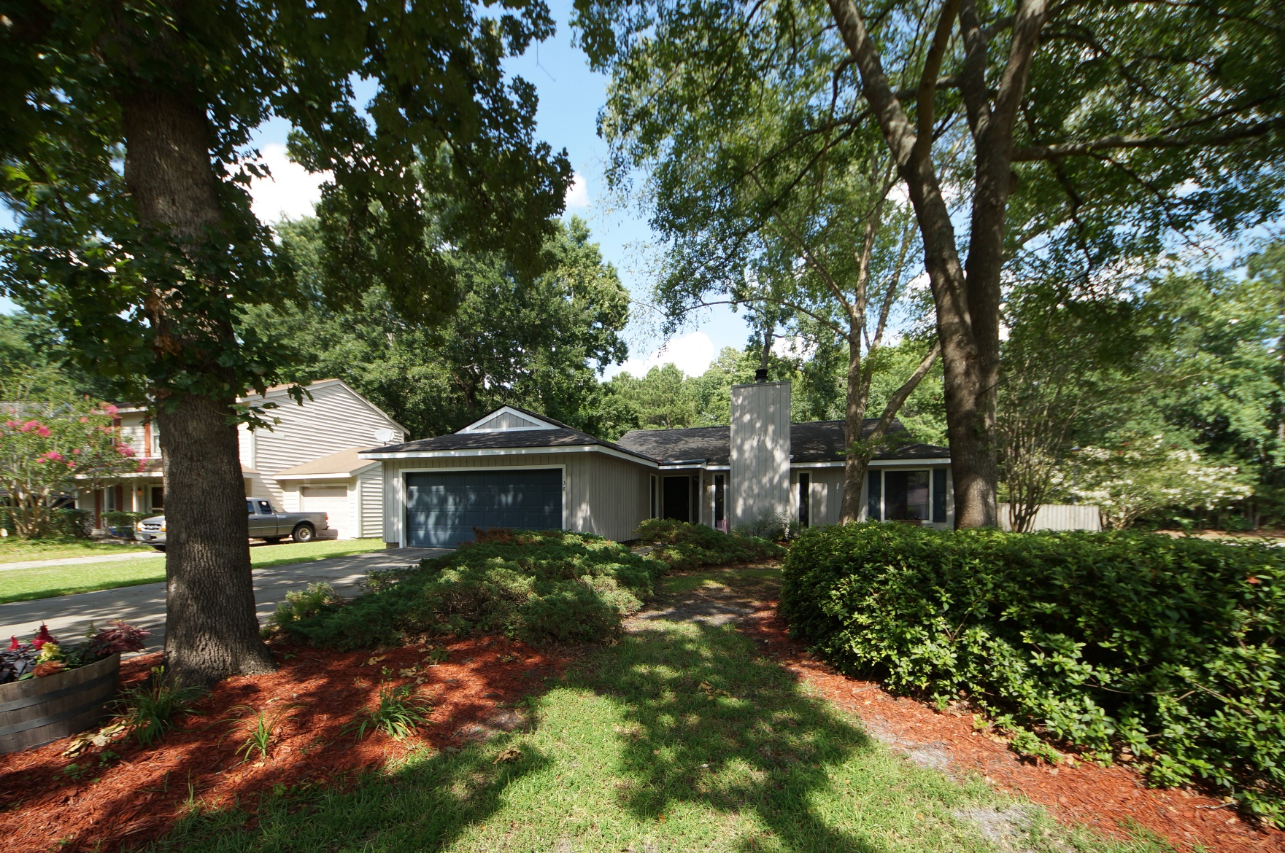
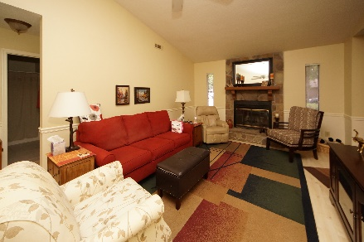
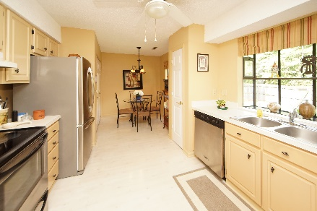
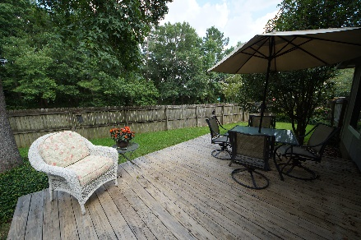


138 Bridgecreek Drive
Crowfield Plantation :: Goose Creek, SC 29445
MLS# 18018411 :: $185,000
3 Bed / 2 Bath
Back On The Market at $180,000
Just Reduced!
$210,000
Charming 3 bedroom 2 bath home in desirable Crowfield Plantation. Sellers have this home looking clean and crisp for the new owner.
New paint, laminate flooring, and a spacious kitchen with stainless appliances make this home a must see and must own. Enjoy your back yard sitting on the deck on this private but spacious corner lot.
Connie White, Broker
843-532-3356
conniesyouragent@gmail.com
Charleston Homes · 597 Old Mt. Holly Road · Suite 301 · Goose Creek, SC 29445

