Slide 1
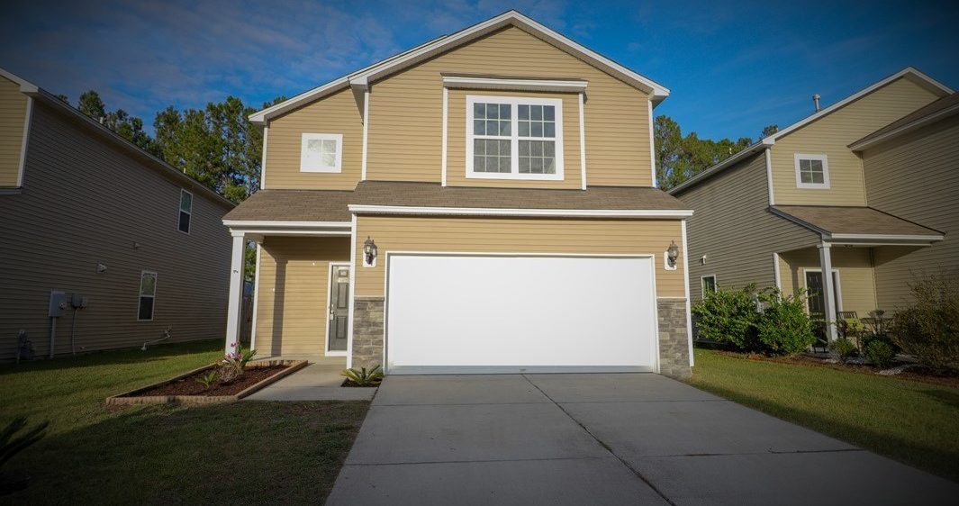
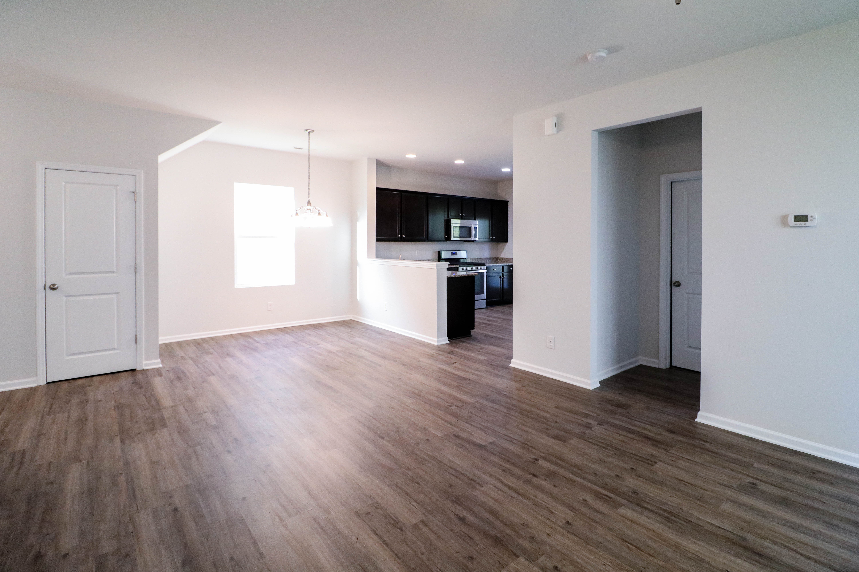
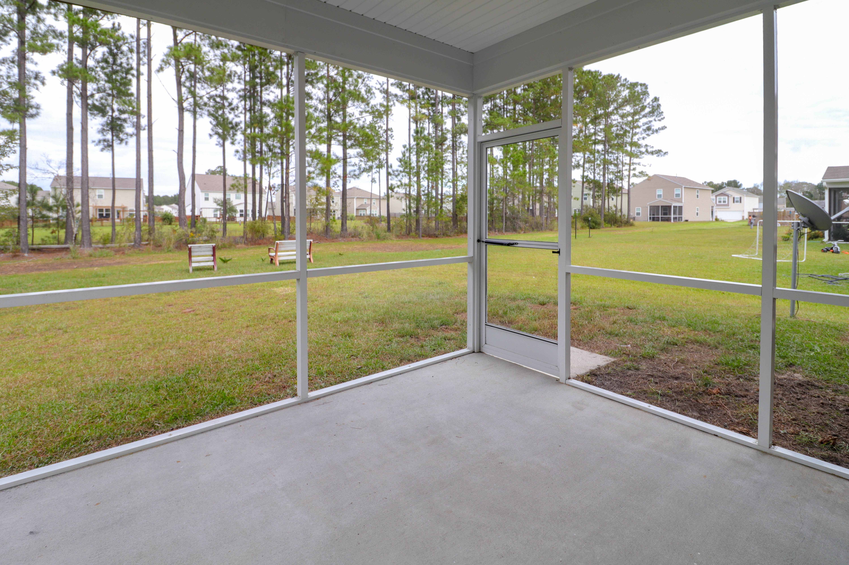



$249,900
JUST LISTed!
4 Bedroom 2.5 Bathroom w/ LOFT ON POND LOT
138 Brookhaven Rd., Summerville, SC 29486
Beautiful home in the highly desired community of Cane Bay Plantation. The living room is ample in size with corner fireplace. Open Kitchen with eat in area, stainless appliances and granite countertops. Guest bedroom downstairs is the 4th bedroom. Upstairs you will find a huge master bedroom with en-suite bath, complete with dual vanities. The loft and second & third bedrooms are also located upstairs. The backyard, which backs up to a pond, is open and airy!
Fresh Paint, New carpet and New LVP flooring
Downstairs guest room
Large kitchen w/ granite countertops and stainless appliances
Amenities include Neighborhood Pool, Play Park and Walk/Jog Trails
54,000 square foot YMCA located in neighborhood
Celena Thornton
REALTOR®- Broker Associate
Cell 843-408-8977
Celena@CarolinaGirlsRealty.com
www.CarolinaGirlsRealty.com
Laurie Johnson
Mortgage Loan Originator
NMLS# 1837491
843.708.4440
Laurie.Johnson@htlenders.com
www.ljhomeloans.com

