Slide 1
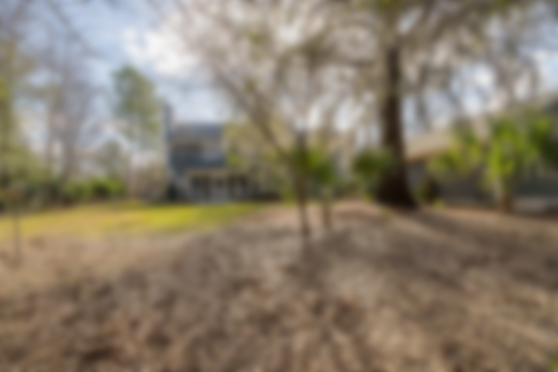
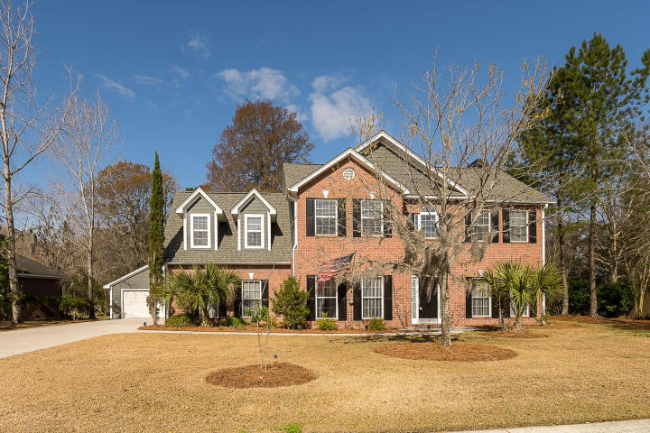
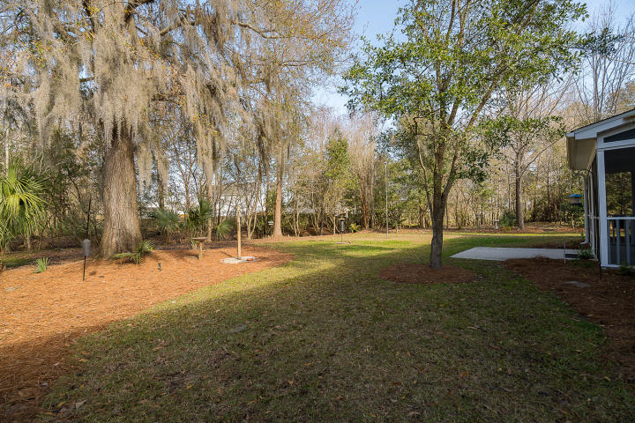
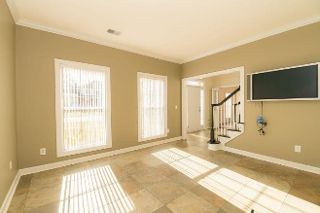
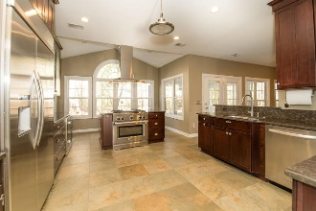
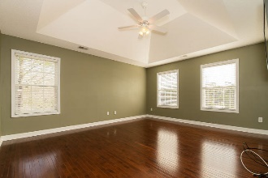
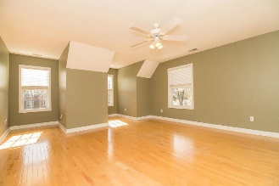
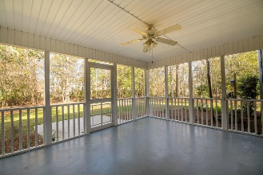


MOVE IN READY!
138 Shadowmoss Parkway
Shadowmoss • Charleston, SC 29414 • MLS# 20006664 • $525,000
As you enter this home you will be greeted with an impressive foyer. There are many upgrades and updated features to this home. The gourmet kitchen was updated in 2012 with custom soft close cabinets and drawers, Silestone countertops, counter-depth 48-inch wide refrigerator, cooking/eat-around island with gas stove and grill and electric oven, custom large pantry, quiet dishwasher, double stainless steel sinks. All bathrooms were updated in 2019. The king sized owners suite includes bath with separate shower and soaker tub and huge walk in closet. In addition to the Owner suite there are 2 additional bedrooms plus a large attached FROG with plenty of space for Gym, playroom, bedroom etc. Some additional great features are the whole house generator powered by natural gas with auto-on feature if power outage occurs; and additional exterior garage that can park up to 4 cars and slat wall system and peg board also has pull down attic stairs for additional storage; Lennox HVAC System with gas furnace and electric AC with variable speed blower installed in 2014; new architectural shingle roof installed in 2014; exterior cement plank siding painted in 2019; Lawn irrigation system with separate water water meter; driveway and sidewalk include stone-look inlays; mature landscaping with outdoor up lighting features. Large Natural lush landscaped backyard adds privacy and shade, great for entertaining and outdoor play area. Large screened in porch with new Screen Tite system. Neighborhood has many amenities including Golf club and neighborhood pool *The information herein is furnished to the best of the Listing Agent's knowledge. All information herewith is subject to verification by the purchaser and their agent. Listing Agent assumes no responsibility for correctness thereof, nor warrant the accuracy of the information or the condition of the property. If square footage is important - measure! Buyer to verify schools and any and all information deemed important.*
Christina Garvin
(843) 270-7667 | cgarvin63@gmail.com
Elaine Brabham and Associates, LLC • 1890 Sam Rittenberg Boulevard, Suite 217 • Charleston, SC 29407

