Slide 1
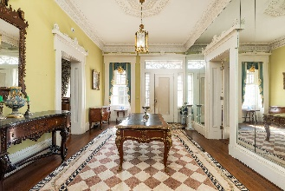
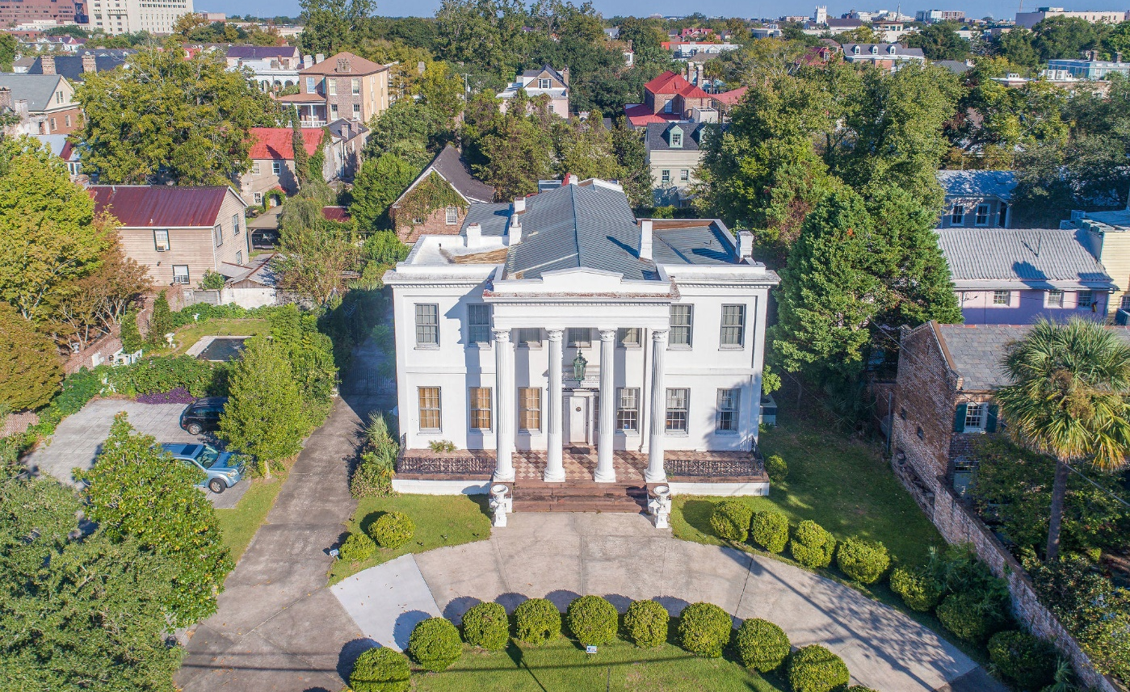
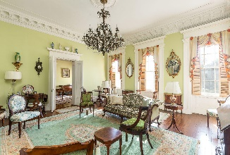

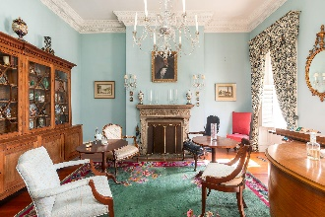
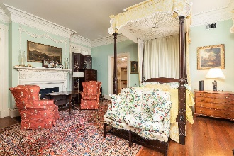

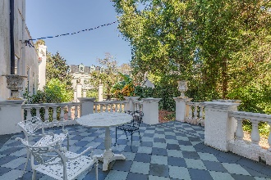
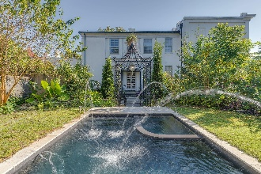
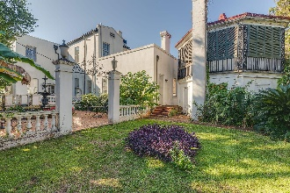
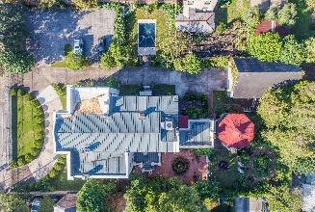

Magnificent Home with Pool Spa
138 & 140 Wentworth Street
Harleston Village · Charleston · MLS# 20028510 · $4,490,000
A unique opportunity to purchase a piece of storied history. The Kerrison House, later known as Villa De La Fontaine, was built circa 1840 and restored in the 1970s. New England architect Russell Warren, a relative of Nathaniel Russel, designed the home and rear bathhouse. The grand residence sits back from the street and welcomes you with a semicircular driveway and front facing portico supported by columns with Temple of the Winds capitals. A descendant of the original merchant-owner, Miss Marguerite Kerrsion left the estate to the Episcopal Church of South Carolina who maintained the home as the diocesan office until 1971. Sold in a private bid to respected designers Fontaine & Hancock, the property once again became a private residence. The new owners meticulously renovated the home, roof, gardens, and driveway. Famed Charleston ironsmith Philip Simmons was commissioned to create the ornate gate and fence situated along the front property line. One of the largest pieces of land in Harleston Village, this estate includes over 6,400 square feet of living space, an attached kitchen house, converted bath house apartment, two story garage, and old world style gardens. Detailed plaster moulding , original hardwood flooring, and Greek Revival details grace the home throughout. Stunning chandeliers fill the home, and include a mixture of blown and cut glass, tin, iron and Italianate triple tiered placements. The impressive home includes a grand foyer, music room, library, formal living room, dining room, breakfast room, elegant spiral staircase, landings, a butler's pantry, kitchen, numerous bedrooms, and private balconies. The property is fully enclosed, providing security and privacy. The front of the estate can be accessed by an electric swinging gate or the coded pedestrian gate. Historical and contemporary walls surround the perimeter of the home, saltwater spa pool, and additional outbuildings. The name Villa De La Fontaine was given to this stunning residence when it was admitted to the Tourist House Association of America in 1978. Esteemed guests such as the Guggenheim family, dignitaries, and civic groups frequented the Villa during the last 45 years of its residency.
Bryan Thompson
(843) 452-1686
bryan.thompson@agentownedrealty.com
Greg Gelber
(843) 494-2354
greg.gelber@agentownedrealty.com
AgentOwned Charleston Group | 902 Savannah Hwy | Charleston, SC 29407-7802

