Slide 1
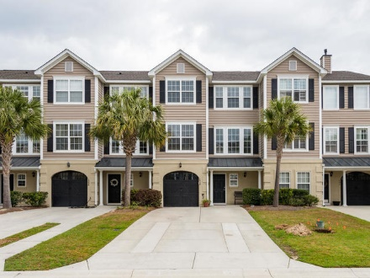
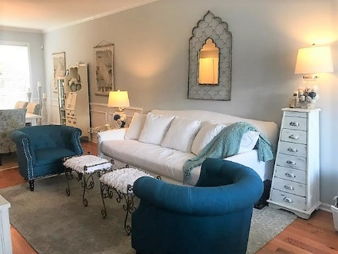
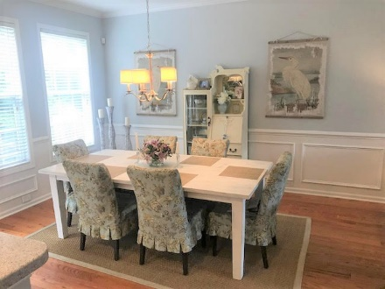
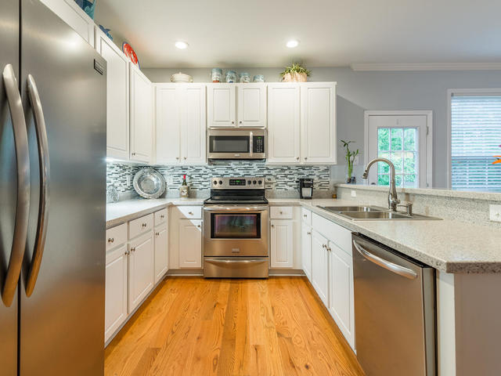


Hamlin Park Beauty
1390 Hamlin Park Circle
4 Bedroom/3 Bath Townhome
Lots of Upgrades
Backs up to Wooded Area and Pond
Offered at $500k
Unit is currently rented until mid-December so owner does not currently have plans to list on the MLS.
Angela Armstrong
843-224-2595
angela.armstrong2010@gmail.com
www.oysterpointgroup.com
Oyster Point Real Estate Group, LLC
4 Legare Street
Charleston, SC 29401

