Slide 1
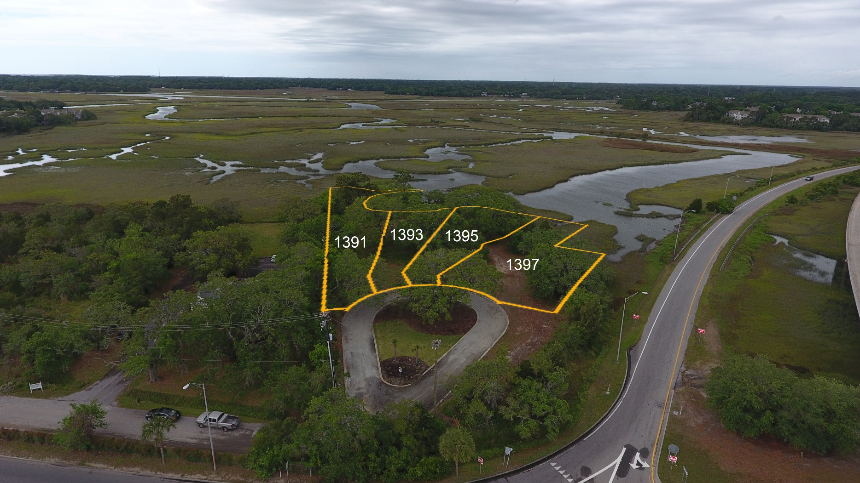
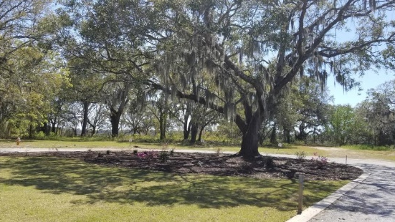
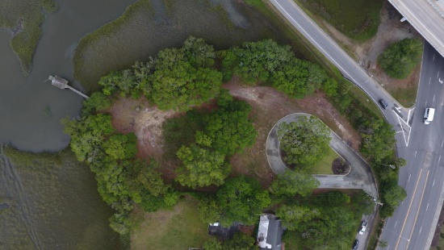
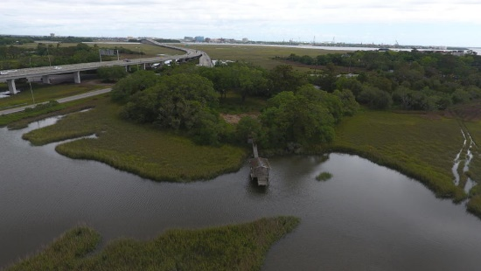

Three Lots to Choose From!
1391 Harbor View Rd
Charleston, SC 29412
MLS# 19009884
$299,900
.31 acres high
.41 acres marsh
For Proposed Construction
see MLS 19015159
1395 Harbor View Rd
Charleston, SC 29412
MLS# 19009891
$299,900
.236 acres high
.256 acres marsh
For Proposed Construction
see MLS 19015158
1397 Harbor View Rd
Charleston, SC 29412
MLS# 19009896
$289,900
.276 acres high
.276 acres marsh
For Proposed Construction
see MLS 19015153
Located on Guy Creek with easy access to downtown , this beautiful secluded marsh front lot is conveniently located to dining, shopping and all the popular activities that Charleston has to offer. Surrounded by tremendous live oaks, this lot offers astonishing views of Charleston at its best. Complete with a dock permit, your dream home awaits!
Heather Spraker
843-475-2624
heather@armadarealestate.org
Kim Adinolfi
843-452-9923
kim.adinolfi@yahoo.com
Armada Realty Group 7301 Rivers Ave. Ste 182
N Charleston, SC 29406

