Slide 1
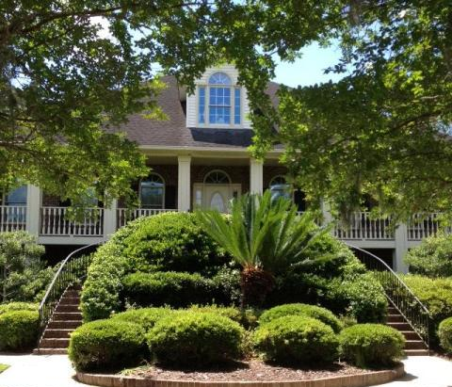
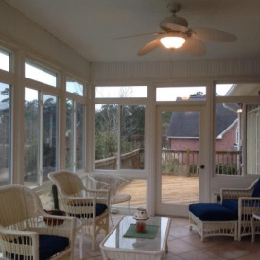
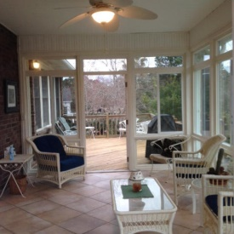
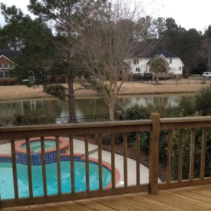
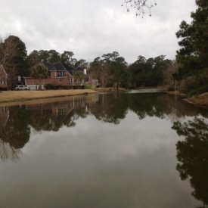
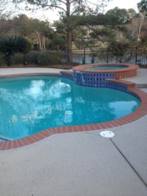
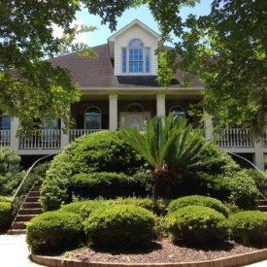
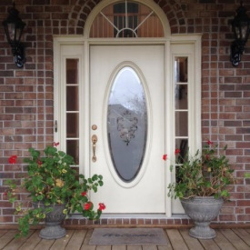
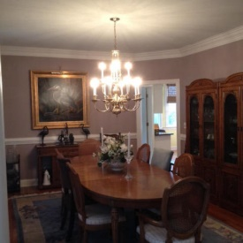
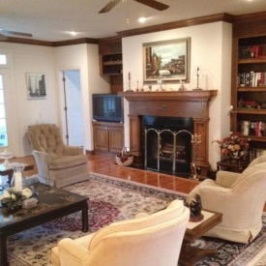
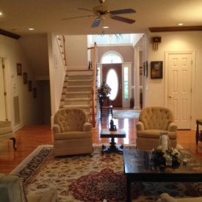
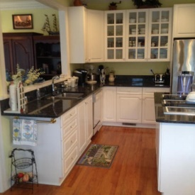
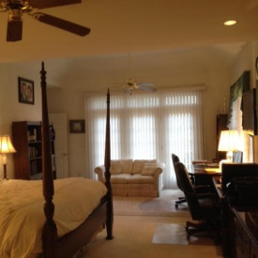


1395 Madison Court Brickyard Plantation Mount Pleasant, SC 29466 MLS# 15004997 $689,000
$5,000.00 Agent Bonus If Close By July 31st
Beautiful Executive home on large corner lot in sought after Madison Court within Old Brickyard in Brickyard Plantation. Over 3600 square feet. Amazing pond views, very private. Quiet street. You must see this wonderful home, very desirable, it won't last long! You will love the floor plan! Stunning entrance foyer. Family room with fireplace and oak book shelves. The view from the sun room is remarkable with decks on either side. 4 Bedrooms with Master on main floor. Large master with sitting room, walk in closet and wonderful master bath, open shower and dressing table. 3 Private large bedrooms up stairs. Storage closets everywhere, you won't believe. Very large 3+ car garage with workshop. Beautiful pool with SPA for you to enjoy. Nothing has been spared for you in this home! Come see! Stainless and granite kitchen with large Profile refrigerator, double wall ovens, eat in kitchen, great for entertaining, 2 hot water heaters, 2100 SF garage, 2 newer HVAC, newer Whirlpool steam washer and dryer, extra freezer, pool heater, surge protection, hardwoods, oak crown molding and bookshelves, instant hot water, Jenn-air stove top grill, microwave, 2 very exclusive brass chandeliers, 9 ceiling fans, 2 story foyer, 2 whirlpool tubs, vaulted ceilings, Sitting room off kitchen, 4 attics for storage (yes 4), Large walk-in closets and storage in all bedrooms, 9 foot ceilings, dual automatic outdoor lights, Large pond. Come see you will be amazed at your new home! We promise!
Frank S Collins
EPRO, REALTOR
(843) 327-3292
frankscollins@gmail.com
www.carolinareal.com

