Slide 1
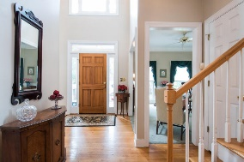
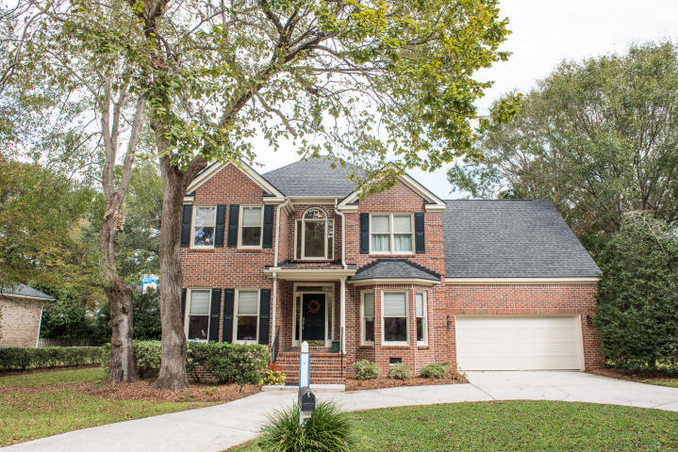
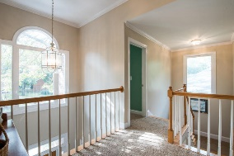
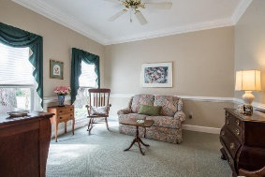
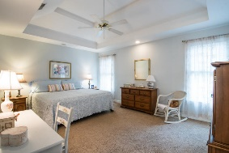
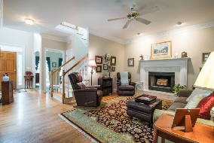
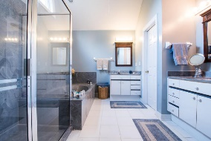
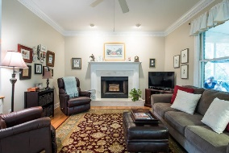
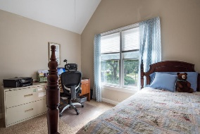
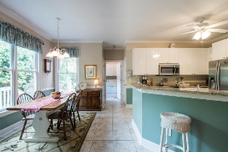
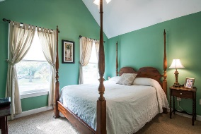
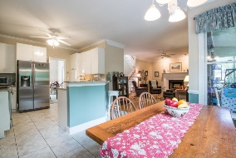
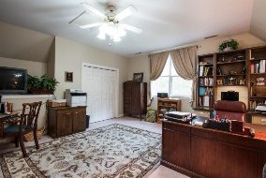
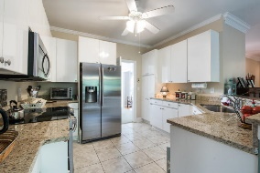
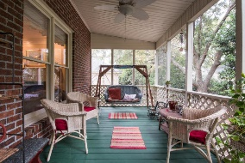
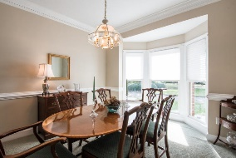
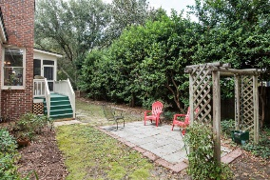


1397 Hidden Lakes Drive
Mount Pleasant · Hidden Lakes
MLS# 16028428 · $498,800
Major Price Reduction in Hidden Lakes
$$ MAJOR REDUCED PRICE $$ BEST VALUE FOR TRULY A RARE FIND IN AREA 42 AND HIDDEN LAKES NEIGHBORHOOD. All BRICK CUSTOM HOME/ REFINISHED OAK FLOORING/UPGRADED KITCHEN / NEW GRANITE COUNTER TOPS/ STAINLESS APPLIANCES/ NEW CARPET IN STUDY AND SEPARATE DINING ROOM/ OPEN BREAKFAST ROOM / DOWNSTAIRS LAUNDRY/ LARGE SCREEN PORCH/BACK DECK/PRIVATE FENCED BACKYARD/ OVERSIZED DOUBLE GARAGE/ LARGE FAMILY ROOM WITH CEILING FAN AND WOOD BURNING FIREPLACE/ MASTER SUITE BOAST OF TRAY CEILING/ MASTER BATH HAS LARGE WALK-IN CLOSET, VAULTED CEILING CULTURED MARBLE OVERSIZED SHOWER AND SEPARATE JETTED TUB ALONG WITH HIS AND HER VANITIES. TWO OTHER NICE SIZED BEDROOMS WHICH SHARE A FULL HALL BATH AND A LARGE FINISHED ROOM OVER THE GARAGE WITH CLOSET WHICH CAN SERVE AS A 4TH BEDROOM/GAME ROOM/HOME OFFICE.
Fenced rear yard with full hedge row provides lots of privacy. Lawn Irrigation system is fed from from lake system. Home has been well cared for and nicely maintained. Roof was replaced in 2015 with upgraded Architectural Shingles. Home has split HVAC systems which has had one system replaced 1 year ago and the other 5 years ago. Utilities are provides by Berkeley Electric and participates in Home Energy Saver Program. Average Utilities bills have been $268 per month for past year.. Kitchen has been up graded with Granite counter tops and stainless appliances. Hidden Lakes has a neighborhood pool and tennis facility and clubhouse. There is a community lake system, boat landing and boat storage facility for homeowners.
This property does not require flood insurance. This community is one of the top sought after communities in Mt Pleasant for location and amenities.
$550,000
Tommy Lovett
Tommy - (843) 442-1276
tlovett@carolinaone.com
www.tommylovettrealestate.com
Carolina One Real Estate
628 Long Point Rd.
Mt Pleasant, SC 29464-3032

