Slide 1
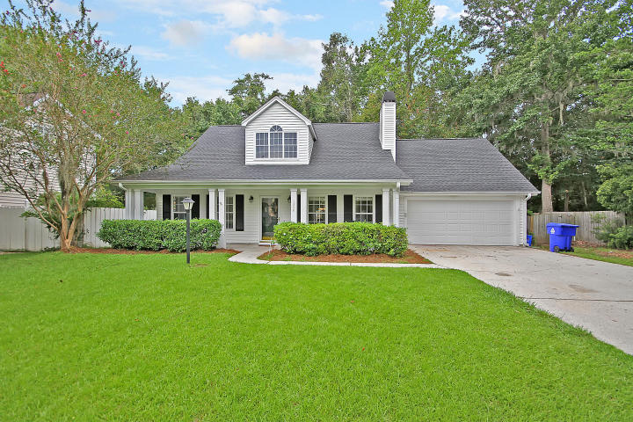
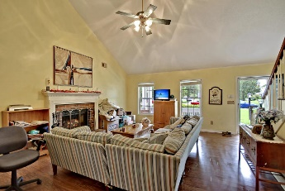
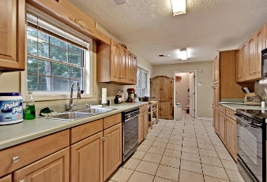
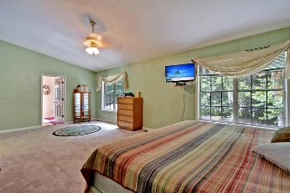
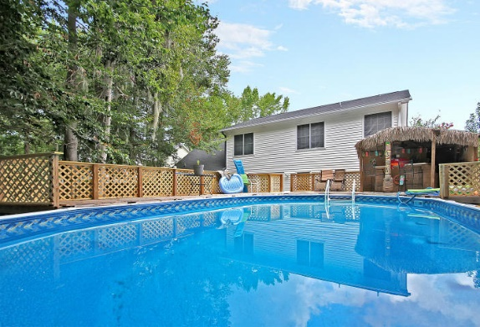
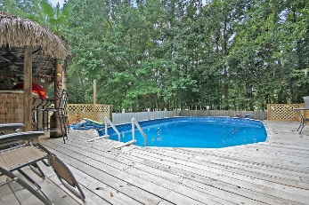
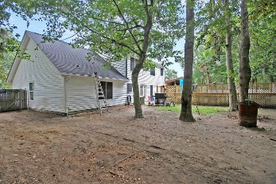


Talk About Location And No HOA!
1399 Emerald Forest Parkway
Forest Lakes Extension
Charleston, SC 29414
MLS# 17022988
$279,900
Come and explore this beautiful home at 1399 Emerald Forest Parkway! This home features new carpet, new roof in 2014, new HVAC system in 2015 (Hospital Grade Electric Air Filter), and tasteful wood look laminate flooring in the living room and dining room! Bring your swim suits as the newer above ground pool is ready for you! It has decking around it and also features a tiki bar! The home has recently been pressure washed and some of the home has been freshly painted. The seller recently had the home appraised and had the home inspected to provide peace of mind for the buyer. Age, sqft, taxes, acreage, HOA dues, and schools are approximate buyer to verify any and all information deemed necessary.
Mason Thurber
(843) 709-5109 – C (843) 576-2699 – O
mason@theeverettgroup.net
RE/MAX Pro Realty, 9209 University Blvd, Charleston, SC 29406

