Slide 1
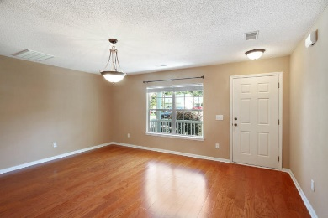
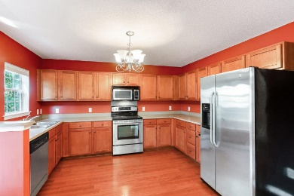
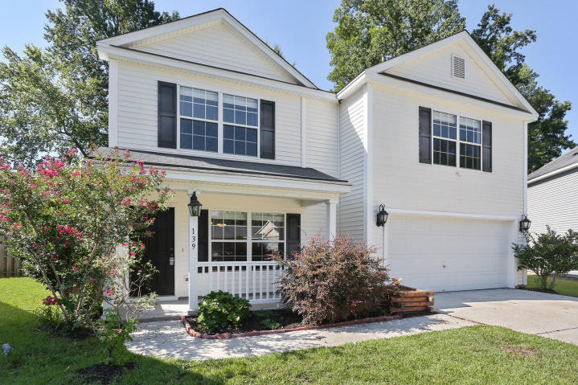
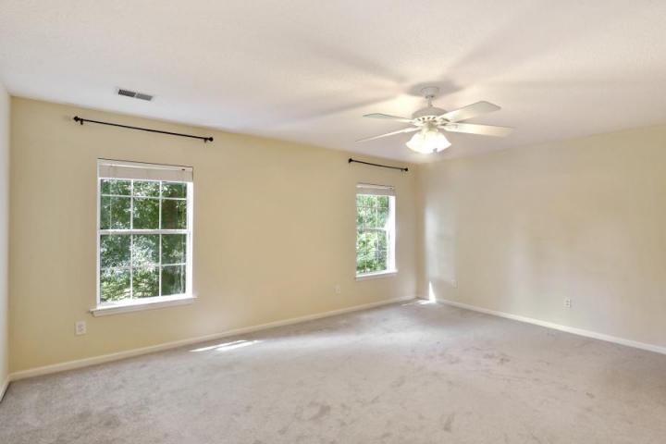
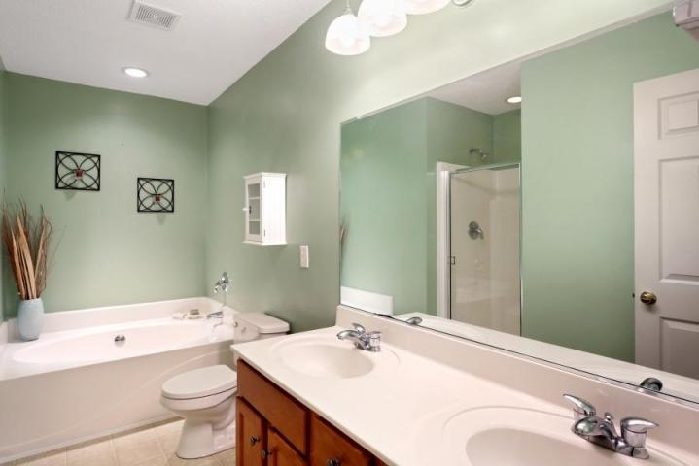
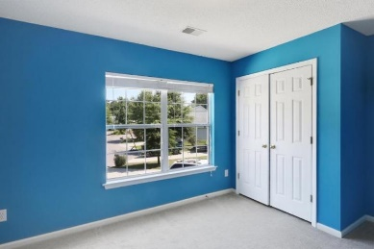
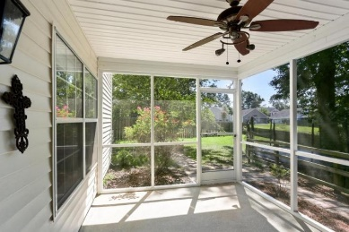
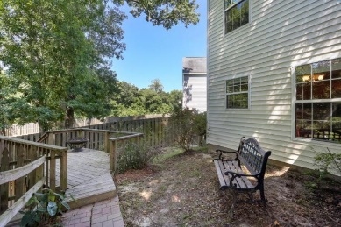
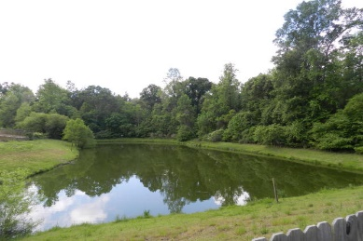

Gorgeous 0.21 acre cul de sac lot with pond views
139 Hammerbeck Road
Brookwood – Summerville – MLS# 16012033
Just Reduced to $214,900
Two Story floor plan features 2.5 bathrooms with 4 bedrooms. Fourth bedroom is perfect for home office, media/game space option. Open floor plan with natural light. Large kitchen with stainless- steel appliances, counters-tops and a breakfast area with plenty room to have your favorite meals. New hardwood floors. The screened in back porch is secluded & relaxing. Perfect place for morning coffee. Master Suite is on the second level. Master bath has a shower, garden tub , double vanities, walk-in closet that makes this a true oasis. The family room/ dining area with large windows allows great views of the amazing & private fenced backyard. If you have dogs, the backyard is the perfect setup for them. Seller is in the process of adding new sod to the backyard lawn and plant houseplants. Double car garage. Neighborhood has a low HOA fee and provides walking trails and a park. *****Seller may consider paying some of the Buyer's closing cost with a reasonable offer ***** We can't wait for you to see 139 Hammerbeck Road. Call your Realtor to reserve your showing appointment.
Aviles Real Estate Brokerage
Susan Aviles
843-697-2383
Gil Aviles
843-697-5535
www.Aviles-RealEstate.com

