Slide 1
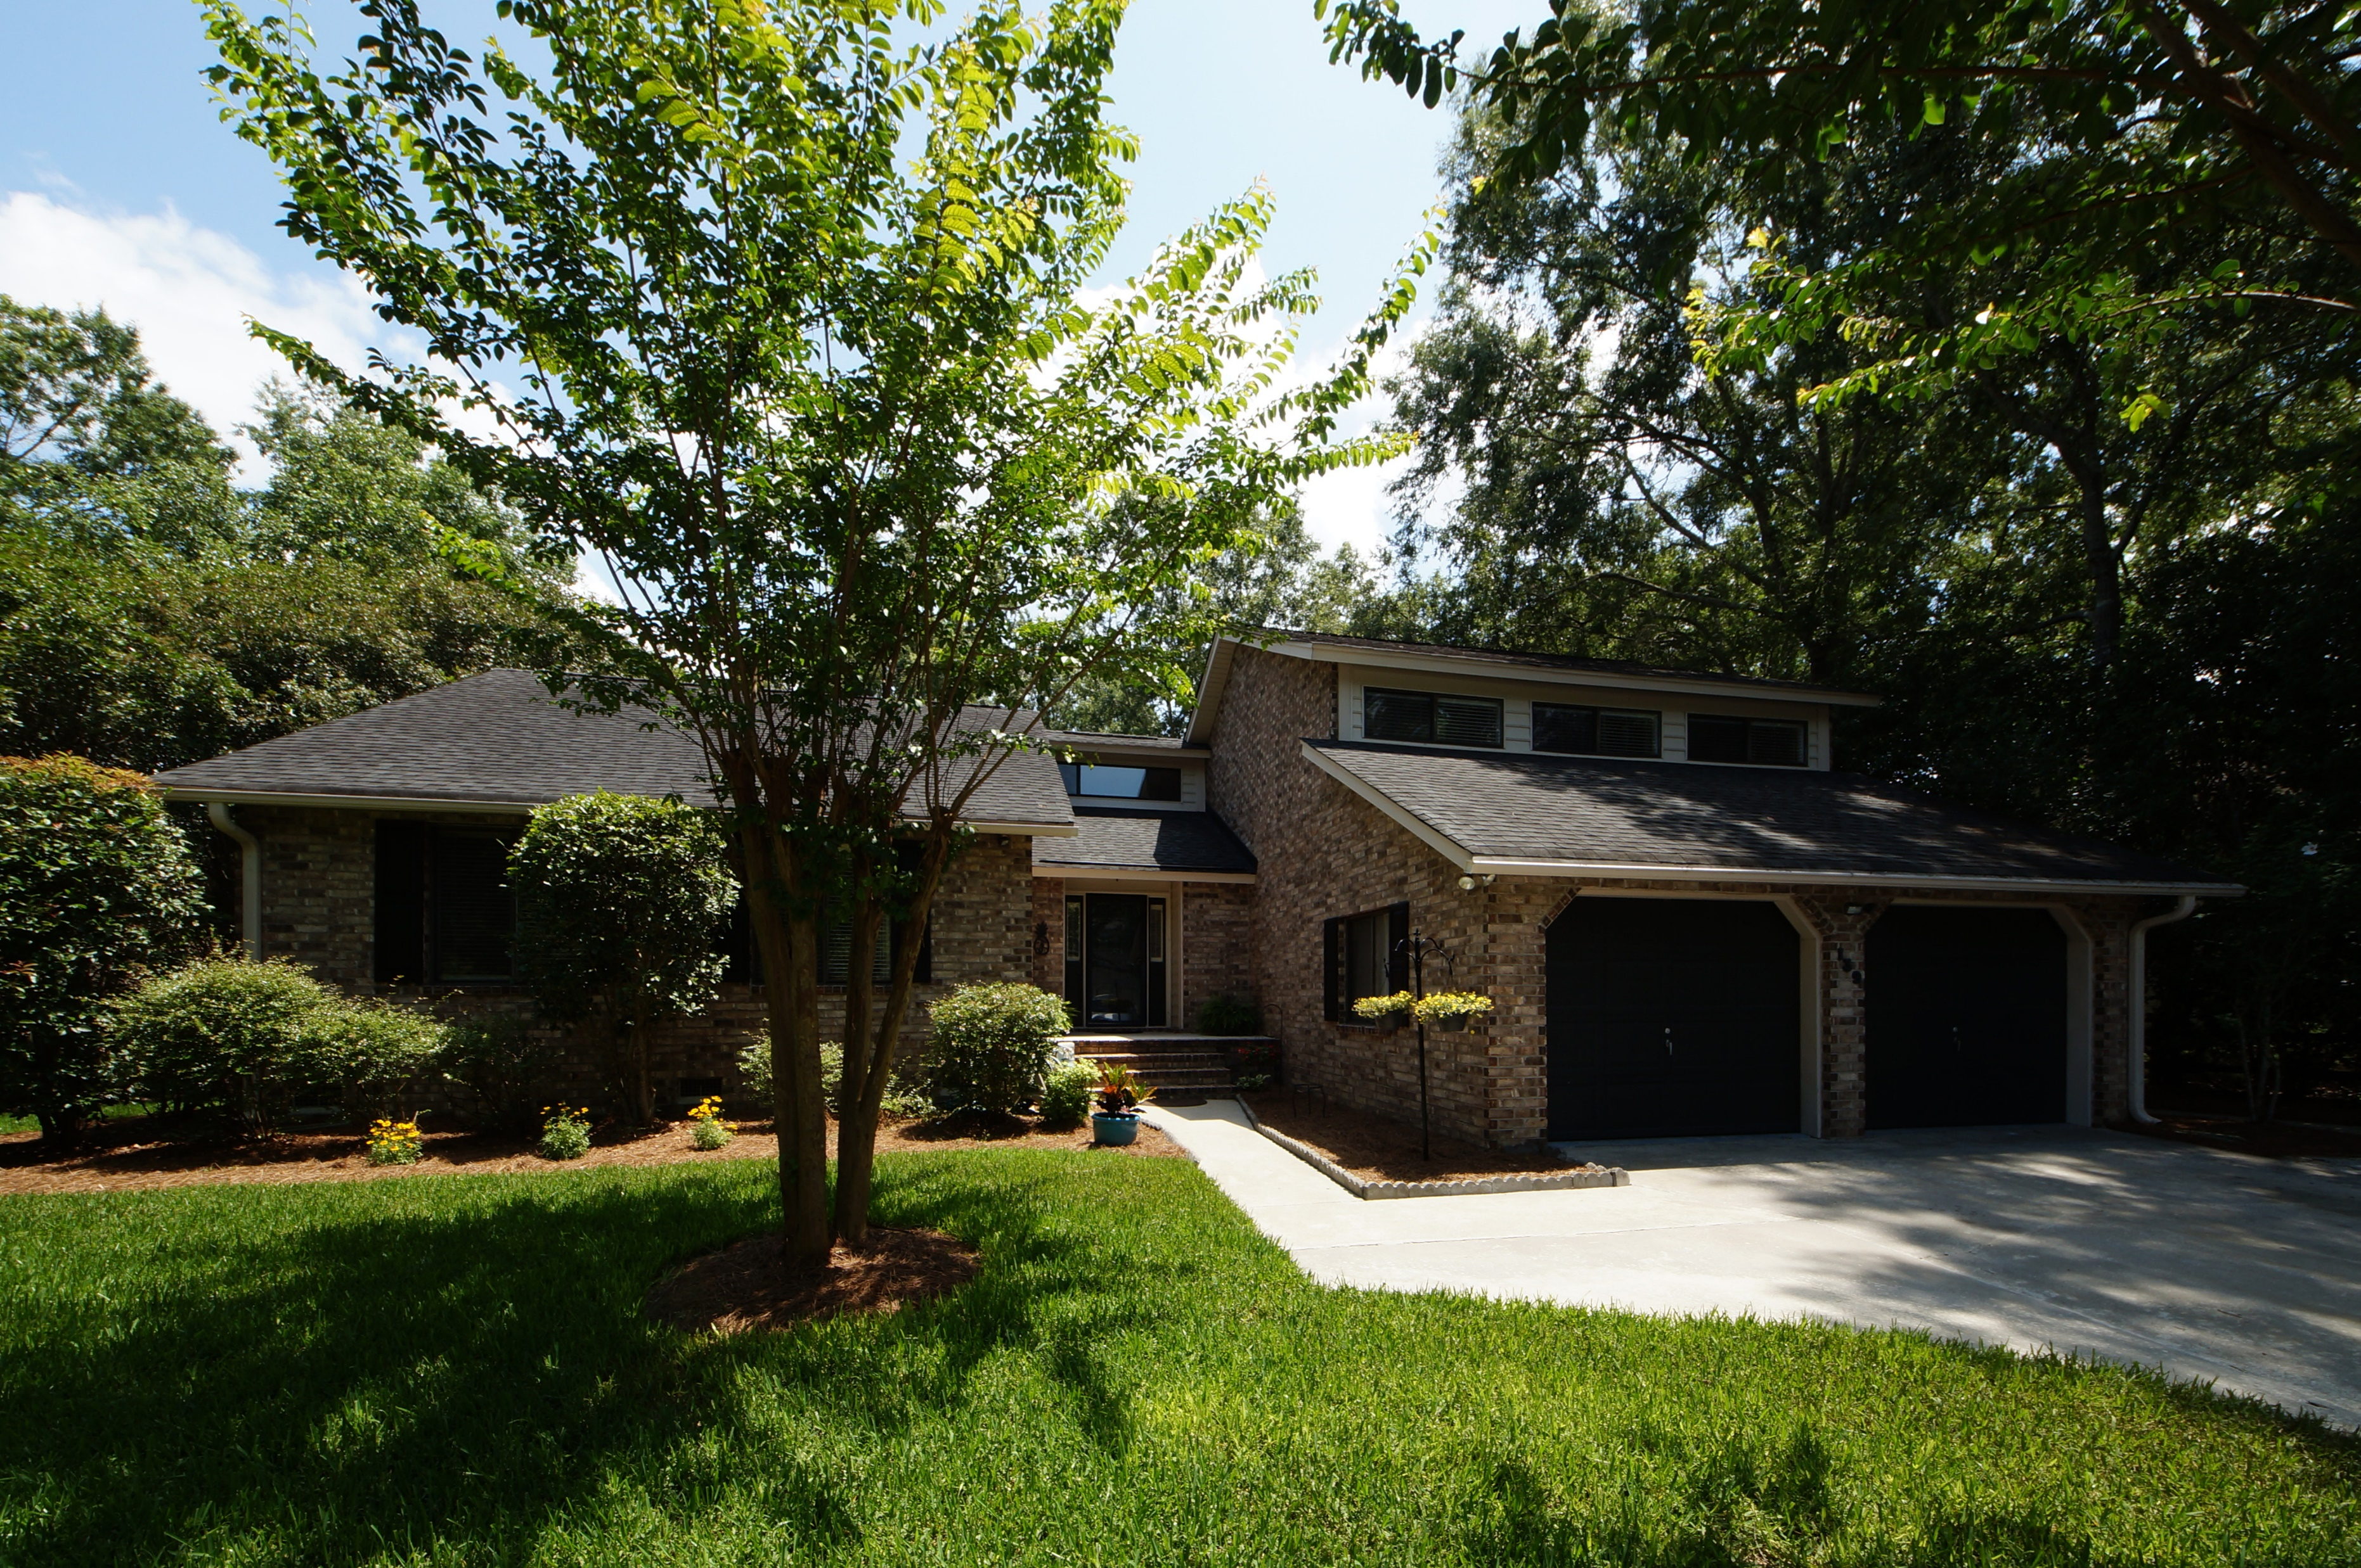
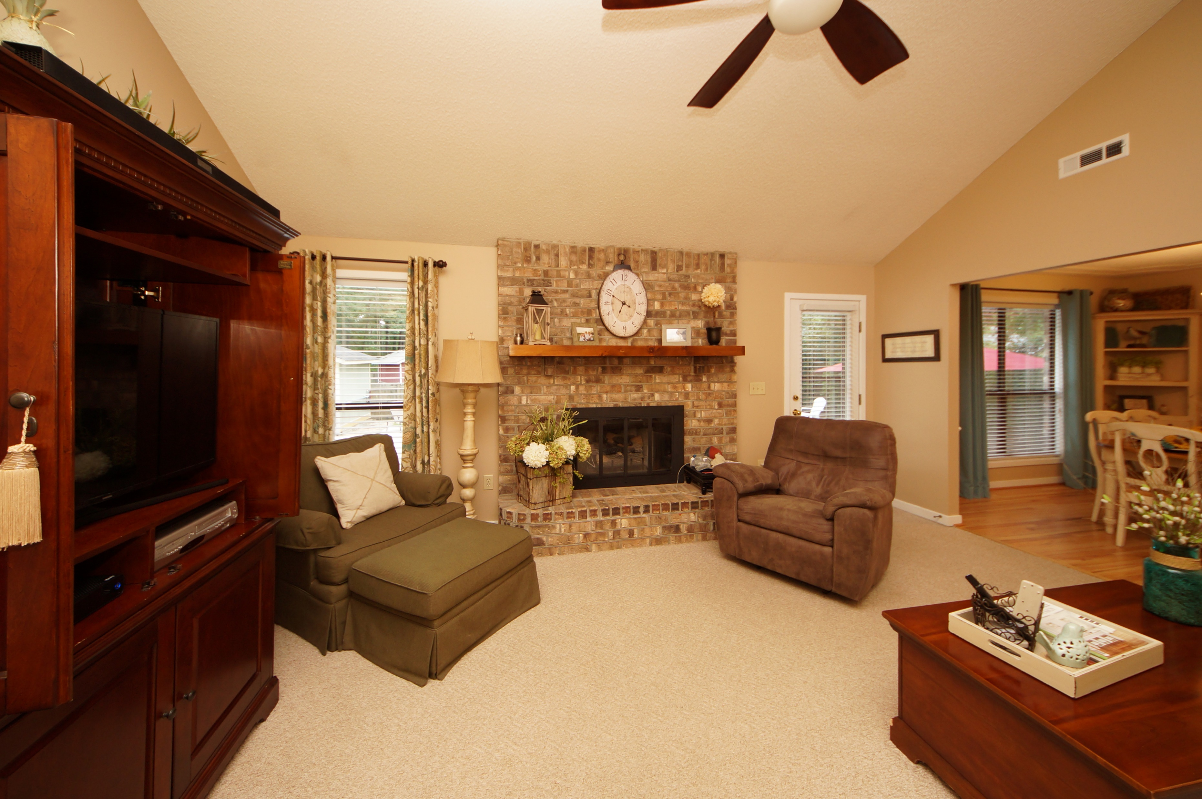
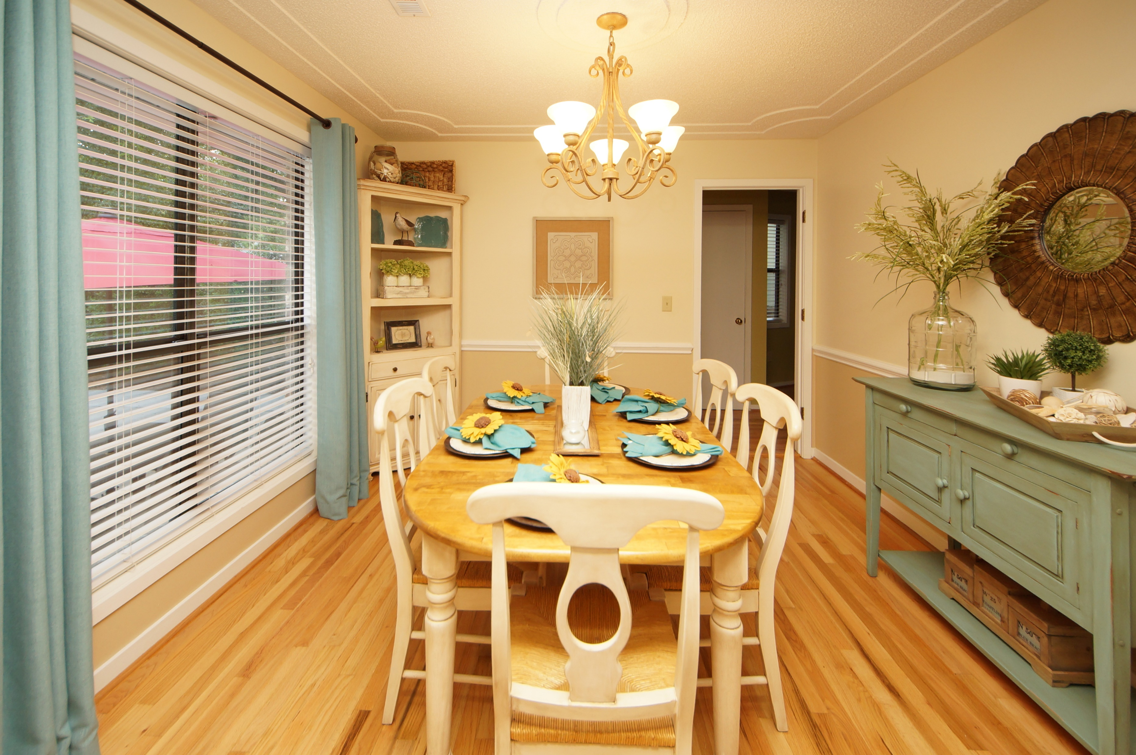
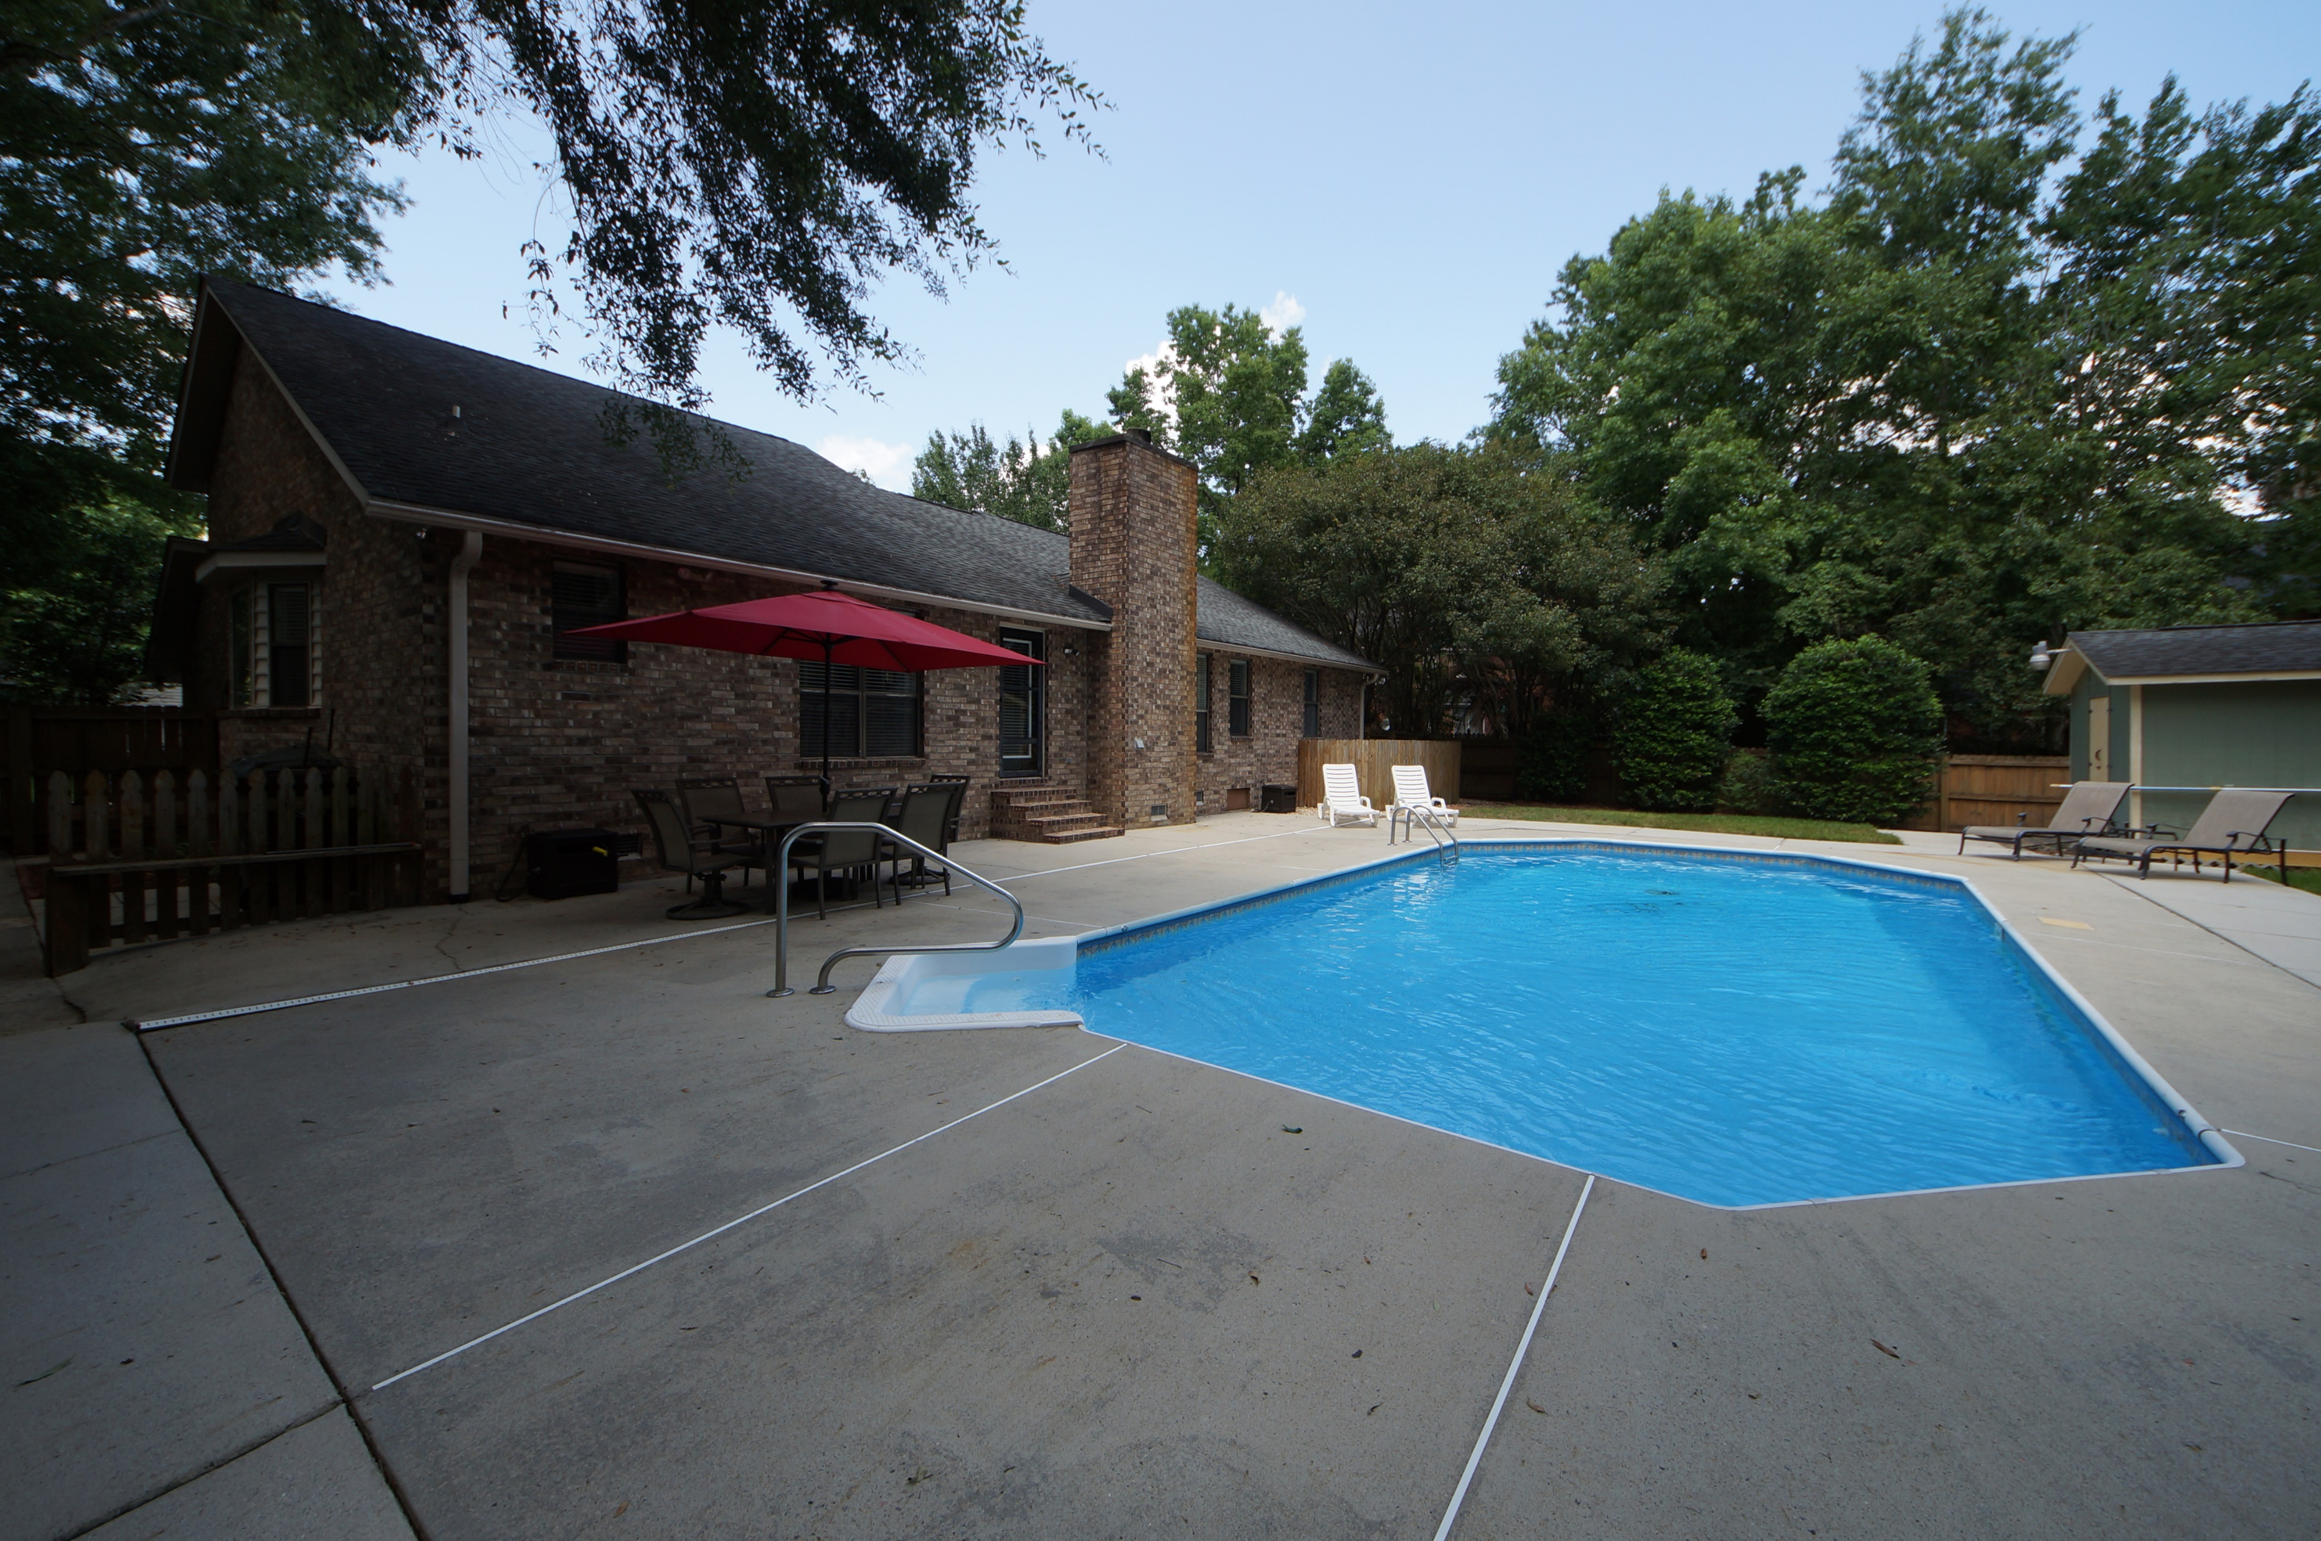


139 Hickory Trace Drive Crowfield Plantation :: Goose Creek, SC 29445 MLS# 18016959 :: $250,000 4 Bed / 2 Bath
Just Reduced $785,000!
Pictures Are Worth A Thousand Words!
Own a brick 4 bedroom home in desirable Crowfield Plantation!
Spacious master bedroom down stairs, family room with fire place, separate dining, eat in kitchen and fourth bedroom is a separate room located over the garage. Freshly stained wood floors and and fresh paint!
Step into the back yard and enjoy hot summer days with an in ground swimming pool!! This home checks off everything on your list for a new home owner!
Connie White, Broker
843-532-3356
conniesyouragent@gmail.com
Charleston Homes · 597 Old Mt. Holly Road · Suite 301 · Goose Creek, SC 29445

