Slide 1
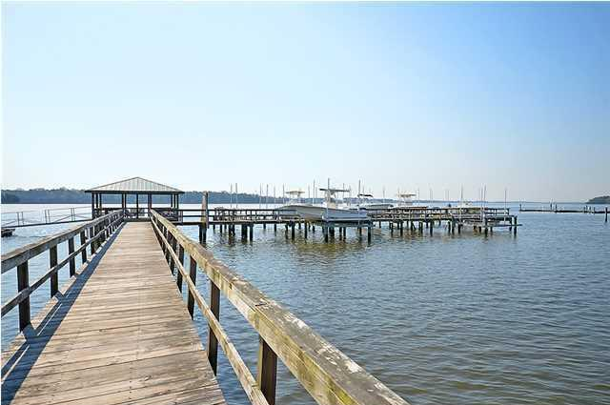
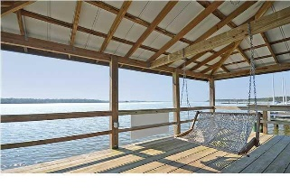
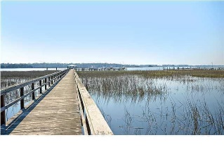

139 Wando Reach Road
Wando Point
Wando, SC 29492
MLS# 15007827
$125,000
Open House This Saturday from 2-4
Loaded with Updates
Gated, landscaped, waterfront community on the deep section of Wando River. One of the most exclusive Daniel Island/Clements Ferry area neighborhoods. Beautiful wooded lot in a low density neighborhood. Community dock with strong Covenants and Restrictions. The neighborhood is a short drive to downtown Charleston with 5-star restaurants, world class shopping and iconic history as well as a short drive to the beaches, the airport, Boeing, Mount Pleasant and Daniel Island. New, nearby K-8 school scheduled to open August 2016 according to Berkeley County Schools website.
Stan Huff
843-670-2835
stan.huff@agentowned.com
Jill Marcacci
843-297-5590
jill@agentowned.com
www.agentownedrealty.com
AgentOwned Realty Co. Preferred Group, Inc. | 824 Johnnie Dodds Blvd | Mt Pleasant, SC 29464

