Slide 1
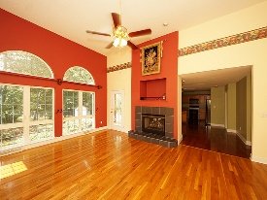
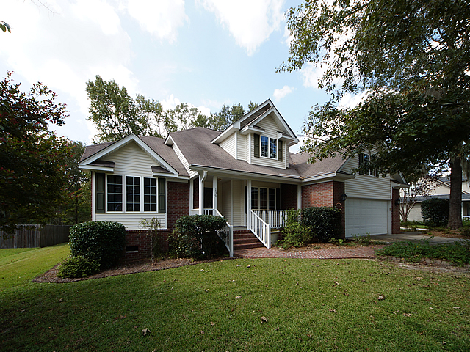
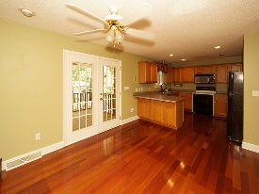
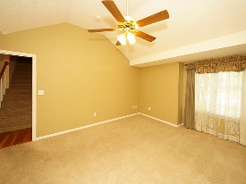
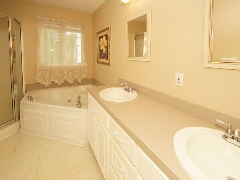
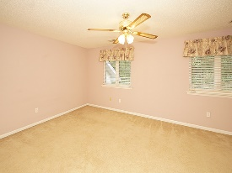
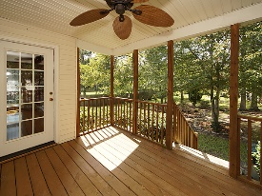
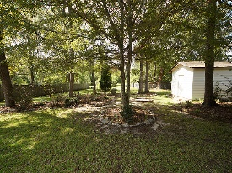

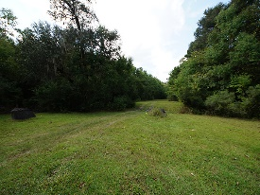

Spectacular Four Bedroom Home With Master Down
139 Winding Rock Rd
Crowfield Plantation
Goose Creek, SC 29445
Open House Canceled!
Under Contract In 3 Days!
MLS# 17025945
$289,900
4 Bed / 2½ Bath
Spectacular four bedroom home with master down in Crowfield Plantation. This home features gorgeous over sized windows with an abundance of natural light. The view of your picturesque back yard is breath taking. Hard wood floors, double sided fire place and amazing back porch make this home a must see and must buy! Behind this lot is the path to the Crowfield Lake. Pictures are worth a thousand words!
Connie White, Broker
843-532-3356 · conniesyouragent@gmail.com
Charleston Homes · 597 Old Mt. Holly Road · Suite 301 · Goose Creek, SC 29445

