Slide 1
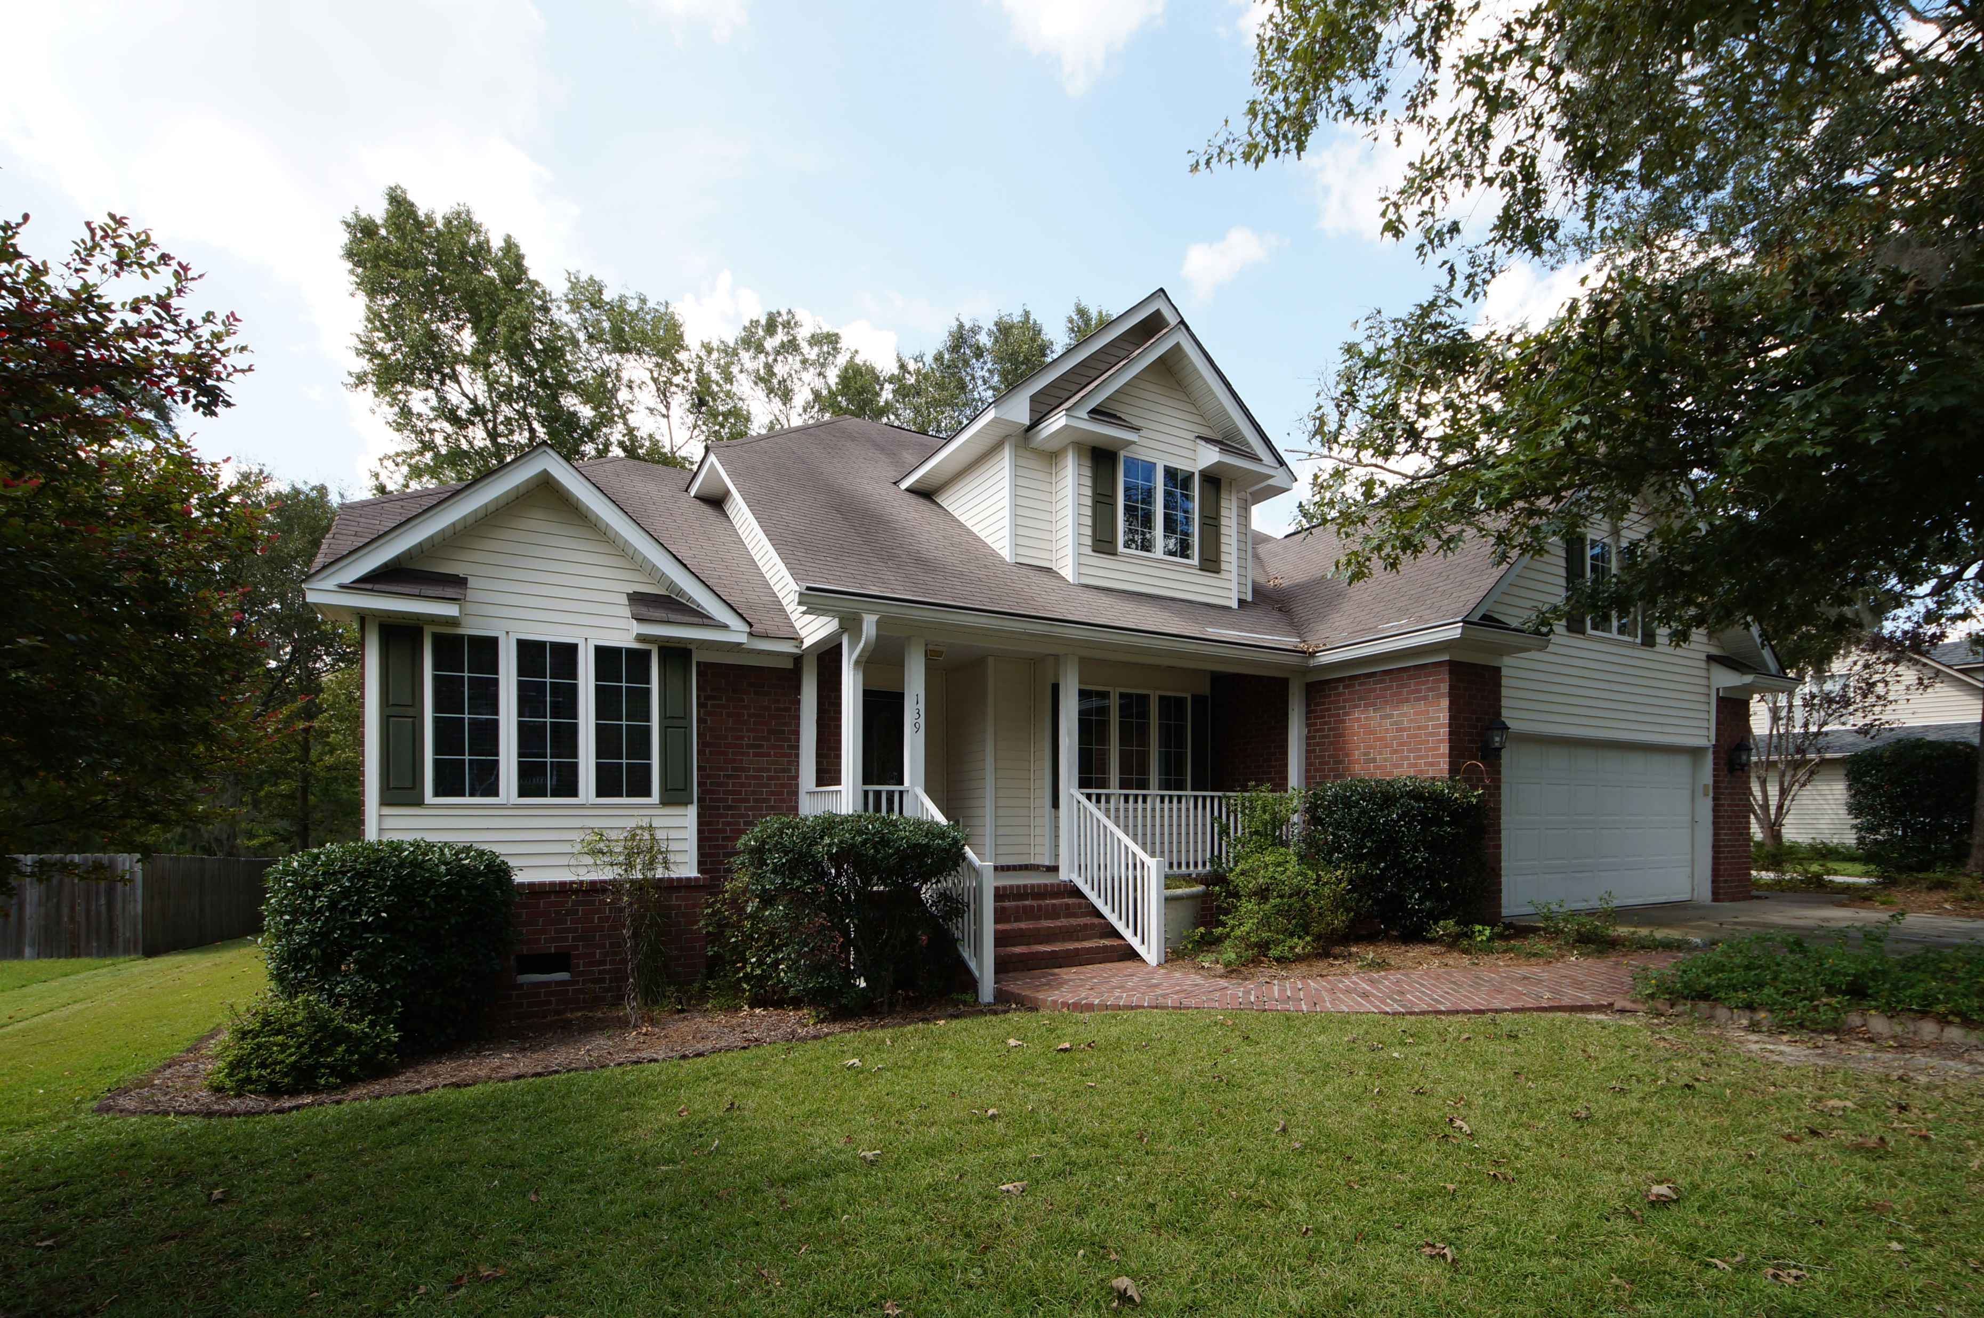
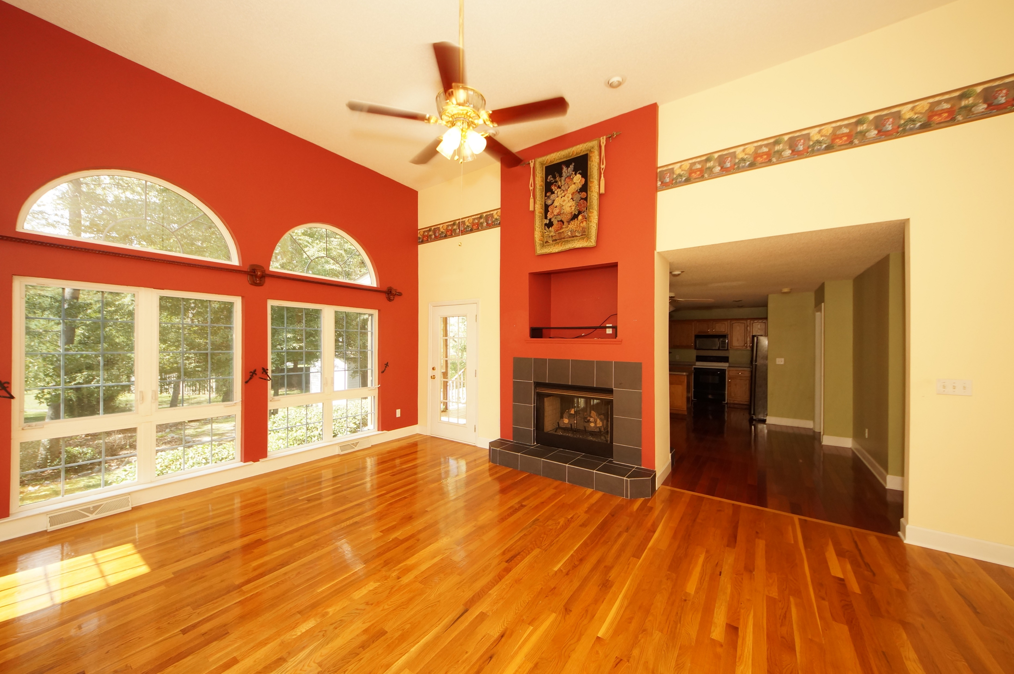
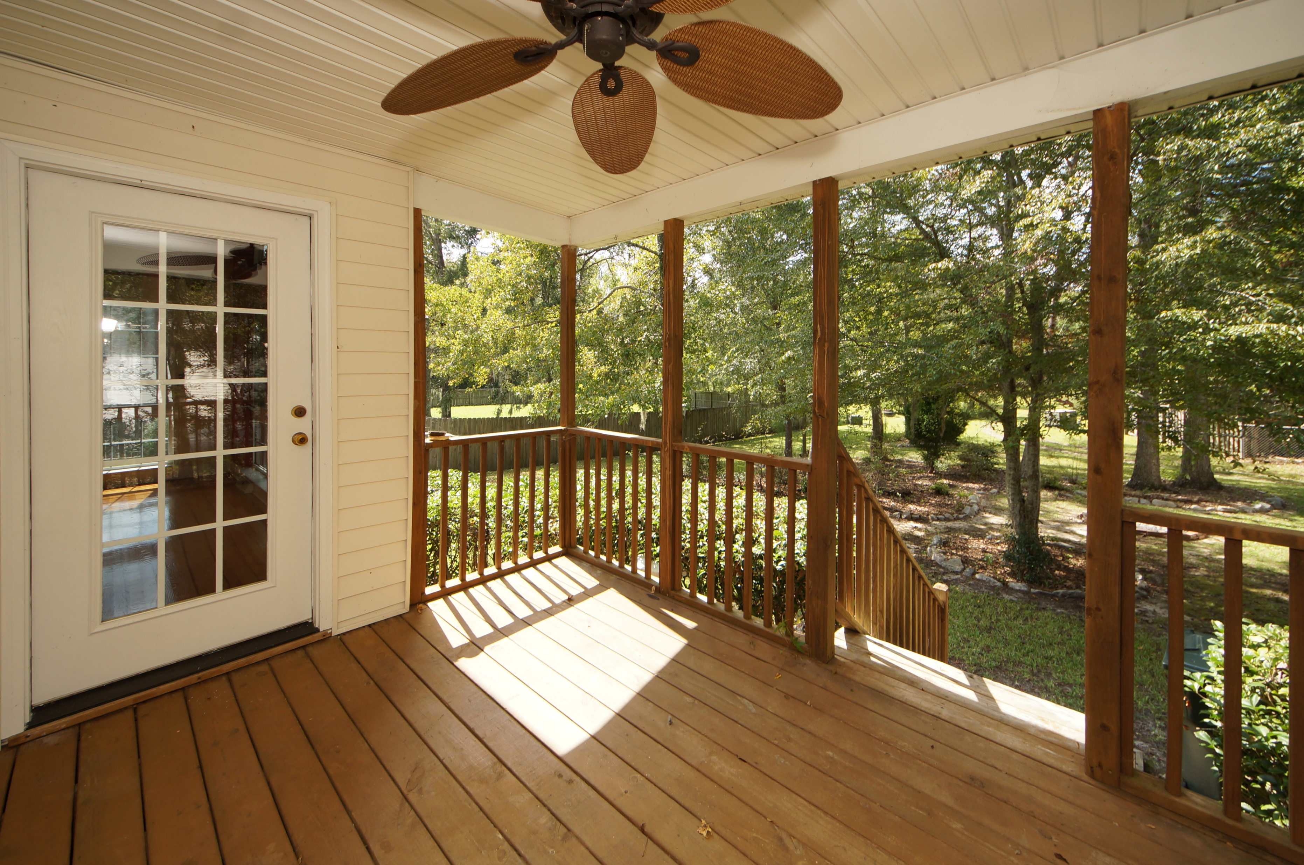
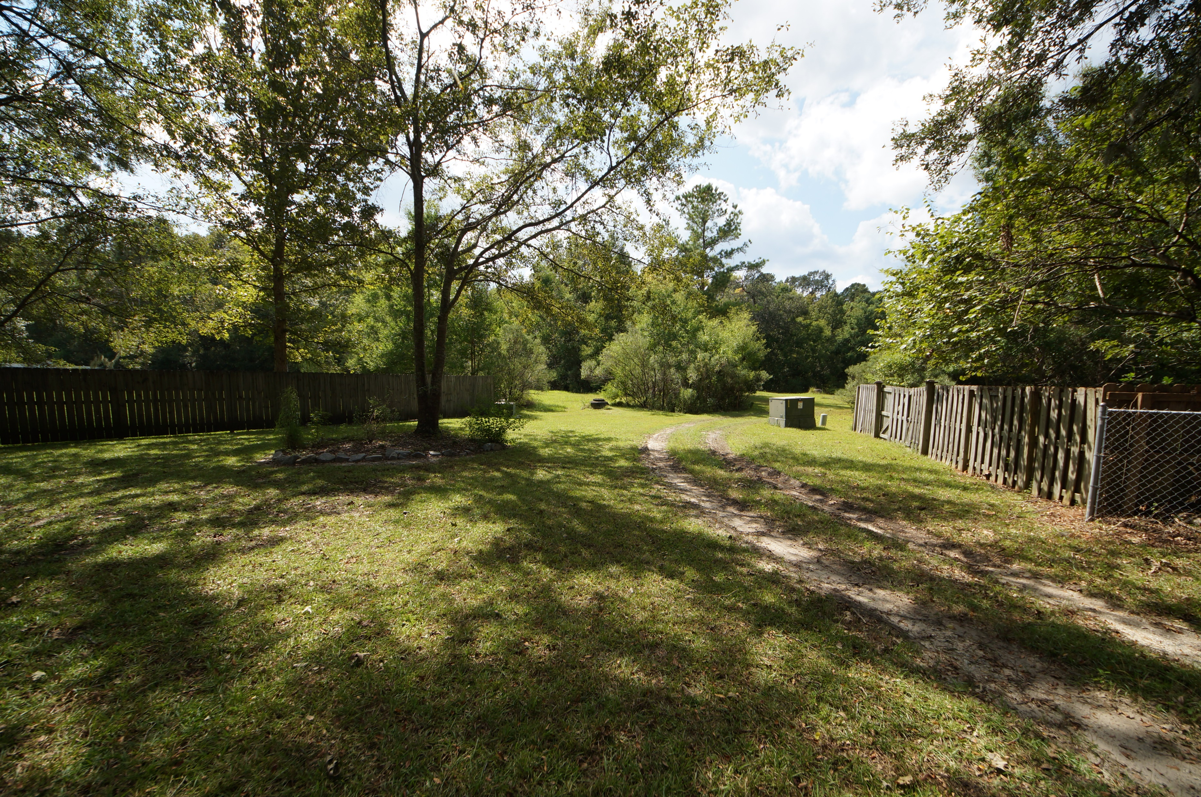


139 Winding Rock Road
Crowfield Plantation :: Goose Creek, SC 29445
MLS# 17025945 :: $285,000
4 Bed / 2½ Bath
Just Reduced
$785,000!
Crowfield Plantation 4 Bedroom
With Master Down
Spectacular four bedroom home with master down in Crowfield Plantation. This home features gorgeous over sized windows with an abundance of natural light. The view of your picturesque back yard is breath taking.
Hard wood floors, double sided fire place and amazing screen porch make this home a must see and must buy! Behind this lot is the path to the Crowfield Lake. Pictures are worth a thousand words!
Connie White, Broker
843-532-3356
conniesyouragent@gmail.com
Charleston Homes · 597 Old Mt. Holly Road · Suite 301 · Goose Creek, SC 29445

