Slide 1
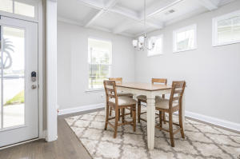
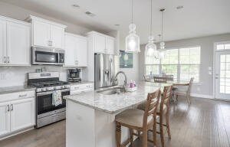
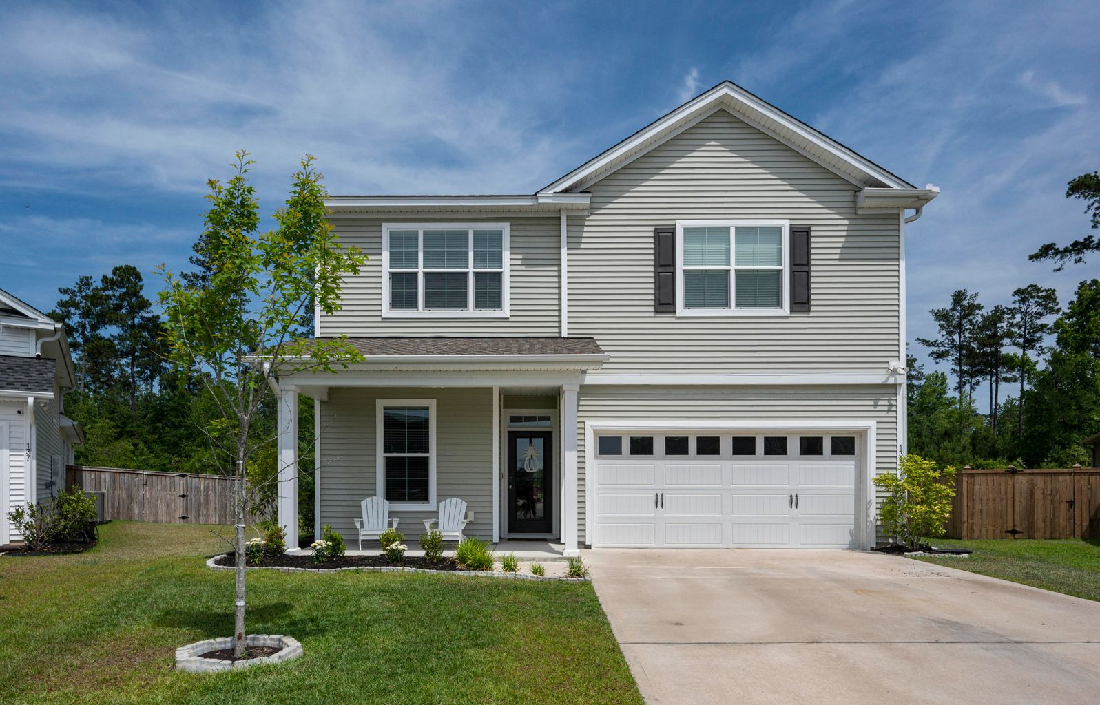
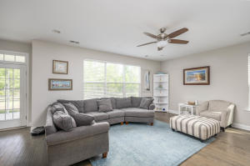
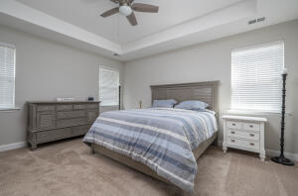
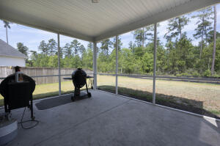
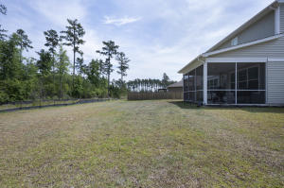


139 Sago Court
Cane Bay Plantation · Summerville, SC 29486
MLS# 21014178 · $385,000
OPEN HOUSE
Saturday, June 12th from 11-2
The highly desirable subsection of Palmetto Walk in Cane Bay offers this truly unique property. This home is within walking distance of all three Cane Bay schools and the shopping center at Publix, while still having the privacy of being on a cul de sac with a wood lined buffer running behind the house. This home has a wonderful screen porch that is perfect for your evening cocktail or morning coffee and overlooks the backyard. The Duke floor plan offers 4 bedrooms with a bonus room for additional living space. Downstairs, you will find the formal dining area with a beautifully coffered ceiling and a butlers pantry passthrough into the beautiful kitchen. The kitchen boasts granite countertops and stainless steel appliances as well as a workstation that could be used for kids and adults alike! The kitchen overlooks the large family room and breakfast area for an open floor plan design. You'll love the hand scraped floors that flow throughout the downstairs! Upstairs, you will find all 4 bedrooms and 3 full bathrooms along with a loft area, which is a great added space! The primary bedroom has a double vanity and a large walk-in closet. There are two secondary bedrooms that share a full bathroom and an additional guest bedroom with its own ensuite bathroom. This home has been HERS Tested by a certified third party and is 30% more energy efficient than the average existing home!
Rodney Hancock
(843) 437-1347
rodneyhancock08@gmail.com
mortgageprofessionalsonline.com
AgentOwned Charleston Group
902 Savannah Hwy
Charleston, SC 29407
Real Estate ● Mortgage
Insurance ● Business Brokerage

