Slide 1
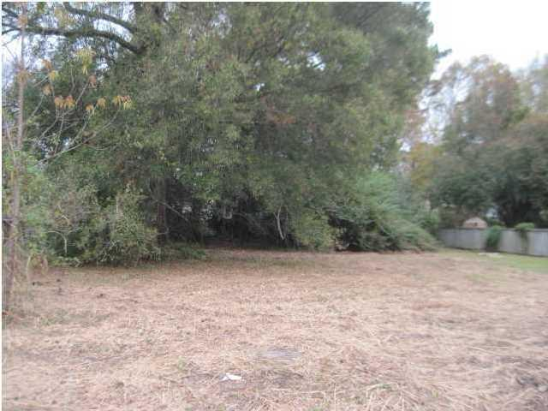




Last vacant lot in James Island neighborhood!
13 Oakcrest Drive
Oakcrest - Charleston, SC 29412
MLS# 1424635 - $70,000
0.30 Acres
Great lot on James Island.
Convenient to downtown, the beach, shopping and restaurants.
Build your ideal home and live the Charleston life!
Owner is a builder and is willing to sell the lot or build you a home.
Lizzie H Ray
(843) 452-9298
lizzieray1122@gmail.com
Eric Draper
(843) 442-7118
eric.draper@gmail.com
www.charlestonrealestategroup.com
Charleston Real Estate Partners. LLC | 792 Folly Rd. C1 | Charleston, SC 29412

