Slide 1
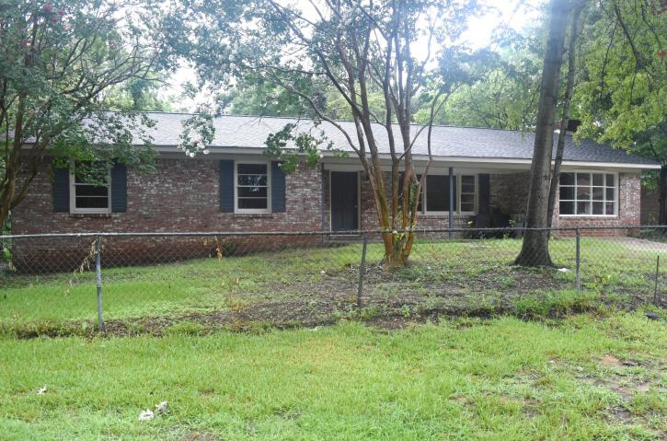
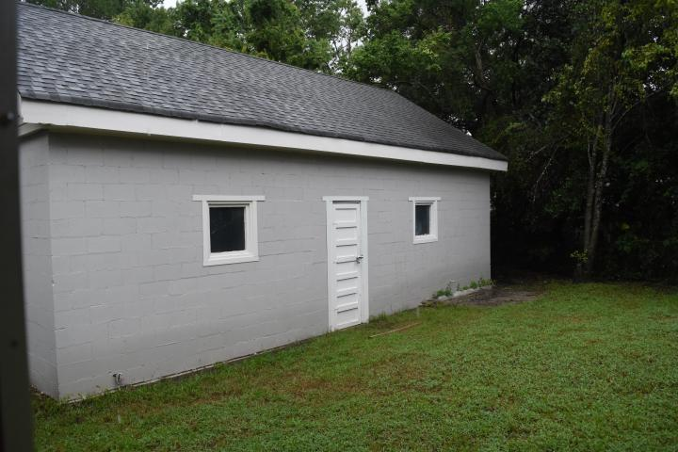
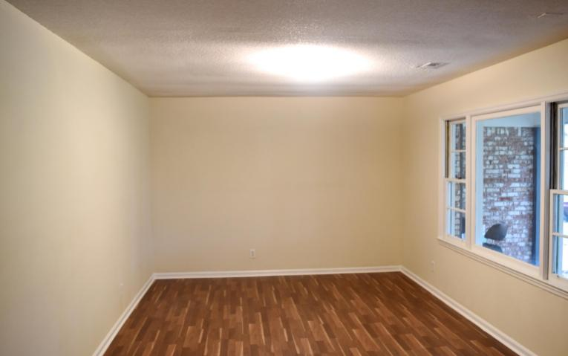
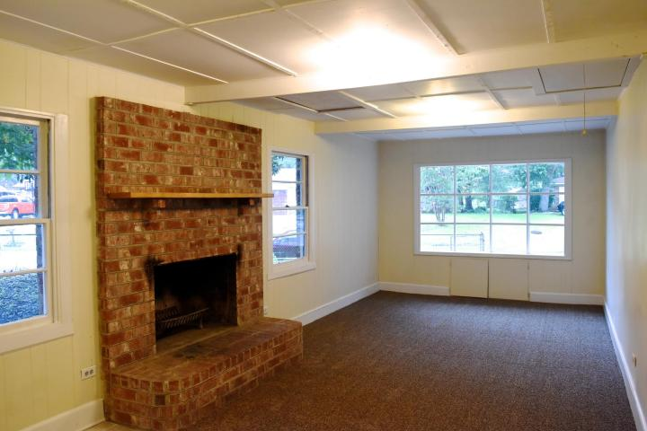
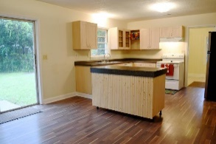
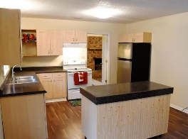
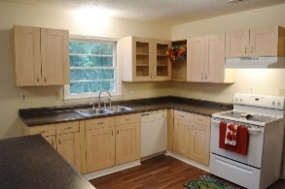
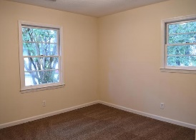
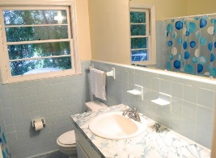


13 Raritan Road Sedgefield Goose Creek, SC 29445 MLS# 16021595 ~ $139,900
Open House Sunday
October 2^{nd,} 2-4pm
GAS CARD DRAWING
Visit this newly renovated home in the well established neighborhood of Sedgefield. Spacious home with 4 bedrooms and 2 baths. So many updates, including a new roof and flooring. New laminate floors and carpet throughout home. Awesome kitchen, so open and spacious! Kitchen has stainless steel appliances, including a refrigerator. Also updated island, cabinets and counter tops. Family room is spacious and has lots of natural light. Comfortable backyard, with area for a grill, Inviting and open front porch, enclosed garage with fireplace attached to home. Plenty of storage on the property, including detached garage with high ceilings and attached storage shed. Great location, minutes from Naval Weapon Stations and shopping.
Cheri Hamner
M - 843-364-4325
cheri.hamner@agentownedrealty.com

