Slide 1

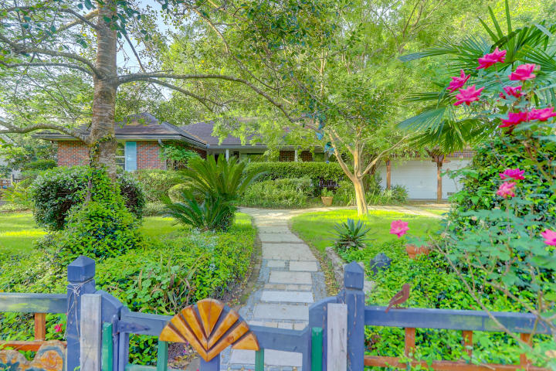
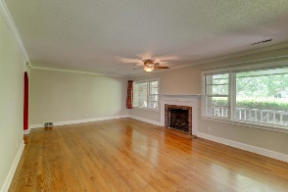
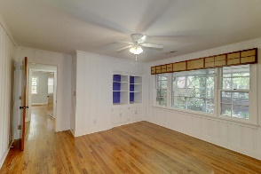
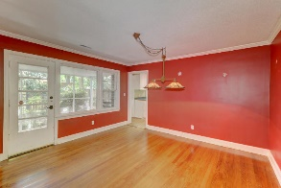
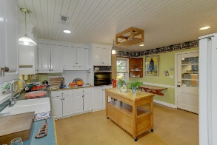
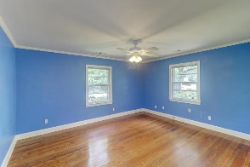
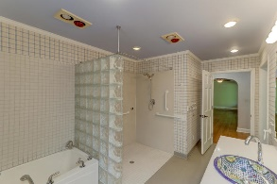
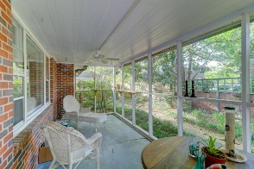
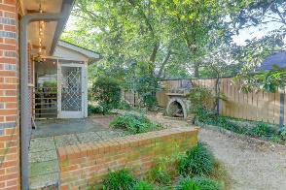
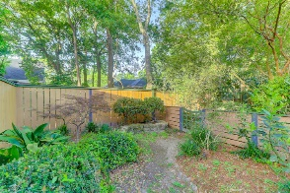


13 Sheridan Road Charleston, SC 29407 | MLS# 19010656 | $539,000
Classic Beauty
in South Windermere
This beautiful 3-bedroom, 2-bathroom home offers a vibrant oasis in West Ashley. At just over 2,000 square feet, it's spacious and accessible, with wide doorways and a curbless shower in one of the bathrooms. Windows throughout afford views of the gardens and let in plenty of natural light. Built in 1952, the updated home has great bones and cozy charm. The huge kitchen has ample space, giving you endless opportunities for cooking. The oven is elevated for easy reach, and you'll have more than enough storage with the bright cabinets and pantry. You'll find gleaming hardwood floors throughout much of the house which add a warm touch and a nice contrast to the light, pastel-colored walls. Windows run the length of almost the entire living room, imparting an airy feel to the expansive room. On colder evenings, you can enjoy the inviting ambiance created by the fireplace. One of the rooms features built-in bookshelves, making it a great space for a home office. An attached 2-car garage provides room for your vehicles or storage. Enjoy your morning coffee as you take in the views from the quiet front porch or screened-in back porch. There is a quarter-acre of beautifully landscaped yard at your disposal. The previous owners were meticulous in the plants they cultivated, so you'll find that many of the plants and trees are native and well suited to the region's climate.
CSA Real Estate Services 339 Cabell Street
Charleston, SC 29407-6928
Charlie Smith
(843) 813-0352
csmith@csarealestate.com
www.csarealestate.com

