Slide 1
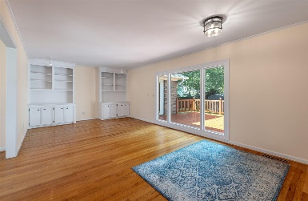
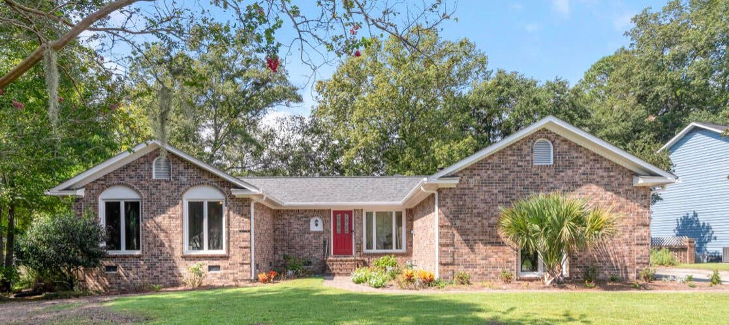
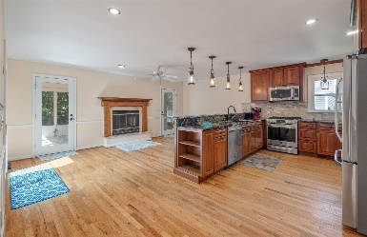
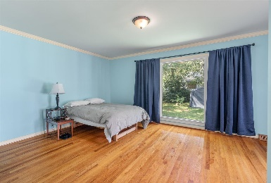
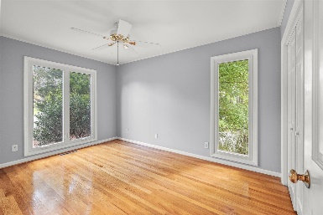
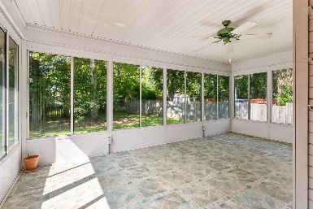
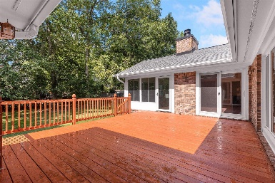
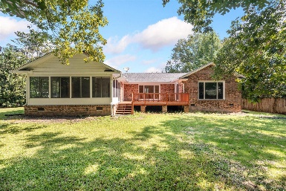


13 Glenkirk Drive Shadowmoss · Charleston, SC 29414 MLS# 23021291 · $550,000
Welcome to Shadowmoss!
This home is located in the section of Shadowmoss that is not in the home owners association which translates to No HOA and no HOA fees! The home is a sprawling 1 story home and is full of charm. As you enter the home you are welcomed into a formal living and dining room combo that can serve multiple functions. The space also has built in cabinets and shelves for extra storage. The house has been updated with a beautiful kitchen that boasts high end cherry cabinets with custom details and orinoco granite. There is a built-in pantry cabinet, a gas range, a long bar which is perfect for entertaining and stainless steel appliances. The kitchen is open to a den with a fireplace that offers a very warm and inviting space. Off of the kitchen and den is a huge sunroom that can also function as a screened in porch. Also off of the kitchen is a door that leads out to a sizeable deck that has recently been replaced. The backyard is spacious and fully fenced in. Back inside the home there are 3 bedrooms and 2 full baths that have been updated. The master bedroom has two closets with ample storage and the hall leading to the bedrooms offers multiple closets as well. The master bedroom has an en suite bathroom and a door that leads out to the back deck. There is a large two car garage and you enter into the home from the garage via the spacious laundry room from the garage. Also in the laundry room is a door that leads directly outside. The laundry room boasts an updated utility sink and cabinetry for more storage so it is very functional. This home features gorgeous hardwood floors and no carpet! It is located in the beautiful West Ashley area of Charleston with the option to join the Shadowmoss Golf and Country Club.
Carey Nikonchuk
(843) 276-1701 M
cnikonchuk@gmail.com
www.palmettoproperty.net

