Slide 1
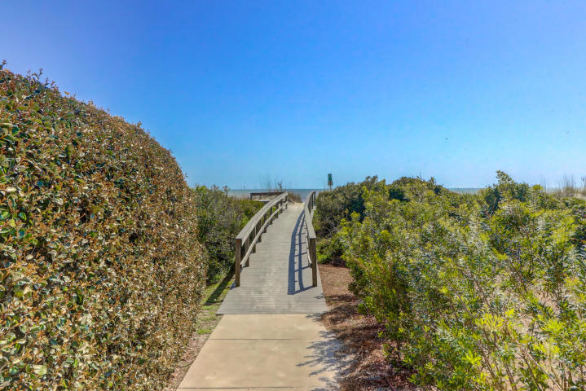
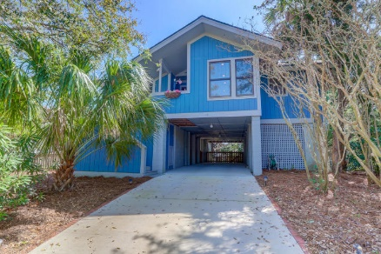
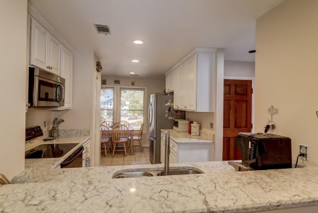
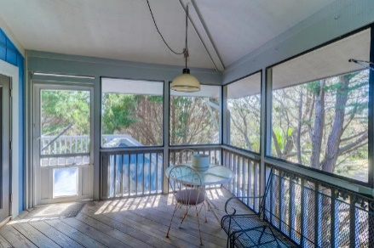
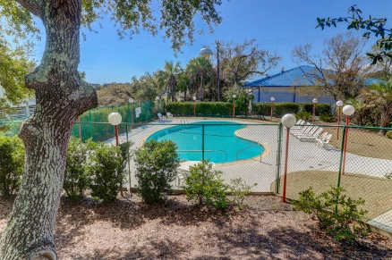


13 Ocean Park Court
Beachside | Isle of Palms, SC 29451 | MLS# 20006633 | $799,000
MOTIVATED SELLER!! REDUCED 150K!
Beachside IOP Cottage Just Steps to the Beach
Pool and Tennis!
Beach cottage just an 8 minute walk to the ocean located in much sought after Beachside subdivision.
Enjoy the community pool, tennis courts and walk to the grocery and great restaurants. This home offers Quartz counter tops, fireplace, dumbwaiter and a quiet cul-de-sac.
Darlene Smith
Office - (843) 886-8110
Mobile - (843) 696-7824
darlenesmith@carolinaone.com
DarleneSmithTeam.com
Carolina One Real Estate
1503 Palm Blvd Ste
Isle of Palms, SC 29451

