Slide 1
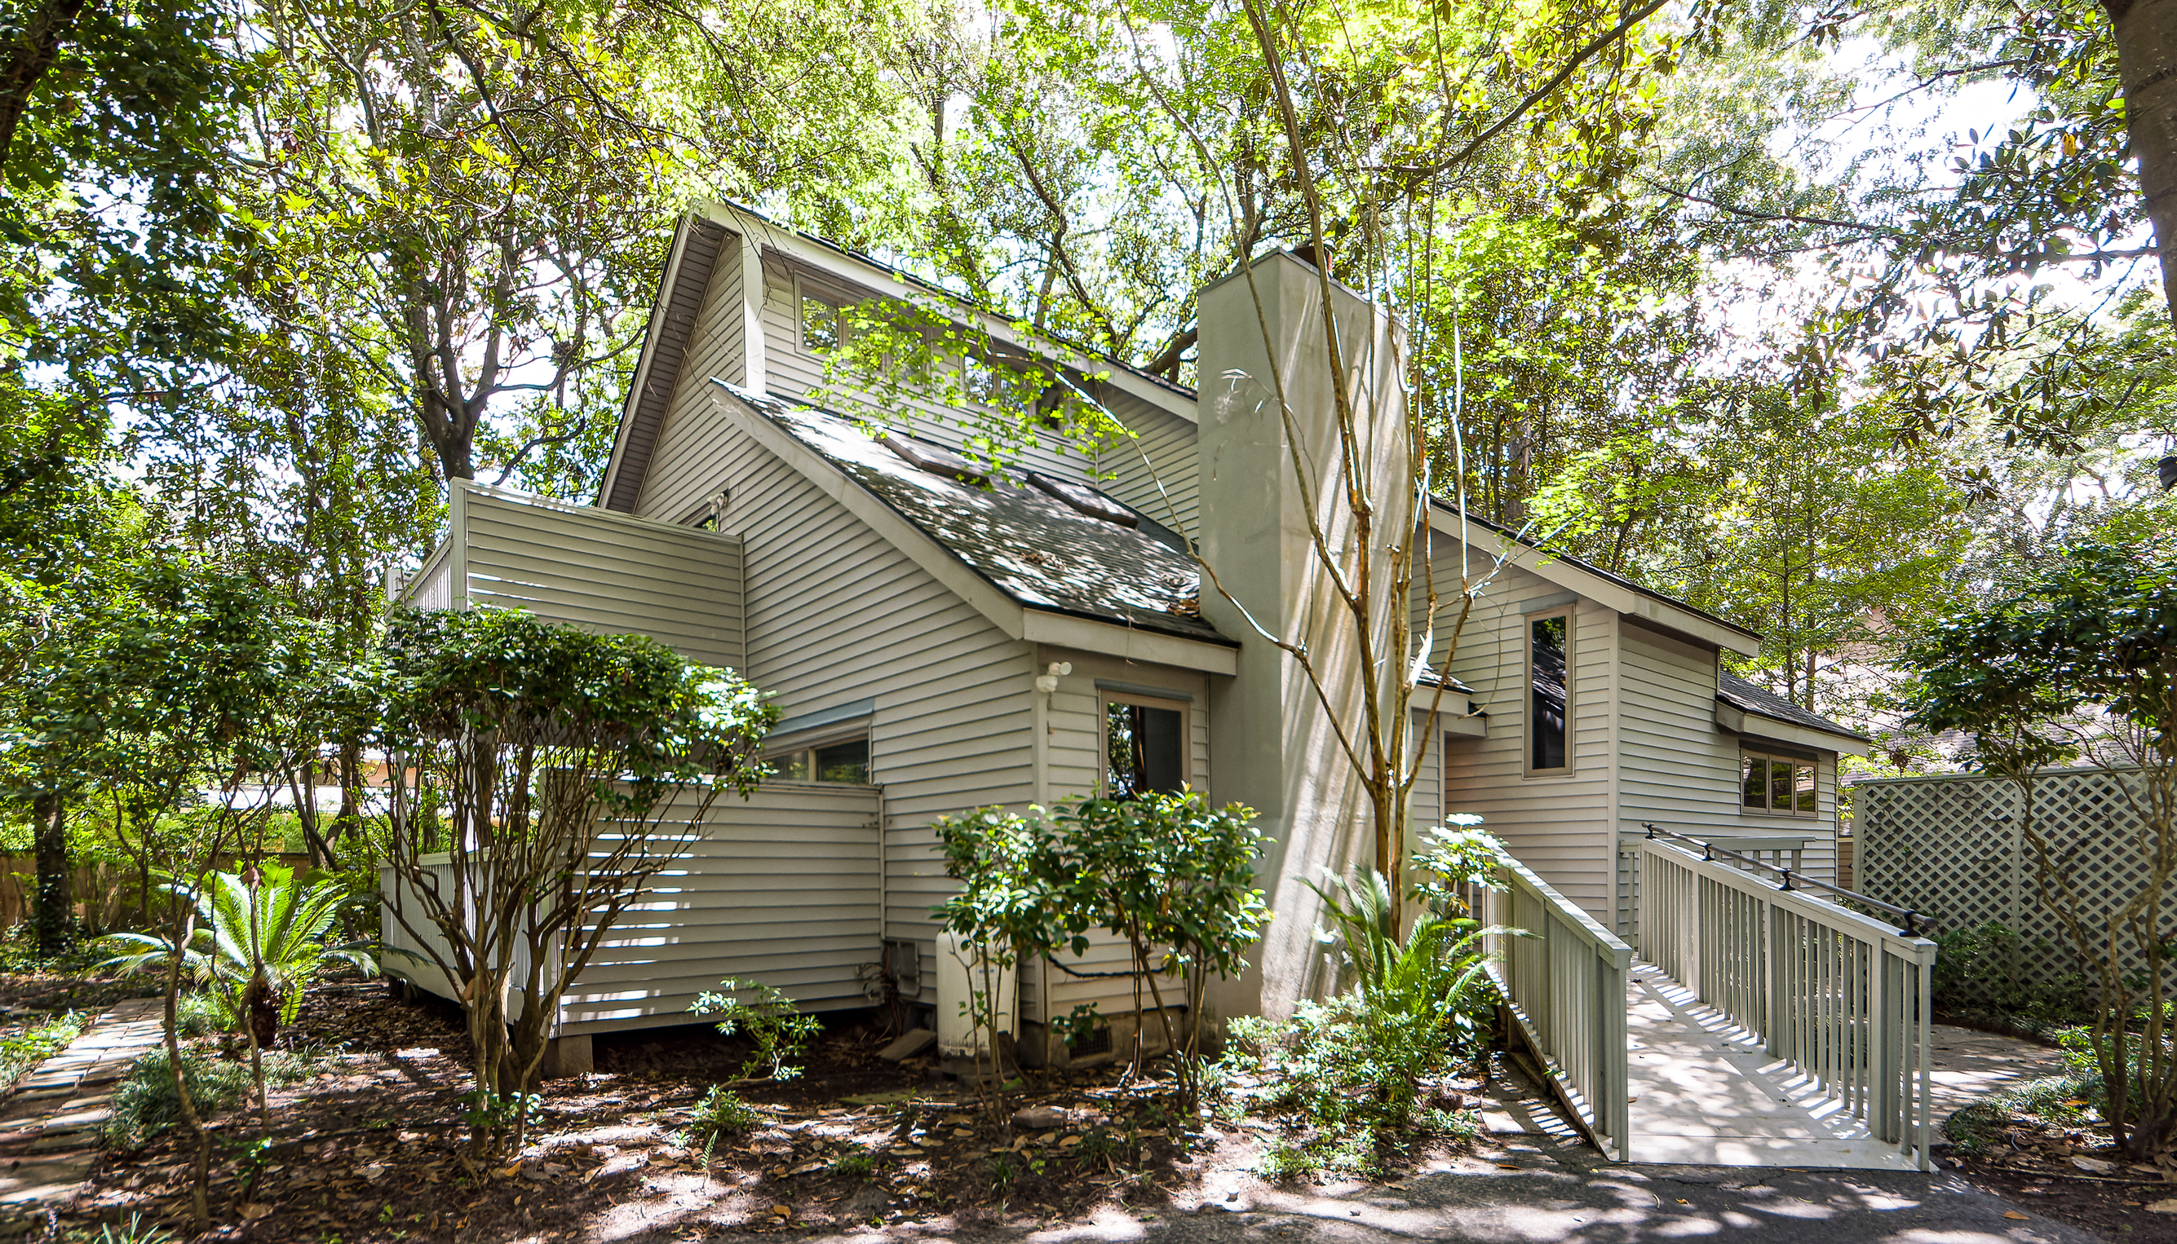
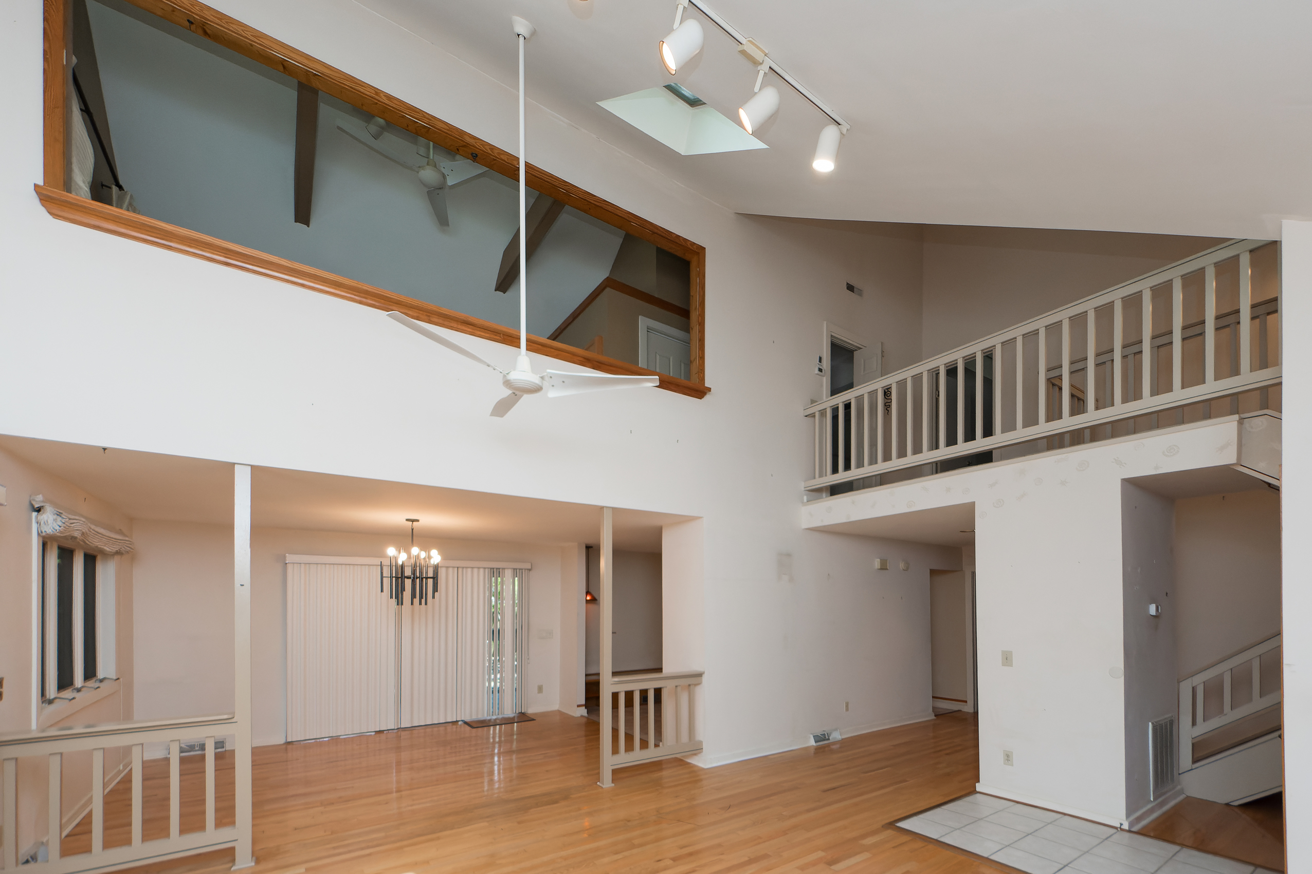
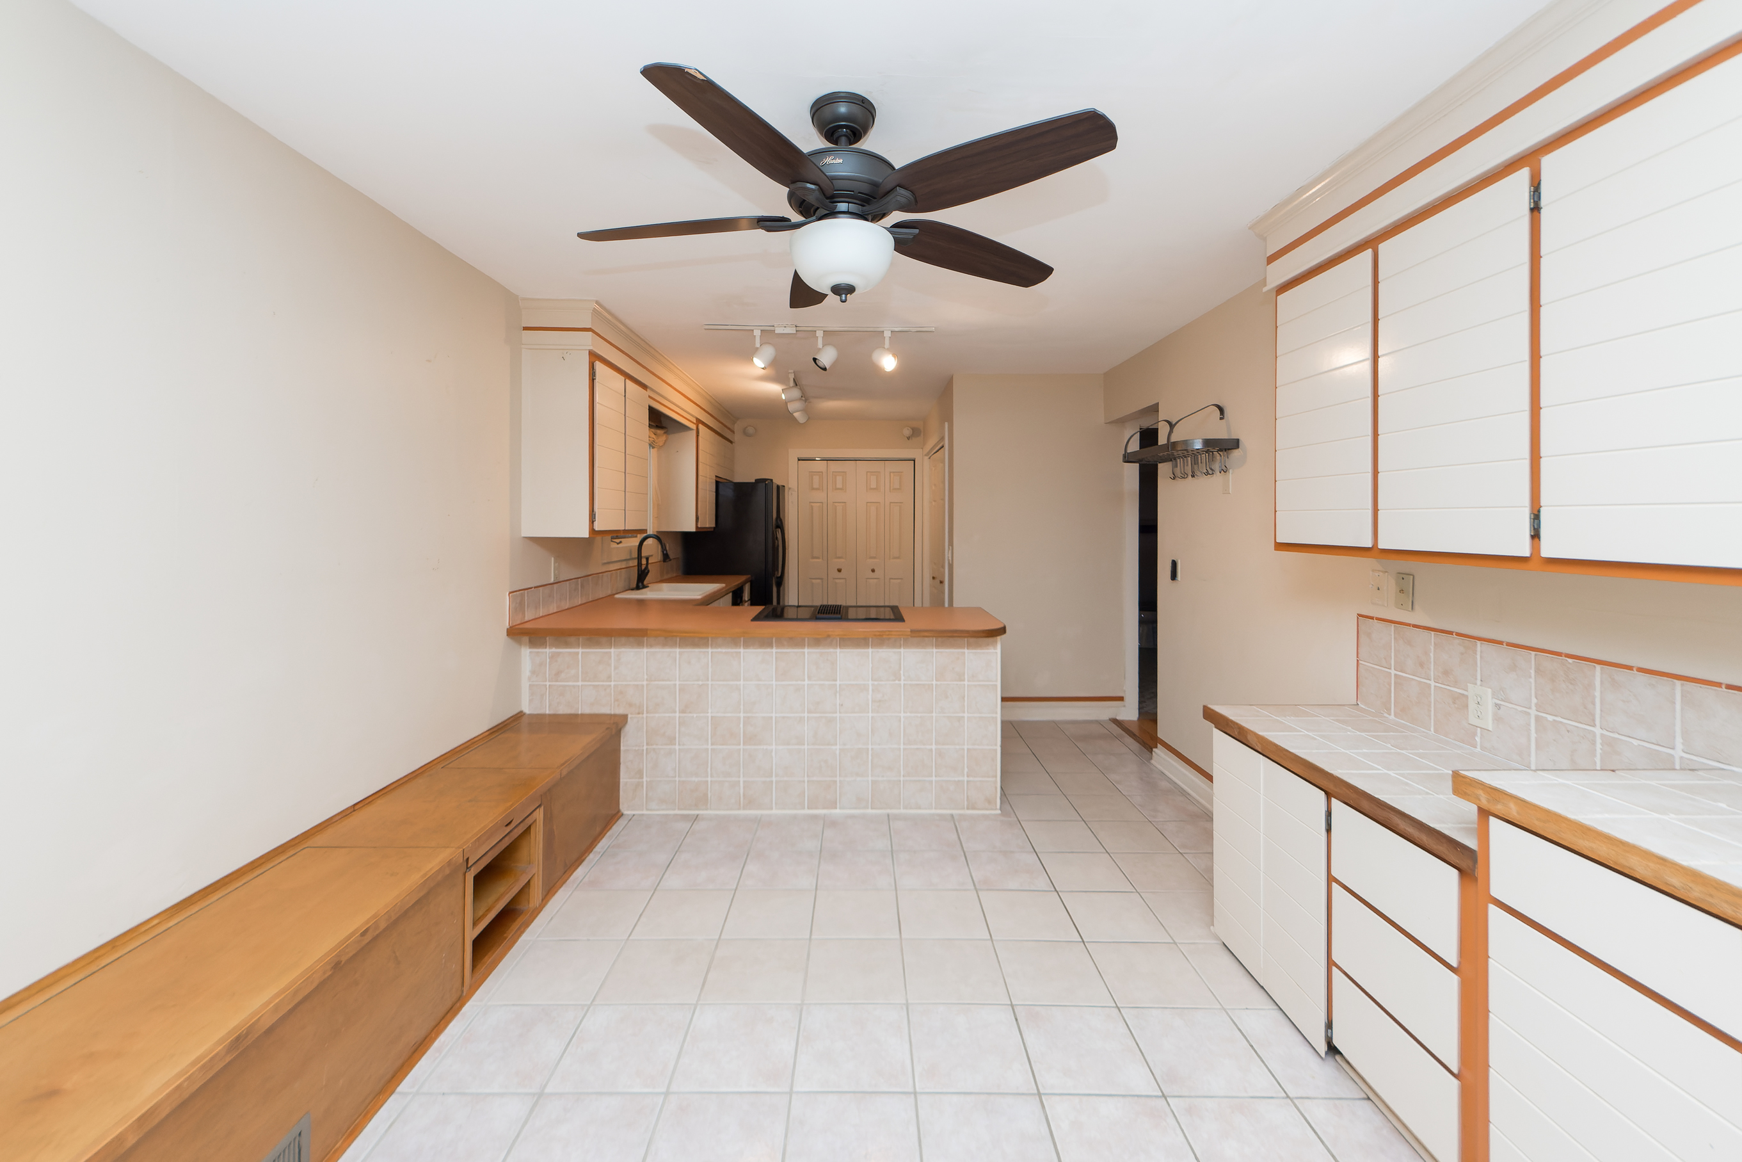
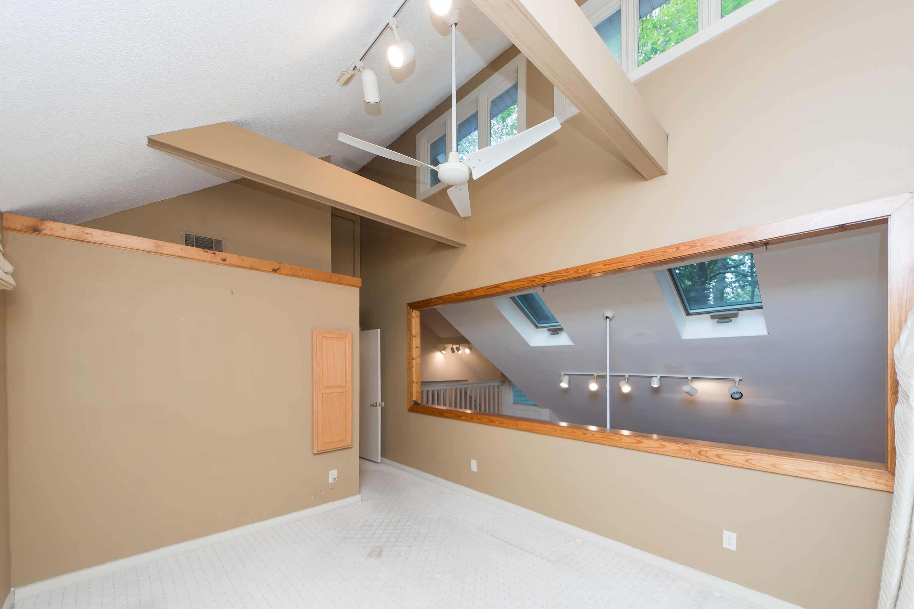
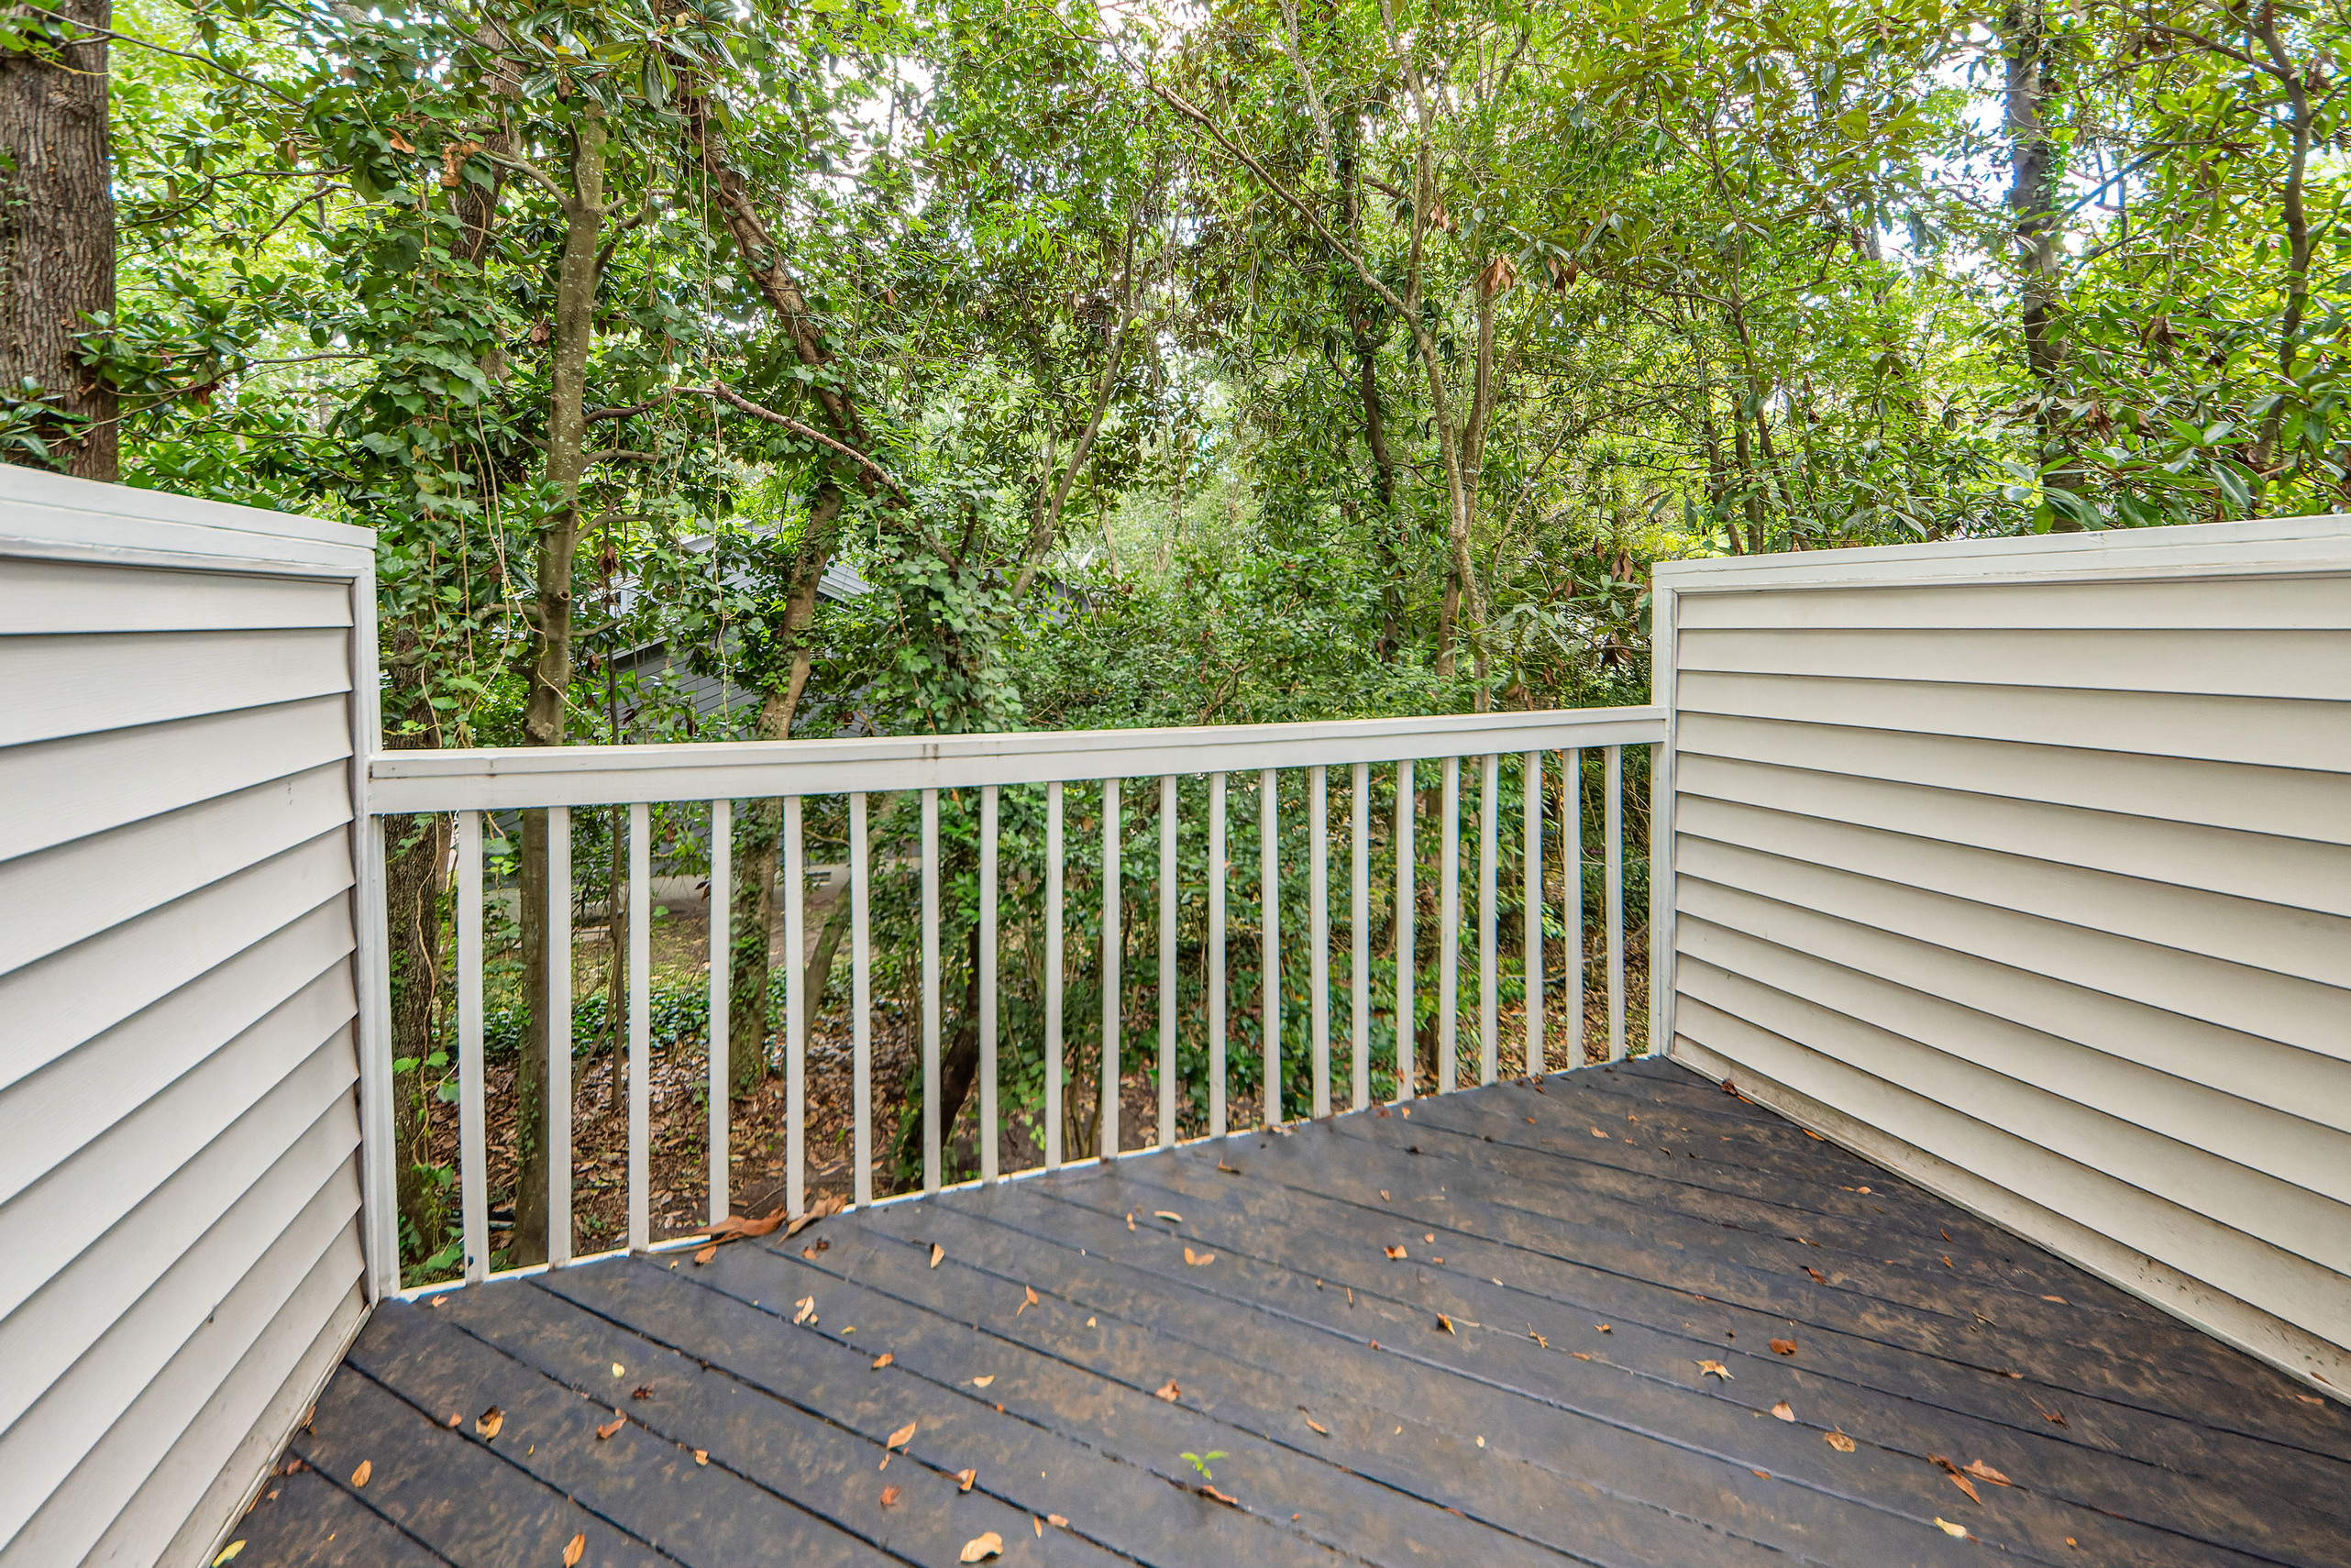
Open Houses this Weekend
Saturday 2-5pm & Sunday 2-4pm
13 Pony Lane
Marsh Cove | Charleston, SC 29407 | MLS# 22019398 | $429,900
Unique interior designed home located in a quiet & secluded neighborhood, close to shopping, schools, houses of worship, & convenient to Ashley Hall Blvd, Hwy 61, & I-526. Great sized home for a starter home. Neighborhood has a tennis court & swimming pool located towards the back of the neighborhood near Arabian Dr & Palominio Ct.
Take a virtual tour: https://www.charlestonvirtualhomes.com/2220303
Charles Salmonsen
M (843) 224-0300 | O (843) 388-6613 | charles@salmonsen.com
Salmonsen Realty | 864 Lowcountry Blvd Ste B | Mt Pleasant, SC 29464

