Slide 1
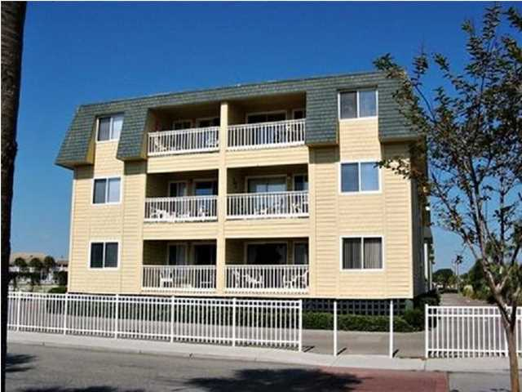
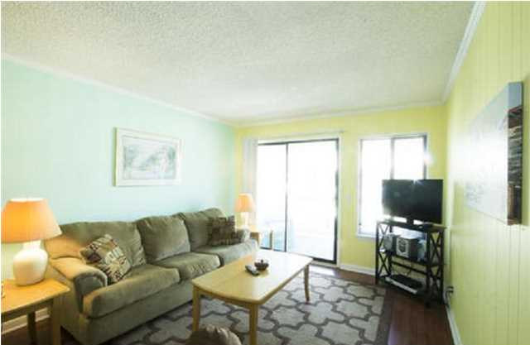
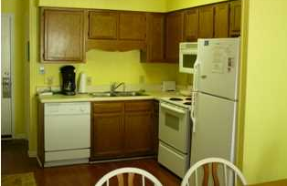
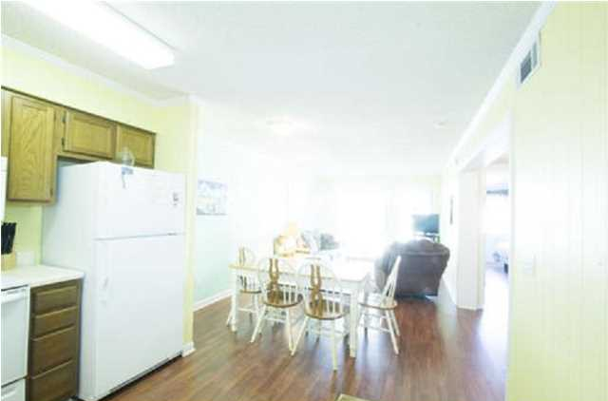
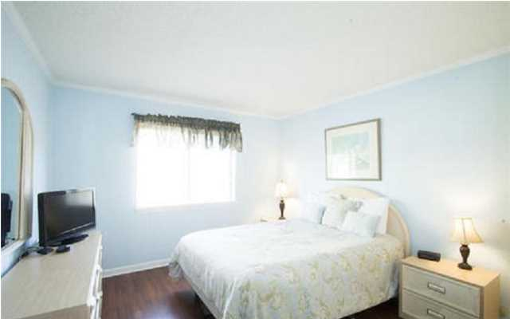
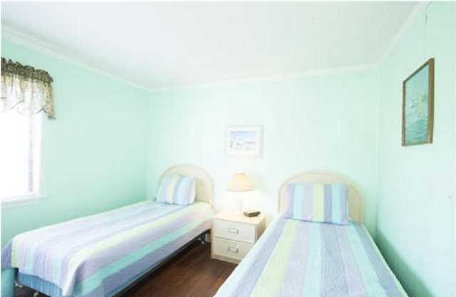
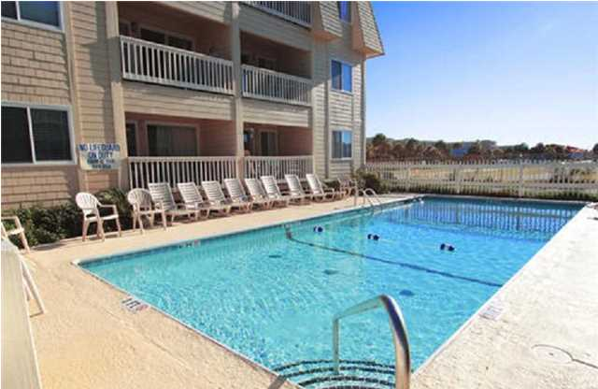


Best Priced Oceanside Villa! New to the Market! 1400-B 207 Ocean Blvd Isle of Palms ~ MLS# 1416245 $290,000 ~ 2 Bed/2Bath
Nicely appointed, well cared for Condominium...Being sold furnished. OCEANSIDE VILLAS have their own pool, with access to the fishing pier right across the street. Great location close to Island Shopping, Restaurants, the Beach...and Charleston! This property has been on the Rental Market and has a good Rental History.
Frank Rutigliano
843-813-4961 M
frutigliano@kwchs.com

