Slide 1
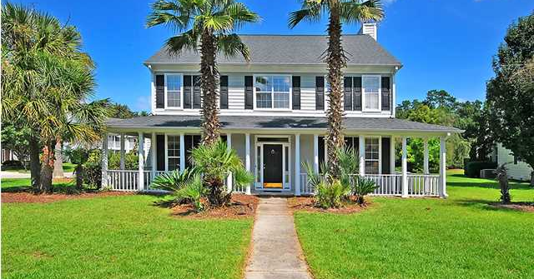
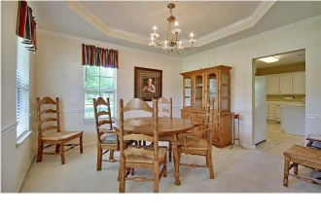
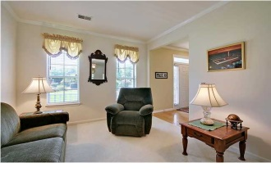
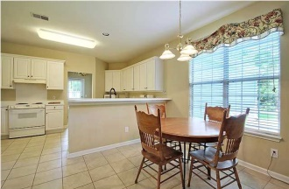
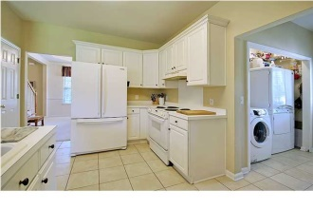
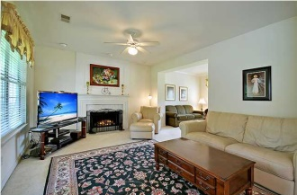
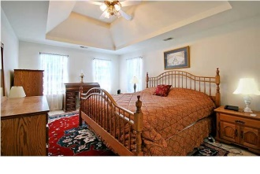
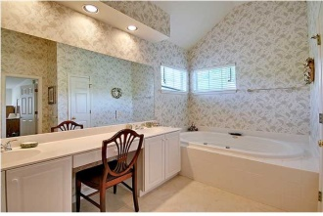
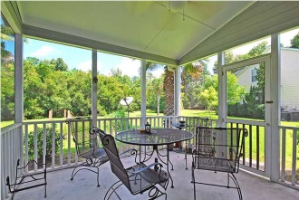
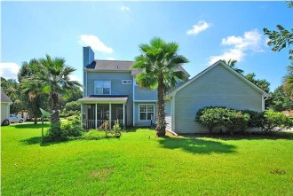
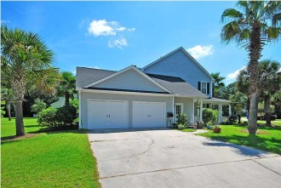

1400 Lakecrest Ct · Mount Pleasant MLS# 1423910 · $349,000
Open House Lunch ~ Friday, Oct 3 from 11 - 1
Handyman Special… Bring your hard hats!
Lowest Priced Home in Brickyard Plantation
This beautiful southern charmer with a full wrap-around front porch on a huge corner lot in the Colonnade section of Brickyard Plantation is a wonderful home in a superb location. The cement plank constructed home has 4 generously size bedrooms and 2.5 lovely baths. The master bedroom is expansive and has an enormous spa-like private bath with dual sinks, garden tub, separate shower and has a spacious walk-in closet. The first floor has a large eat-in kitchen filled with natural light and has a breakfast bar that sits 4, perfect for doing homework or grabbing a quick meal. The open kitchen leads to the family room with a handsome fireplace. The first floor is also comprised of a living room, separate dining room, half bath, and laundry/mudroom area. The family room connects to a screened-in porch to enjoy a relaxing cup of coffee before the day begins. Brickyard offers exceptional amenities including: neighborhood pool, tennis courts, club house, community dock, boat storage, boat ramp, play park and walking/biking trails. Brickyard Plantation is located close to shopping, awesome award winning restaurants, the beaches, downtown Charleston, and I-526 for easy access to the airport. This home offers great living at an affordable cost in one of the most desirable neighborhoods in Mount Pleasant! Lender paid closings costs of 0.50% of the loan amount, redeemable only at the time of closing when financing is completed by the seller's preferred lender. Closing costs credit must be mentioned at application and may only be applied to offset actual costs. *for a Jumbo loan amount (over $417,000) the credit is 0.375%
Stan Huff
843-670-2835 stan.huff@agentowned.com
www.stanhuff.com
Jill Marcacci
843-297-5590 jill@agentowned.com
www.agentownedrealty.com
AgentOwned Realty Co. Premier Group, Inc. | 824 Johnnie Dodds Blvd | Mt Pleasant, SC 29464

