Slide 1
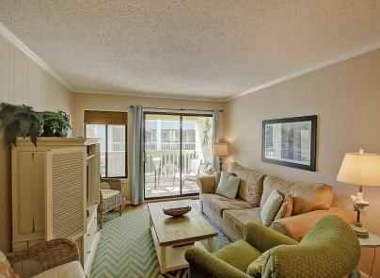
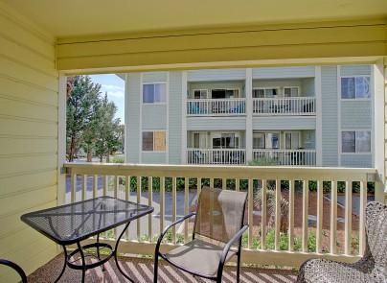
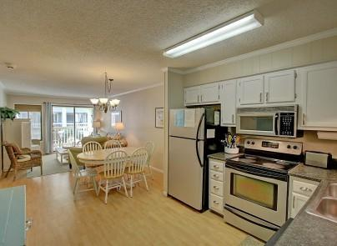
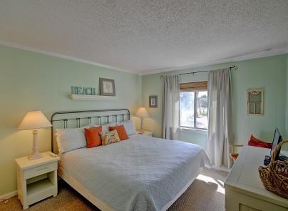
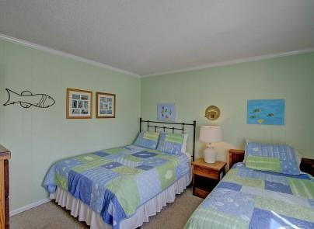
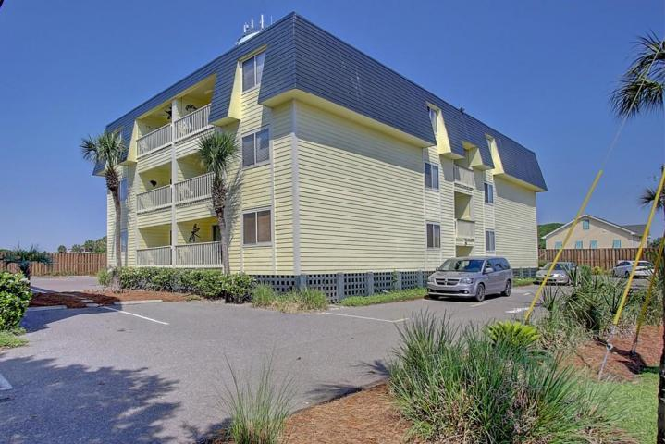


1400 Ocean Boulevard 101-A
Isle of Palms, SC 29451
MLS# 16012103
$364,900
Easy To Show May 22-28th
Condo in Oceanside on IOP, Private Pier/Pool,
Well Maintained and Great Rental History
Enjoy beach living in the Heart of the Isle of Palms. Oceanside Villas is located just steps to the beach via your own private pier for beach access across the street. Don't feel like a beach day...enjoy your Oceanside's private pool. This terrific location is close to Island shopping, the Beach and Charleston! This well maintained condo has a proven rental history that's a real plus! 101-A Oceanside is sold furnished so just pack and bag and enjoy the Beach!
Darlene Smith
Office - (843) 886-8110
Mobile - (843) 696-7824
darlenesmith@carolinaone.com
DarleneSmithTeam.com
Carolina One Real Estate
1503 Palm Blvd Ste
Isle of Palms, SC 29451

