Slide 1
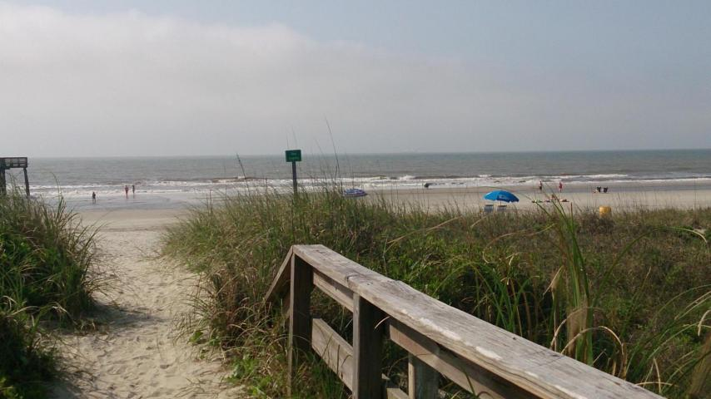
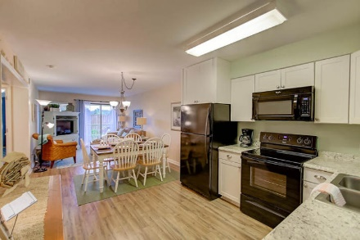
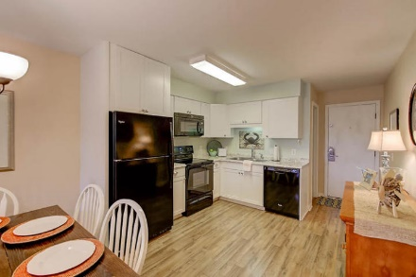
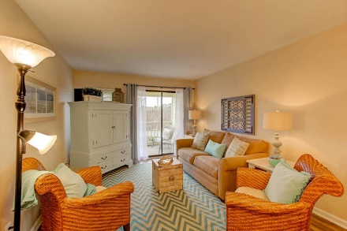
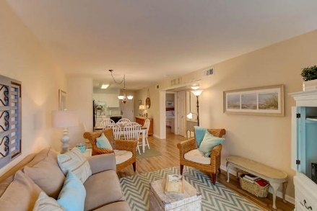
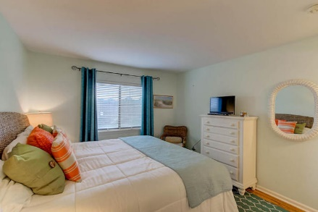
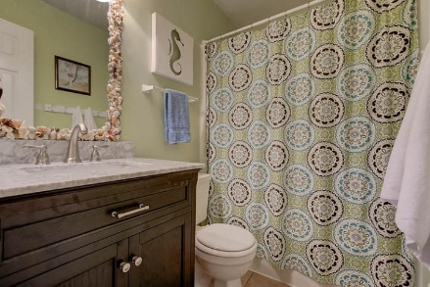
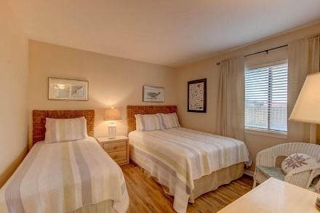
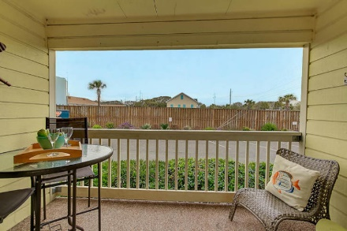


1400 Ocean Boulevard 104-A Isle of Palms, SC 29451 MLS# 17005789 $359,000
Oceanside Villa
Beautiful Coastal Retreat/Great Rental
Condo in Oceanside on IOP, Private Pier/Pool, Well Maintained and Great Rental History
Easy to Show
April 6th-April 13th
Oceanside Villas is located just across the street from the Isle of Palms beach. Enjoy the community pool, private access to the beach and pier and be close to all shopping, restaurants and the history of Charleston! This 2 bedroom Coastal condo is beautiful, with laminate wood flooring throughout, smooth ceilings and updated bathrooms and kitchen. Bring your suitcase and enjoy! Sold fully furnished. This unit is on VRBO and has a proven track record as a vacation rental.
Darlene Smith Office - (843) 886-8110
Mobile - (843) 696-7824
darlenesmith@carolinaone.com
DarleneSmithTeam.com
Carolina One Real Estate
1503 Palm Blvd Ste
Isle of Palms, SC 29451

