Slide 1

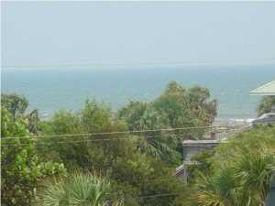
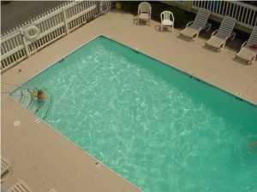
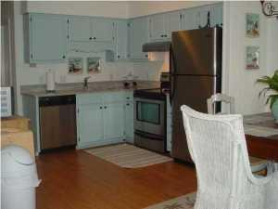
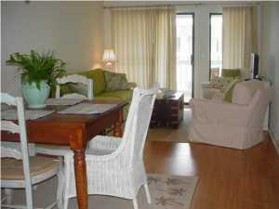
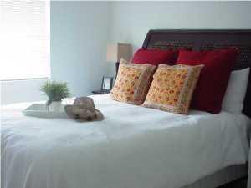
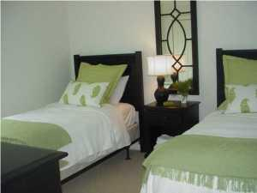

Own a Piece of Paradise!
1400 Ocean Boulevard
#306B
Oceanside
Isle of Palms, SC 29451
MLS# 15020663
$339,000
2 Bedrooms | 2 Baths | 960sf
Sit on the deck overlooking the pool, with an ocean view.
This 2BR/2BA unit has been completely renovated, and has granite counters and stainless steel appliances.
A MUST SEE!
Robin Iriart
Mobile 843-568-7720
Office 843-284-8834
Rickrobin@comcast.net
Gatehouse Realty, LLC
708 S. Shelmore Blvd, Ste. 102
Mt. Pleasant, SC 29464
www.gatehousecharleston.com

