Slide 1
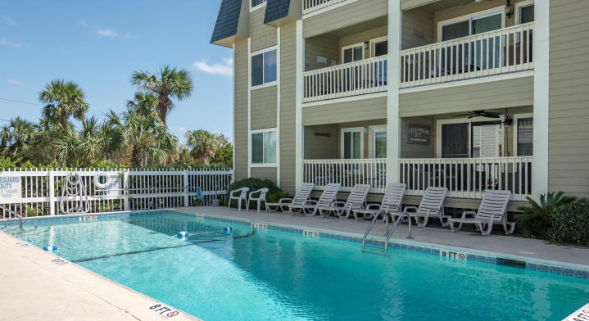
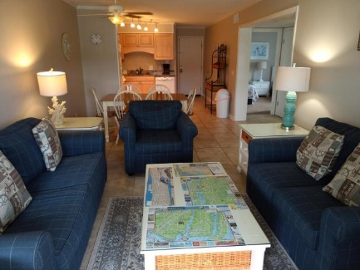
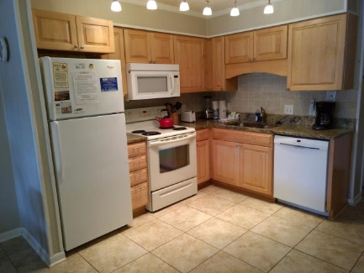
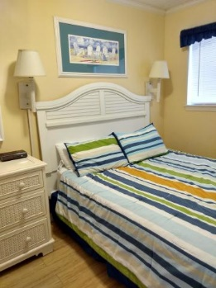
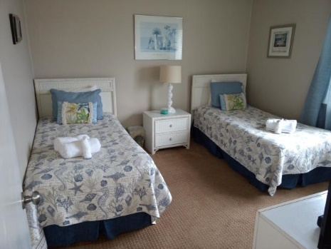
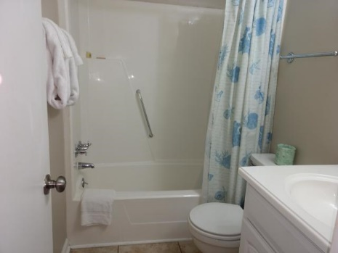
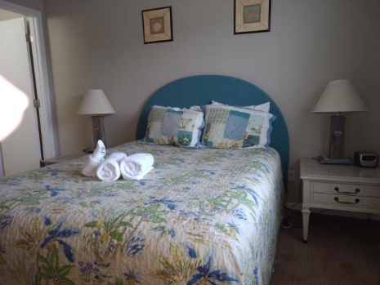
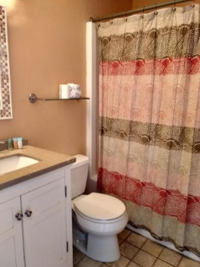
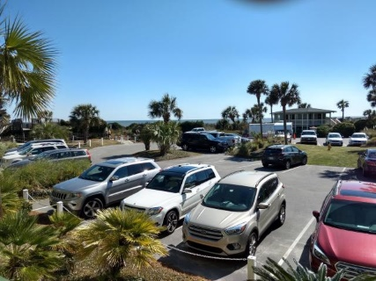


In The Heart of Isle of Palms!! Across The Street From The Beach
1400 Ocean Boulevard #308-B
Isle of Palms, SC 29451 ~ MLS# 20002855 ~ $365,995
2 Bedroom | 2 Bath | 960sf
Upgrades:
New patio furniture
New patio carpet
HVAC Compressor is less than two years old
New dinette, family room couch and love seat
Overstuffed chair and large LED TV
New window treatments in 2019
New master bedroom furniture in 2018
Frank Rutigliano
843-813-4961
frutigliano@kwchs.com

