Slide 1
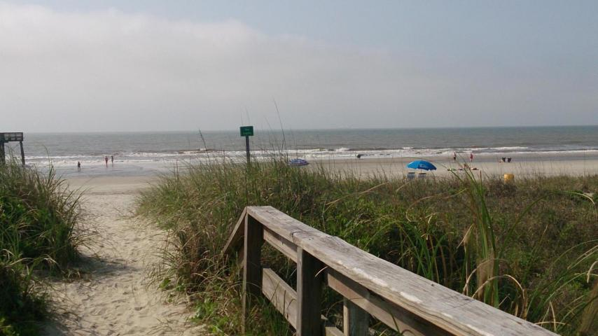
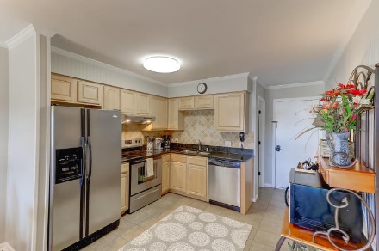
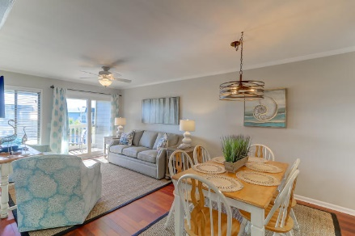
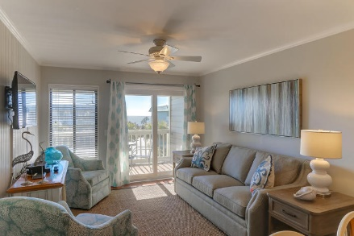
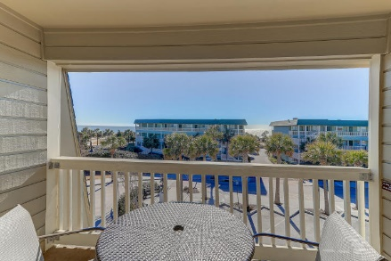
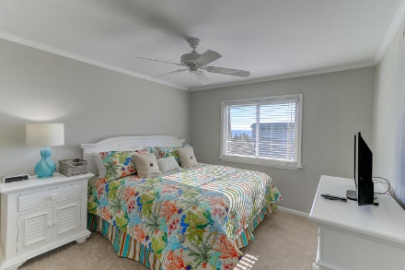
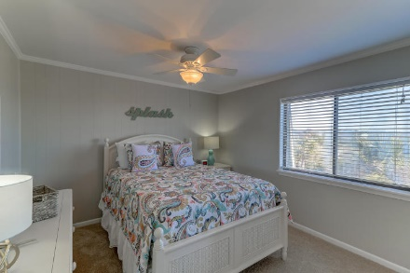
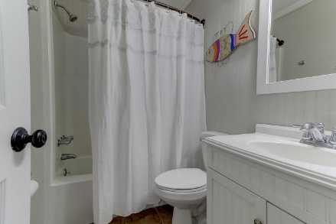
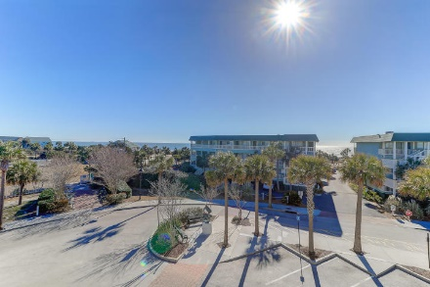


1400 Ocean Boulevard 309C Isle of Palms, SC 29451 MLS# 18019784 $450,000
Oceanside Villas @ IOP
Renovated Ocean View Condo
Easy to Show
August 11-18th
Condo in Oceanside on IOP, Private Pier/Pool, Well Maintained and Great Rental History
Oceanside Villas with Ocean Views--across the street from Isle of Palms Beach! This is the #1 condo in Oceanside Villas located on the 3rd floor and has fabulous ocean views--views you won't have from many of the other units. 309C has recently been renovated with updated furnishings, paint, refinished flooring and accessories. The master has it's own private bath. With the outstanding views and furnishings and being literally steps to the beach, this property has been a very active vacation rental. Owners and rental guests of Oceanside have private access to beach and pier at Sea Cabin. Oceanside Villas has it's own private pool. Enjoy the balcony with views, ocean breezes and total relaxation!
Darlene Smith Office - (843) 886-8110
Mobile - (843) 696-7824
darlenesmith@carolinaone.com
DarleneSmithTeam.com
Carolina One Real Estate
1503 Palm Blvd Ste
Isle of Palms, SC 29451

