Slide 1

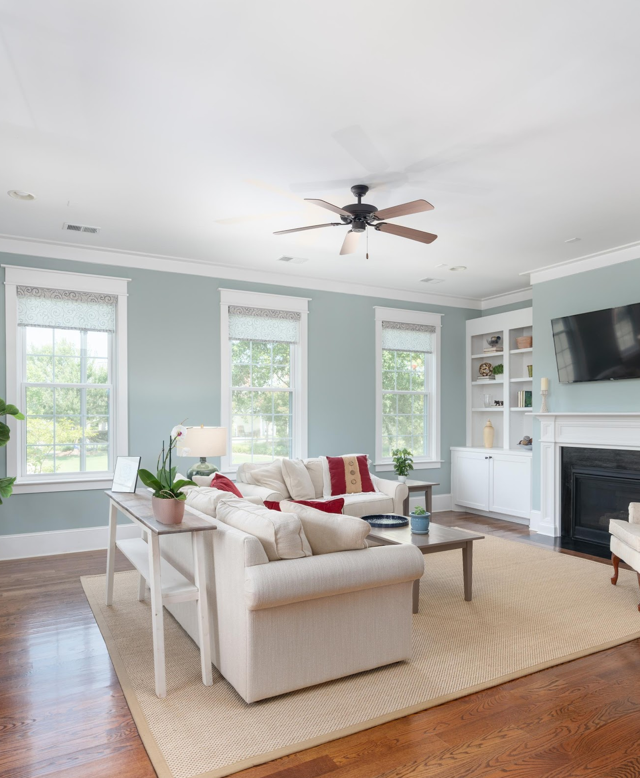
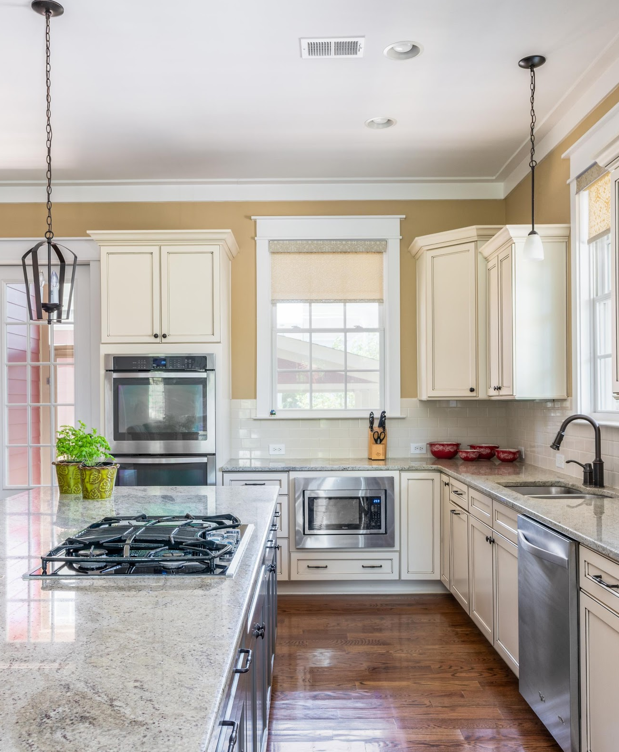

1401 Lettered Olive Lane
OPEN HOUSE TUESDAY AUGUST 18 ~ 11:30 TO 1 pm
Take a Video Tour: https://www.youtube.com/watch?v=F36wn_0xpRQ
WATERMARK Subdivision
Mt. Pleasant, SC
$875,000
4 Beds
5th bedroom or remote office in FROG-kitchenette
4.5 Baths
3,536 SqFt
Life on the piazzas. The classic Charleston Single House design with double wrap-around piazzas adopts the up-to-date open-concept interior. This 2014 house is move-in ready. The 1st floor has a gracious Family Room, Dining area, spacious Kitchen with eat-in alcove and a large Pantry. The Master suite and 2 guest bedrooms access the piazza. The 3rd floor has a bonus room, bedroom, bath and walk-in attic. The mini guest suite over the garage is perfect for a remote office or visitors.
Kay Kennerty
REALTORⓇ
843-345-5011
Kay@AgentOwned.com
AgentOwned.com
Notes:
DO NOT ALTER LAYOUT. YOUR FILE WILL BE RETURNED OR EDITED IF IT IS RECEIVED ALTERED.

