Slide 1
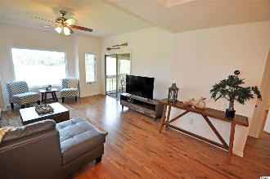
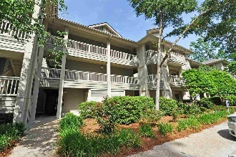
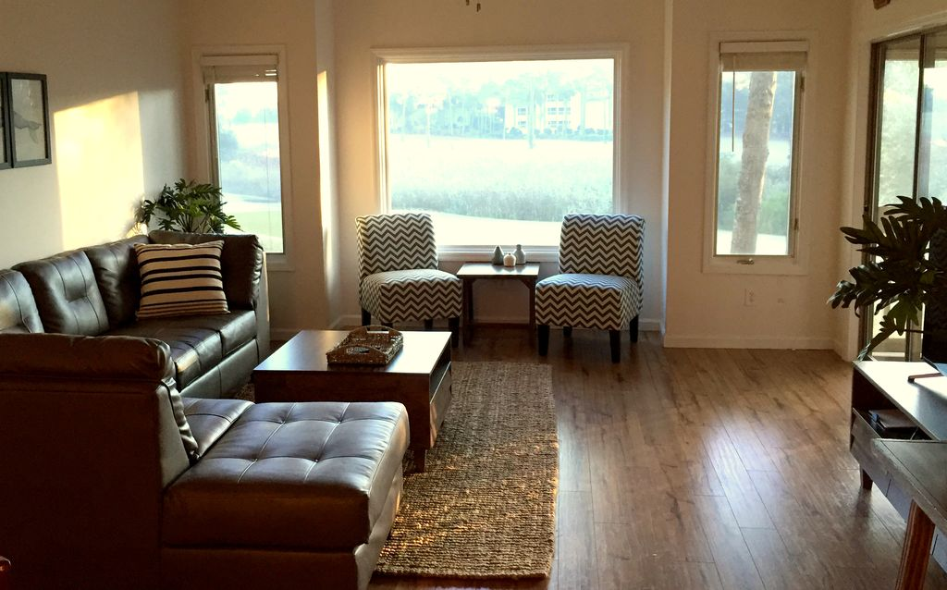
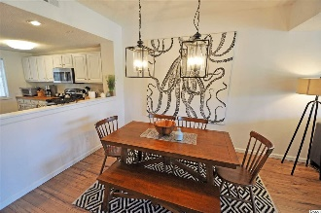
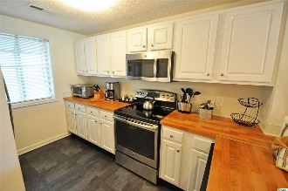
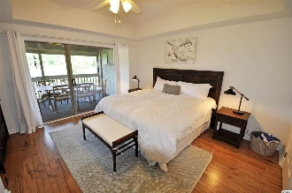
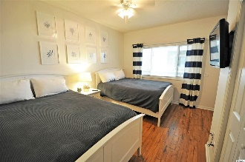
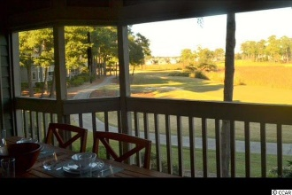
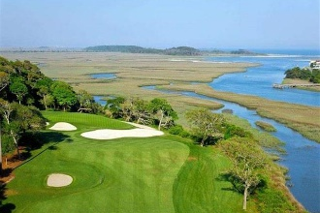
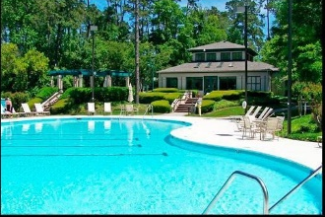
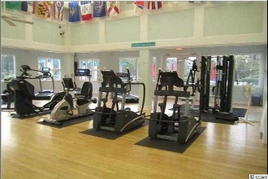
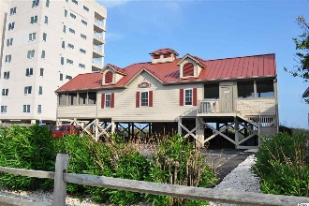


Top Turnkey Tidewater Resort Condo!
1401 Lighthouse Drive #4123
Lighthouse Point Villas ~ North Myrtle Beach
MLS# 1811932 ~ $172,900
This singular 2bd/2ba state-of-the-art, fully furnished Tidewater Plantation luxury turnkey condo is perfect for investors, as well as for a primary or vacation home. Deemed the "Pebble Beach of the East," Tidewater Plantation's golf course has been named among Golf Magazine's "Top 100 Places You Can Play in the United States" and ranked one of the "Top 75 Resorts in America" by Golf Digest. The condo is a quick 5-minute walk to the Tidewater Clubhouse with access to the bag drop, golf practice facilities and Tidewater Grill eateries, event center and bar. The Tidewater Swim and Racquet Club Amenity Center Complex is a charming 10-minute walk away. The amenities here include the large community pools with pool chairs and tables, kiddie pool, hot tub, fitness and amenity centers and a tennis facility with 2 clay and 2 paved tennis courts, plus pickle ball. Tidewater enjoys a wonderful environment for walking and bike riding as well as the safety and security of 24-hour-a-day, manned gated security. The newly renovated 2nd-story unit with upscale, highly desirable hard-wood floors and designer furnishings has stunning views of the 9th and 18th holes from the living room and screened-in porch. The windows have an exterior privacy film so that anyone on the golf course cannot see into the condo during the day so that owners or guests can have an unobstructed view of the wonderful landscape while still obtaining privacy. The condo can comfortably sleep up to 6 guests. The master bedroom has a memory foam-topped king-size bed with 32" TV and on-suite bath with double vanity and stand-up shower. The guest bedroom has 2 memory foam queen-size beds with 32" TV and on-suite bath as well. Relax in the open floor plan living space to watch the new 50" Ultra HD TV or just to enjoy the view. The fully equipped kitchen has signature butcher-block counter tops and stainless steel appliances and is great for making a few beach snacks to a full home-cooked dinner. Eat or hang out on the spacious screened-in patio, while also enjoying the extraordinary, serene golf and marsh views. This condo is a great home or vacation spot for family, friends, golfers and beach-goers. The short 7-minute drive to the beach makes you only minutes away while being able to quickly come back to the peace and tranquility of Tidewater. Owners have a private oceanfront beach cabana on the wide, white-sand Cherry Grove Beach with parking and amenities. The condo is fully equipped to make families as comfortable as possible, too, by providing a Pack-and-Play, high chair/booster seat and child-friendly dishware, something for everyone of any age! The cheery condo is filled with natural light and comes with wifi, cable and Netflix. Plus, you will enter the condo with a simple code. So no keys to look after! Amenity-rich Tidewater is on a tree-lined road to oceanfront Anne Tilghman Boyce Coastal Reserve, a nature conservancy, including Waties Island, with access for managed recreational use. Tidewater itself is on an elevated peninsula of live oaks and southern pines between the Intracoatal Waterway and the Cherry Grove Inlet to the Atlantic Ocean. The plantation also preserves the singular look of its own historic origins. It is minutes from the beach, shopping, medical services, entertainment and access to major highways. Amenities include that oceanfront beach cabana for owners' use with open/screened porches, bathrooms, showers and kitchen. Residents enjoy the use of several pools/hot tubs. Other amenities include a driving range, golf shop, clubhouse with bar/dining and event facilities overlooking the 18th hole, clay and hard surface tennis courts, pickle ball court, fitness center overlooking a pool, bocce courts and amenity center for public/private events. Tidewater has a gated storage yard for boats, jet skis, motorcycles and kayaks. Tidewater Plantation, with its full range of things to do and to enjoy, really reflects a "way of life" in popular North Myrtle Beach.
Deborah Collins
843-424-9013
dctidewater@yahoo.com
Connie Ross-Karl
702-306-2643
conniesross@aol.com
NEW WAY PROPERTIES MYRTLE BEACH

