Slide 1
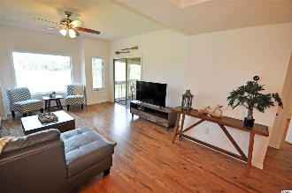
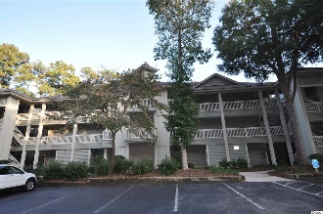
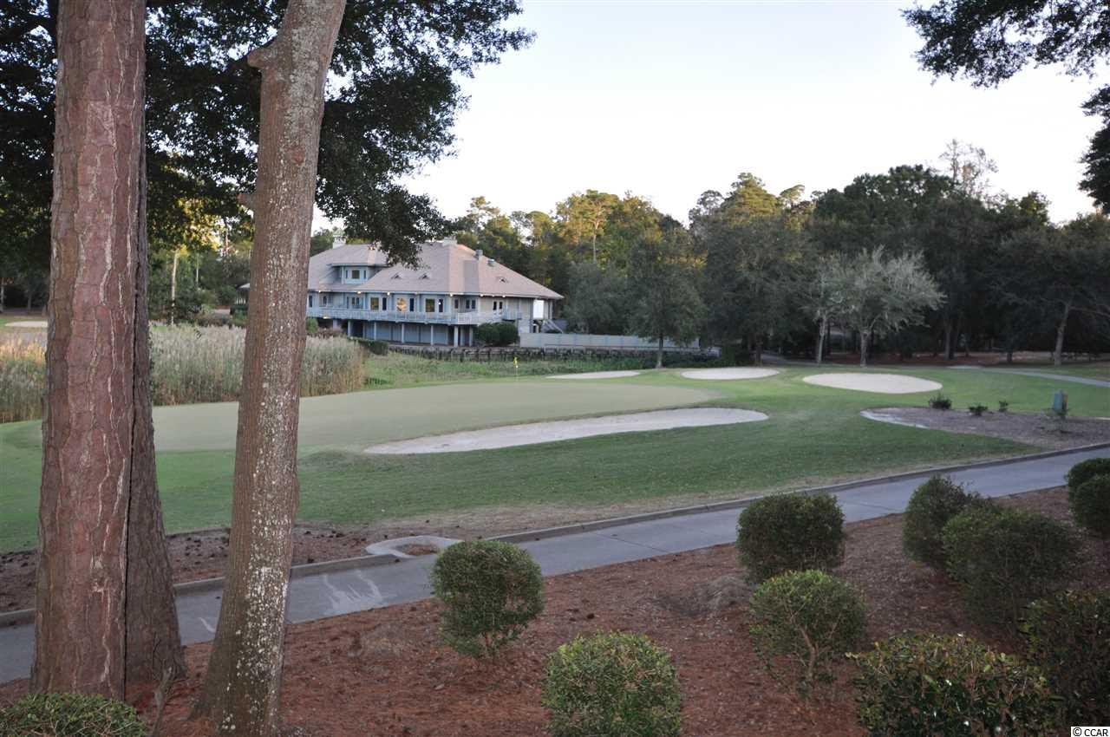
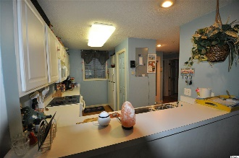
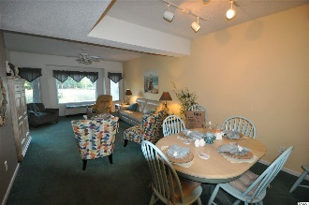
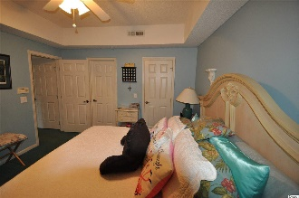
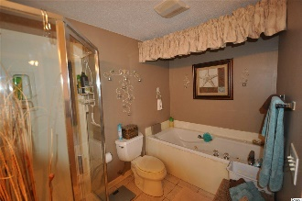
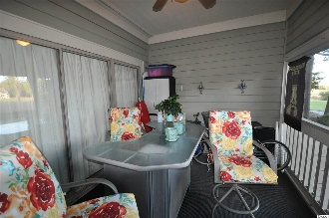
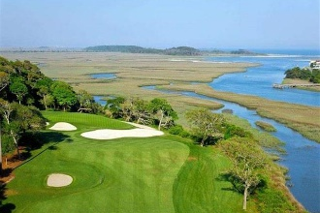
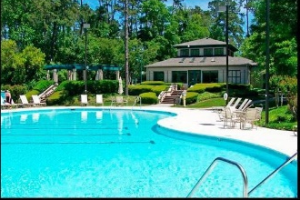
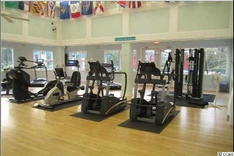
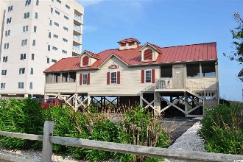


The Lighthouse Point Villas Unit You Want
1401 Lighthouse Drive #4214
Lighthouse Point Villas ~ North Myrtle Beach
Tidewater Plantation ~ MLS# 2023497 ~ $184,900
Lovely, impeccably cared for FIRST FLOOR 2 bedroom beach-golf condominium in the highly desirable Lighthouse Point Villas complex of Tidewater Plantation. Tidewater boasts 24 hour gated, manned security. This lovely condo epitomizes the best of Southern Living, with close-up views of the marsh, the signature 9th and 18th holes and is in close proximity to the popular Tidewater Clubhouse/Grill. Upon entering the condo, one is greeted by breathtaking views through large windows admitting an abundance of natural light. These vistas of the world famous Tidewater Golf Course are right out of Golf Digest! Properties in this upscale, pristine development are highly valued as homes, second homes and investment properties. The master bedroom adjoins a sizable, furnished screened porch for dining, relaxing and enjoying the beautiful golf course and marsh views reflecting great natural beauty. The entire condo has been repainted within the past 2 years. Owners are also including a top of the line Old Republic Home Warranty-Platinum Level which includes the HVAC. Tidewater is on a tree-lined road leading to the Anne Tilghman Boyce Coastal Reserve, a nature conservancy, including Waties Island, with access for managed recreational use. Tidewater itself is on an elevated peninsula of live oaks and southern pines between the ICW and the Cherry Grove inlet to the Atlantic Ocean. The plantation also preserves the singular look of its own historic origins. It is minutes from the beach, shopping, medical services, entertainment and access to major highways. Amenities include an oceanfront beach cabana for owners' use with open/screened porches, bathrooms, showers and kitchen. Residents enjoy the use of several poos/hot tubs. Other amenities include a driving range, golf shop, clubhouse with bar/dining and event facilities, clay and hard surface tennis courts, pickle ball court, fitness center overlooking a pool, bocce courts and amenity center for public/private events. Tidewater has a gated storage yard for boats, jet skis, motorcycles, kayaks and small trailers. Your new neighbors will welcome you to Tidewater Plantation which truly reflects the best of the classic golf/beach/resort lifestyle! Did we say FIRST FLOOR!
Video Tour: https://www.youtube.com/embed/LXhPrfnVE74
Deborah Collins
843-424-9013
dctidewater@yahoo.com
Connie Ross-Karl
702-306-2643
conniesross@aol.com
NEW WAY PROPERTIES MYRTLE BEACH

