Slide 1
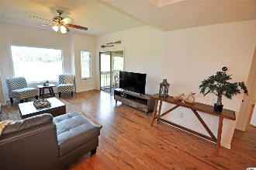
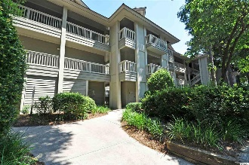
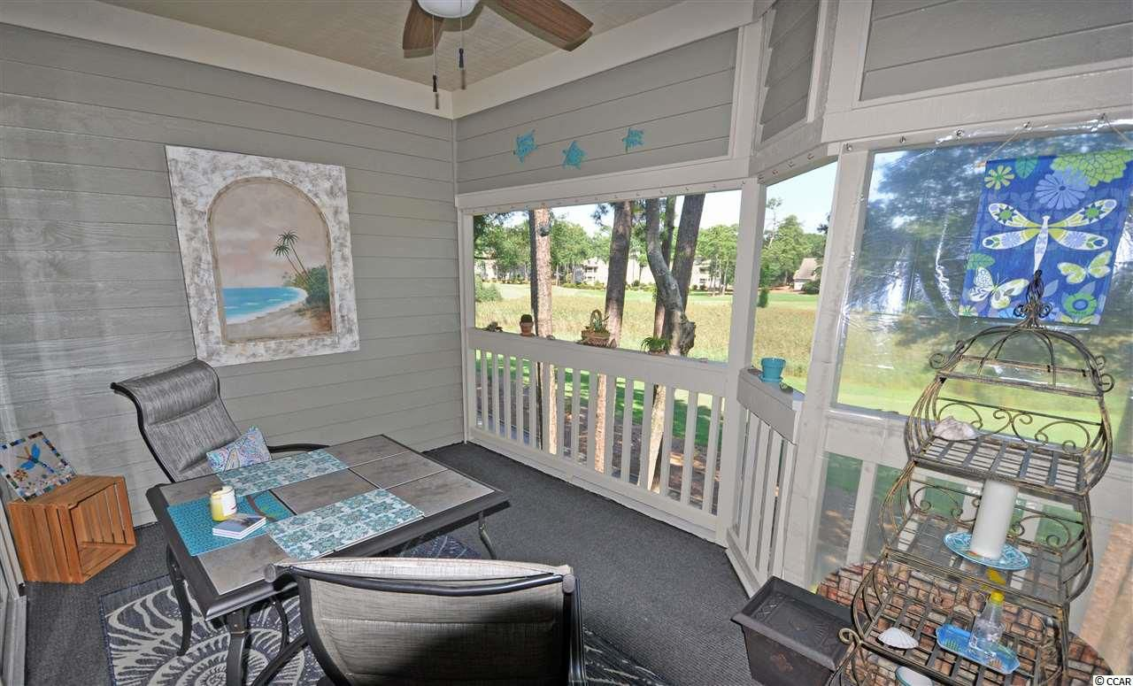
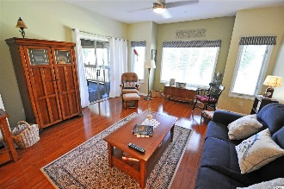
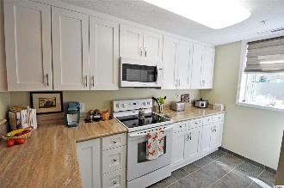
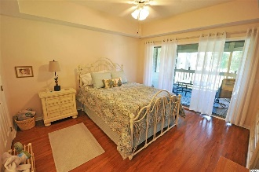
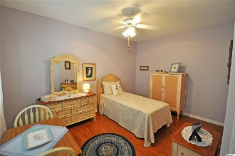
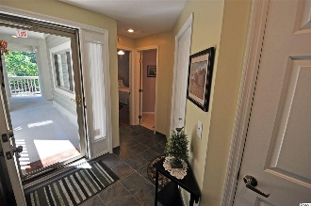
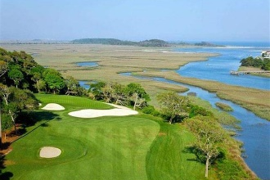
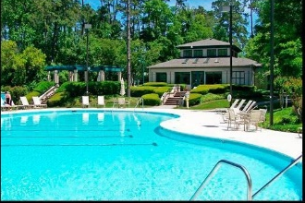
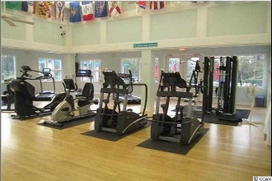
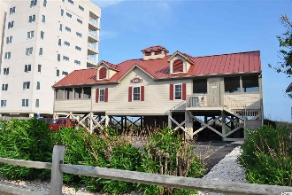


The Lighthouse Point Villas Unit You Want
1401 Lighthouse Drive #4224
Lighthouse Point Villas ~ North Myrtle Beach
Tidewater Plantation ~ MLS# 1816778 ~ $164,900
This is the Lighthouse Point Villas unit everybody wants -- marsh and golf-course views and a short stroll to clubhouse, two restaurants and golf amenities -- and it is perfect for an investment, home or vacation home. It is now a lovely 2 bedroom/2 bath luxury but easy-living primary-home. Take the virtual tour as well, but see this one in person today...kitchen redone, including sophisticated lazy-susan corner cabinetry; high-tech manufactured flooring throughout, along with new paint, decor and MORE! Furnishings are comfortably stylish. The unit itself is light and inviting. Decorative accessories are likewise pleasing. The large picture window in the living room, as well as the side windows and the screened-in porch off the living/dining area and master bedroom, all have THE VIEW! Other amenities include convenient parking adjacent to building, handicap access and wide halls, SECOND FLOOR NEAR ELEVATOR and lots of open space surrounding the building. The 42 Building of Lighthouse Point Villas is set apart, secluded and peaceful! It also has the most requested Tidewater Plantation spacious 2-bedroom condo floor plan -- split bedrooms with master off the great-room area and featuring a large signature screened porch from the living room and master bedroom with that amazing golf course/marsh view and privacy. Even wake up to it! The master also enjoys a walk-in closet, en suite with double-sink vanity, separate walk-in shower and jetted garden tub. The split guest bedroom has a large jack-and-jill bath that also opens to living space for ease of use by guests. The laundry is off the hallway as well and is equipped with a full-sized washer and dryer! The dining room is big and seats six comfortably. The living/dining great-room combination is spacious for a family or a foursome. There are numerous storage closets and even a pantry. Want it all in a beautiful beach & golf condo? Look no further! The condo has it all and is just what everyone wants. Plus, it is an incredible opportunity to purchase a singular Tidewater Plantation Resort beauty overlooking the world-class Tidewater Golf Course. Amenity-rich Tidewater is on a tree-lined road to oceanfront Anne Tilghman Boyce Coastal Reserve, a nature conservancy, including Waties Island, with access for managed recreational use. Tidewater itself is on an elevated peninsula of live oaks and southern pines between the Intracoatal Waterway and the Cherry Grove Inlet to the Atlantic Ocean. The plantation also preserves the singular look of its own historic origins. It is minutes from the beach, shopping, medical services, entertainment and access to major highways. Amenities include an oceanfront beach cabana for owners' use with open/screened porches, bathrooms, showers and kitchen. Residents enjoy the use of several pools/hot tubs. Other amenities include a driving range, golf shop, clubhouse with bar/dining and event facilities overlooking the 18th hole, clay and hard surface tennis courts, pickle ball court, fitness center overlooking a pool, bocce courts and amenity center for public/private events. Tidewater has a gated storage yard for boats, jet skis, motorcycles and kayaks. Tidewater Plantation, with its full range of things to do and to enjoy, really reflects a "way of life" in safe, popular North Myrtle Beach.
Deborah Collins
843-424-9013
dctidewater@yahoo.com
Connie Ross-Karl
702-306-2643
conniesross@aol.com
NEW WAY PROPERTIES MYRTLE BEACH

